Slide 1
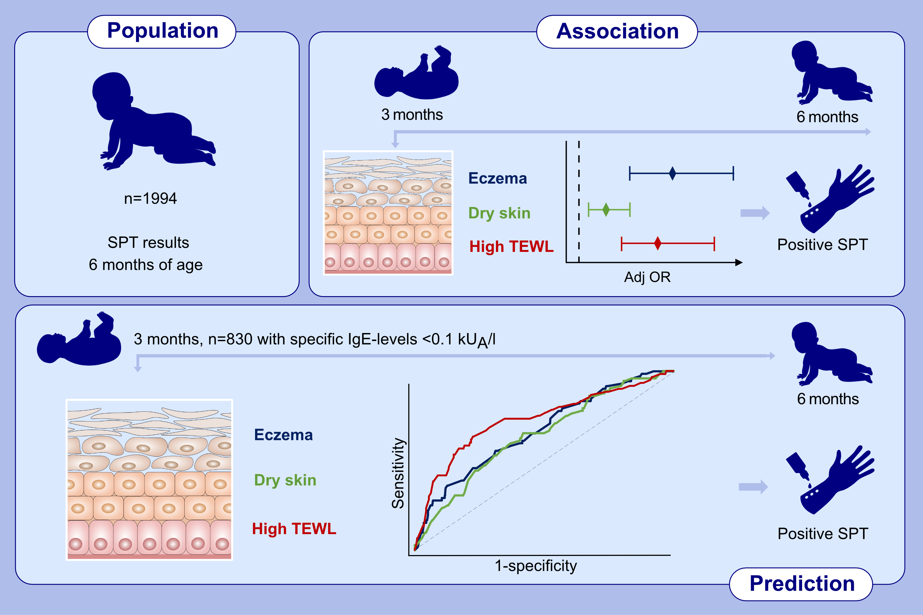
Impaired skin barrier and allergic sensitization in early infancy
Sabina Wärnberg Gerdin, Anine Lie, Anna Asarnoj, Magnus P. Borres, Karin C. Lødrup Carlsen, et al.
Allergy. 2022; 1464-1476 https://doi.org/10.1111/all.15170
© 2019 EAACI and John Wiley and Sons A/S. Published by John Wiley and Sons Ltd.
Notes:
HIGHLIGHTS
At 6 months, 198/1994 infants (9.9%) had any sensitization, the majority to food.
Eczema, dry skin, and high TEWL at 3 months increased the risk of sensitization at 6 months
of age.
Eczema, dry skin, and high TEWL at 3 months predicted incident sensitization at 6 months
of age (n=87/830, 10.5%).
Abbreviations: Adj, adjusted; kU_{A}/L – kilounits of allergen-specific IgE per liter; OR, odds ratio; SPT, skin prick test; TEWL, transepidermal water loss

