Slide 1
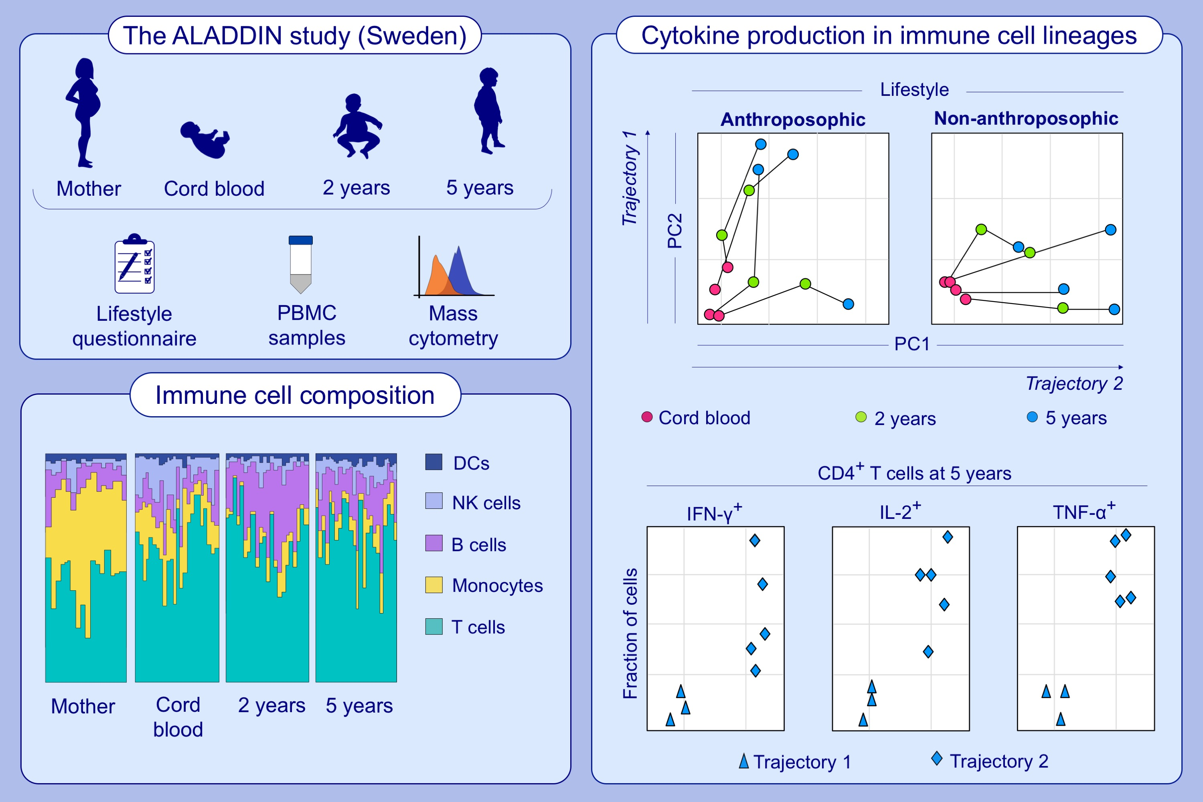
Longitudinal analyses of development of the immune system during the first five years of life in relation to lifestyle
Axel Olin, Nathalie Acevedo, Tadepally Lakshmikanth, Yang Chen, Catharina Johansson, , et al.
Allergy. 2022; 1583-1595 https://doi.org/10.1111/all.15232
© 2019 EAACI and John Wiley and Sons A/S. Published by John Wiley and Sons Ltd.
Notes:
HIGHLIGHTS
This study identifies environmental and lifestyle related factors during pregnancy and early childhood.
NK cells and monocytes are more abundant in cord blood and decrease with age, while B cells peak at two years of age.
Children exhibit similar stimulation responses at birth, but subsequently segregate into two discrete functional trajectories. The largest differences seen at age five years between children in trajectory 1 and trajectory 2 are in the ability of the CD4⁺ T-cell population to produce IFN-γ, IL-2 and TNF-α.
Abbreviations: ALADDIN, Assessment of Lifestyle and Allergic Disease During Infancy; DC, dendritic cell; IL-2, interleukin 2; INF-γ, interferon gamma; NK, natural killer cell; PC, principal component; TNF-α, tumor necrosis factor alpha.

