Slide 1
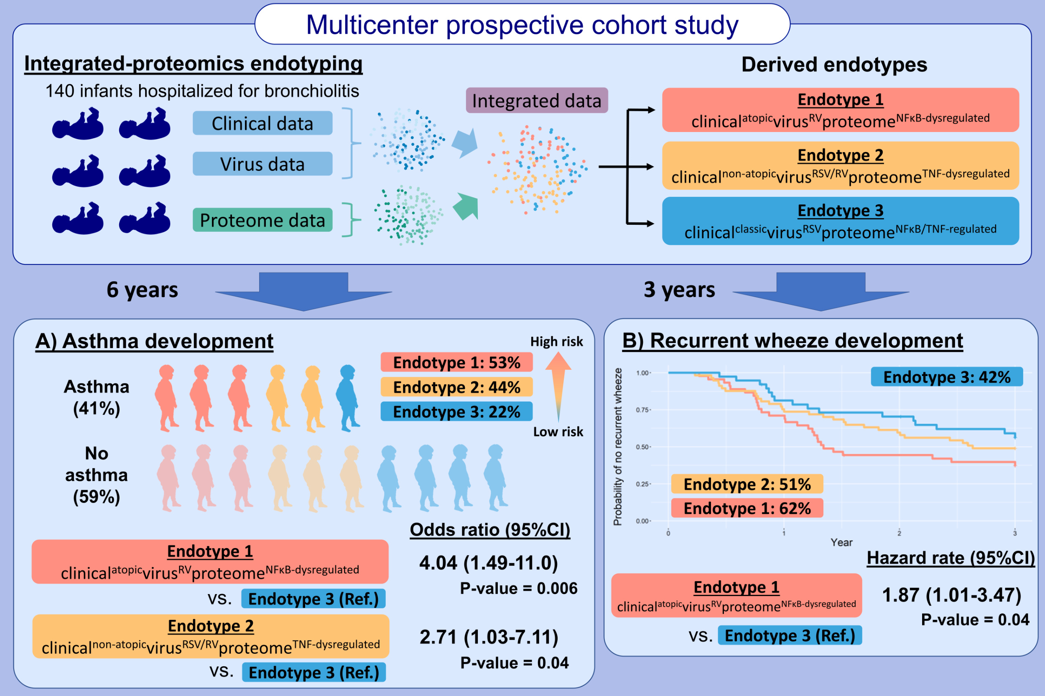
Proteomics endotyping of infants with severe bronchiolitis and risk of childhood asthma
Tadao Ooka, Yoshihiko Raita, Michimasa Fujiogi, Robert J. Freishtat, Robert E. Gerszten, et al.
Allergy. 2022; pages: 3350-3361
https://doi.org/10.1111/all.15390
© 2019 EAACI and John Wiley and Sons A/S. Published by John Wiley and Sons Ltd.
Notes:
HIGHLIGHTS
We identified three clinically-meaningful and biologically-distinct proteomics endotypes by integrating the clinical, virus, and serum proteomic data from a multicenter cohort of infants hospitalized for bronchiolitis.
Each endotype had a different risk for developing asthma and recurrent wheeze.
Endotype 1—characterized by atopic manifestations, rhinovirus infection, and dysregulated NFκB pathways—had the highest risk for developing asthma and recurrent wheeze.
Abbreviations: CI, confidence interval; NFκB, nuclear factor-κB; RSV, respiratory syncytial virus; RV, rhinovirus; TNF, tumor necrosis factor

