Slide 1
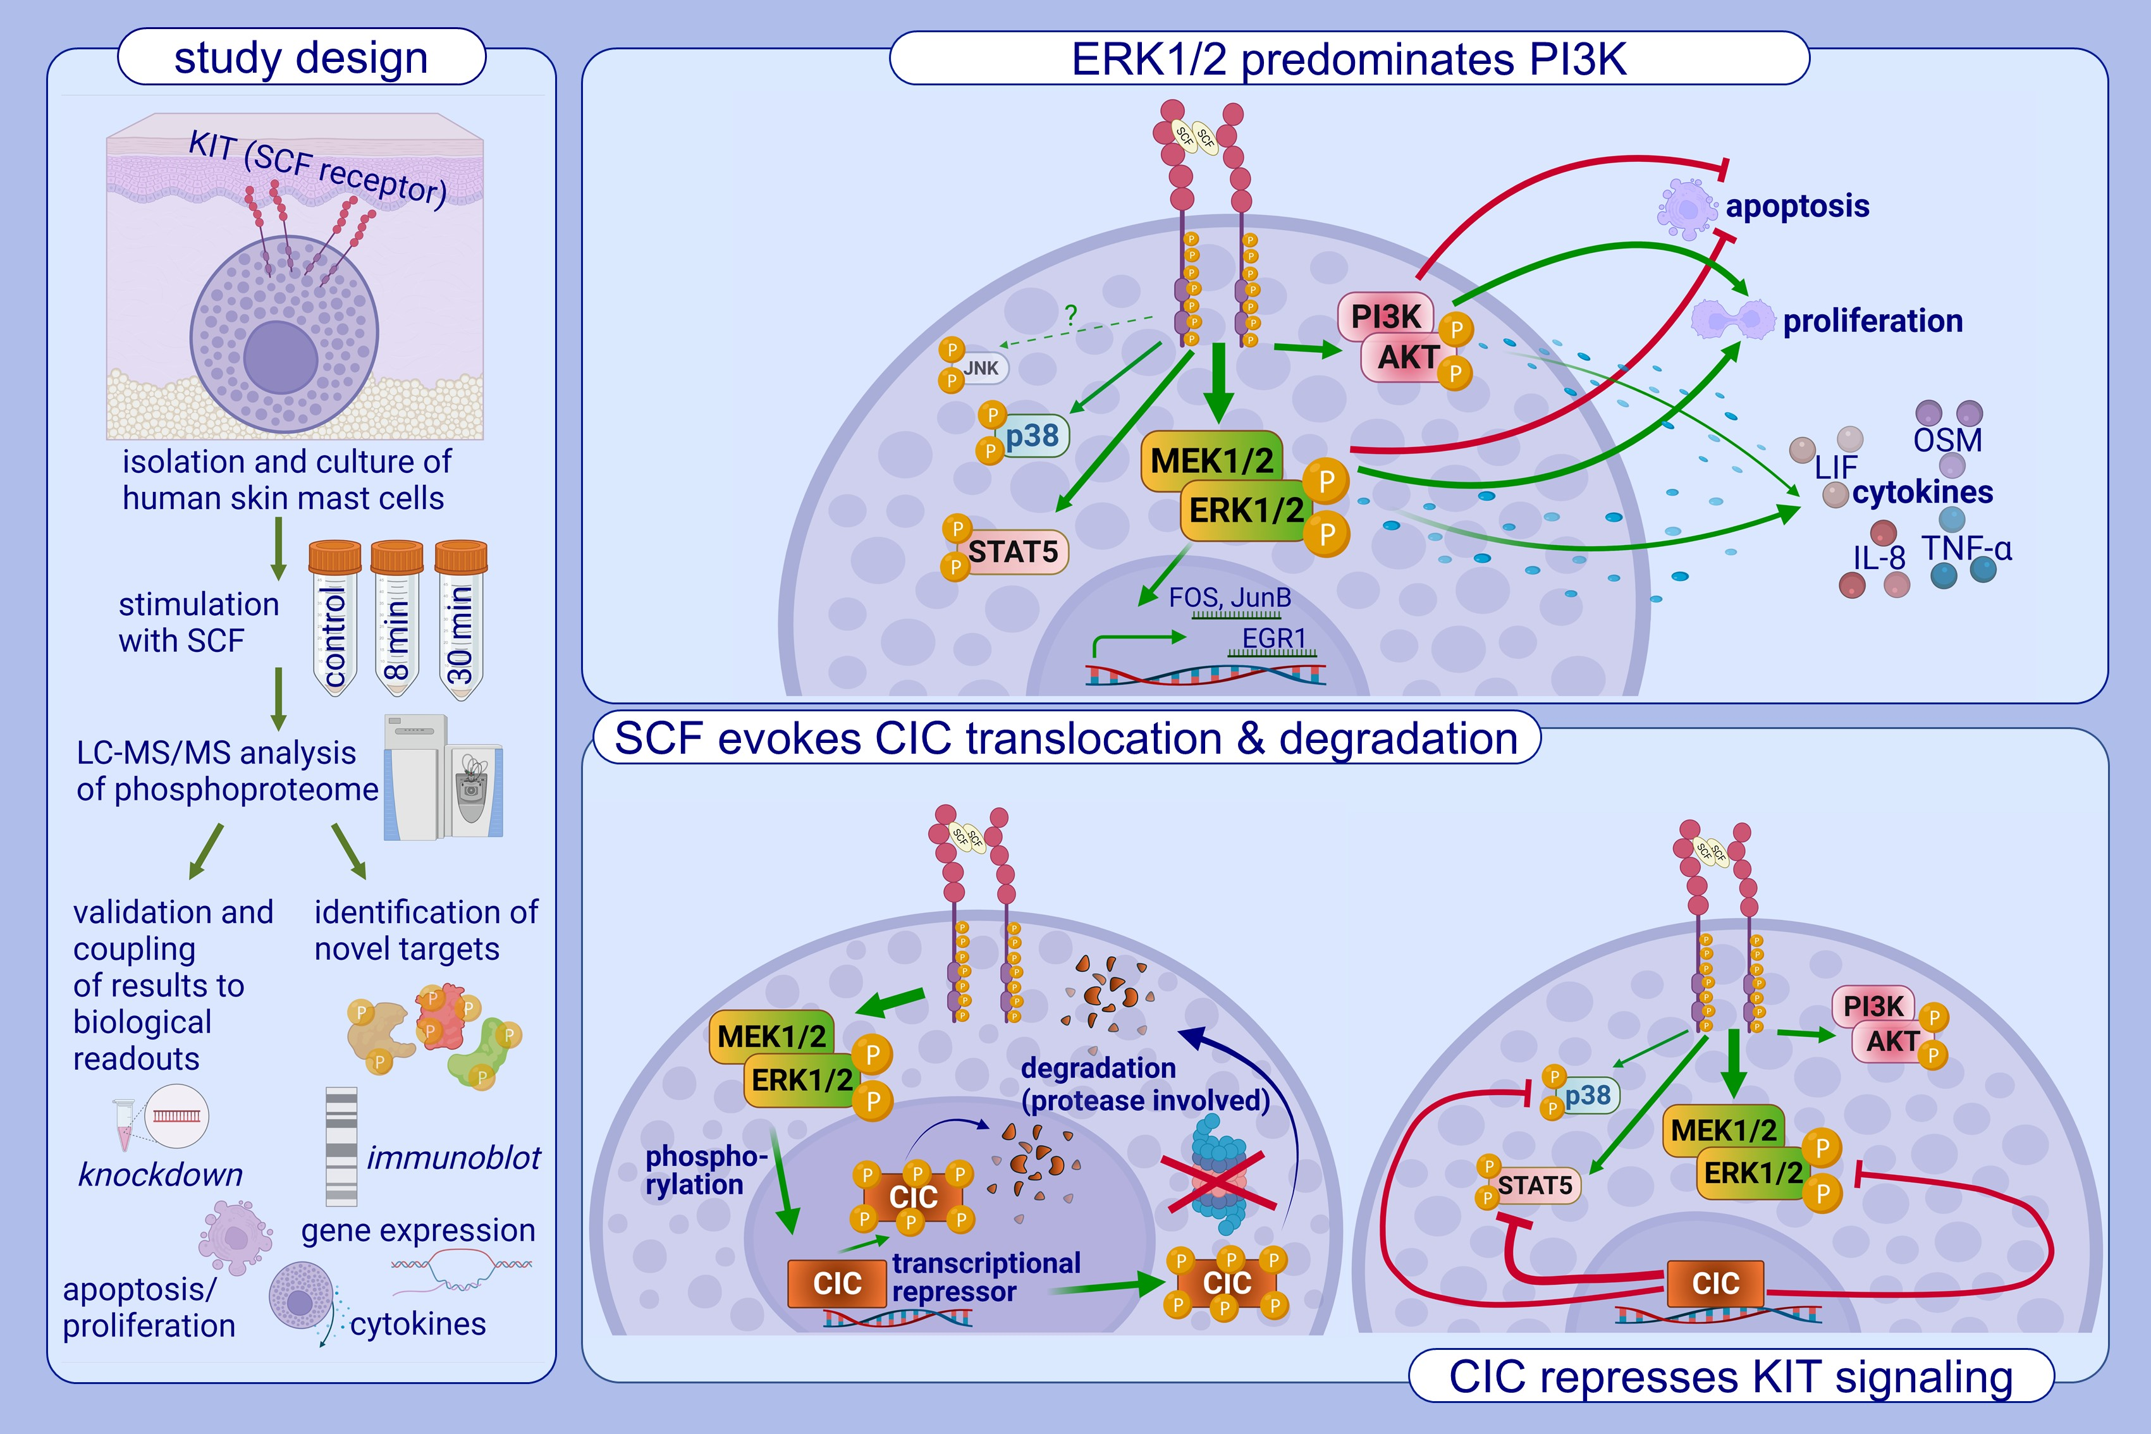
The SCF/KIT axis in human mast cells: capicua acts as potent KIT repressor and ERK predominates PI3K
Kristin Franke, Marieluise Kirchner, Philipp Mertins, Torsten Zuberbier, Magda Babina
Allergy. 2022; pages: 3337-3349
https://doi.org/10.1111/all.15396
© 2019 EAACI and John Wiley and Sons A/S. Published by John Wiley and Sons Ltd.
Notes:
HIGHLIGHTS
This study presents the first global phosphoproteome downstream of the SCF/wildtype-KIT axis in mast cells detecting over 5,400 regulated sites in known and novel targets.
The MEK/ERK-module is potently activated predominating PI3K/Akt; functional programs preferentially depend on ERK, while in proliferation and anti-apoptosis both modules are equivalent.
Being phosphorylated and degraded following SCF, CIC is uncovered as potent repressor of KIT signaling.
Abbreviations: Akt, Protein kinase B; CIC, Capicua; EGR1, Early growth response 1; ERK, Extracellular signal-regulated kinase; FOS, Fos proto-oncogene; IL-8, Interleukin 8; JNK, c-Jun N-terminal kinase; JunB, JunB proto-oncogene; KIT, SCF-receptor; LC-MS/MS, Liquid chromatography tandem mass spectrometry; LIF, Leukemia inhibitory factor; MAPK, Mitogen-activated protein kinase; MEK, MAPK kinase; OSM, Oncostatin; PI3K, Phosphoinositide-3-kinase; SCF, Stem cell factor; STAT5, Signal transducer and activator of transcription 5; TNF-α, Tumor necrosis factor alpha

