Slide 1
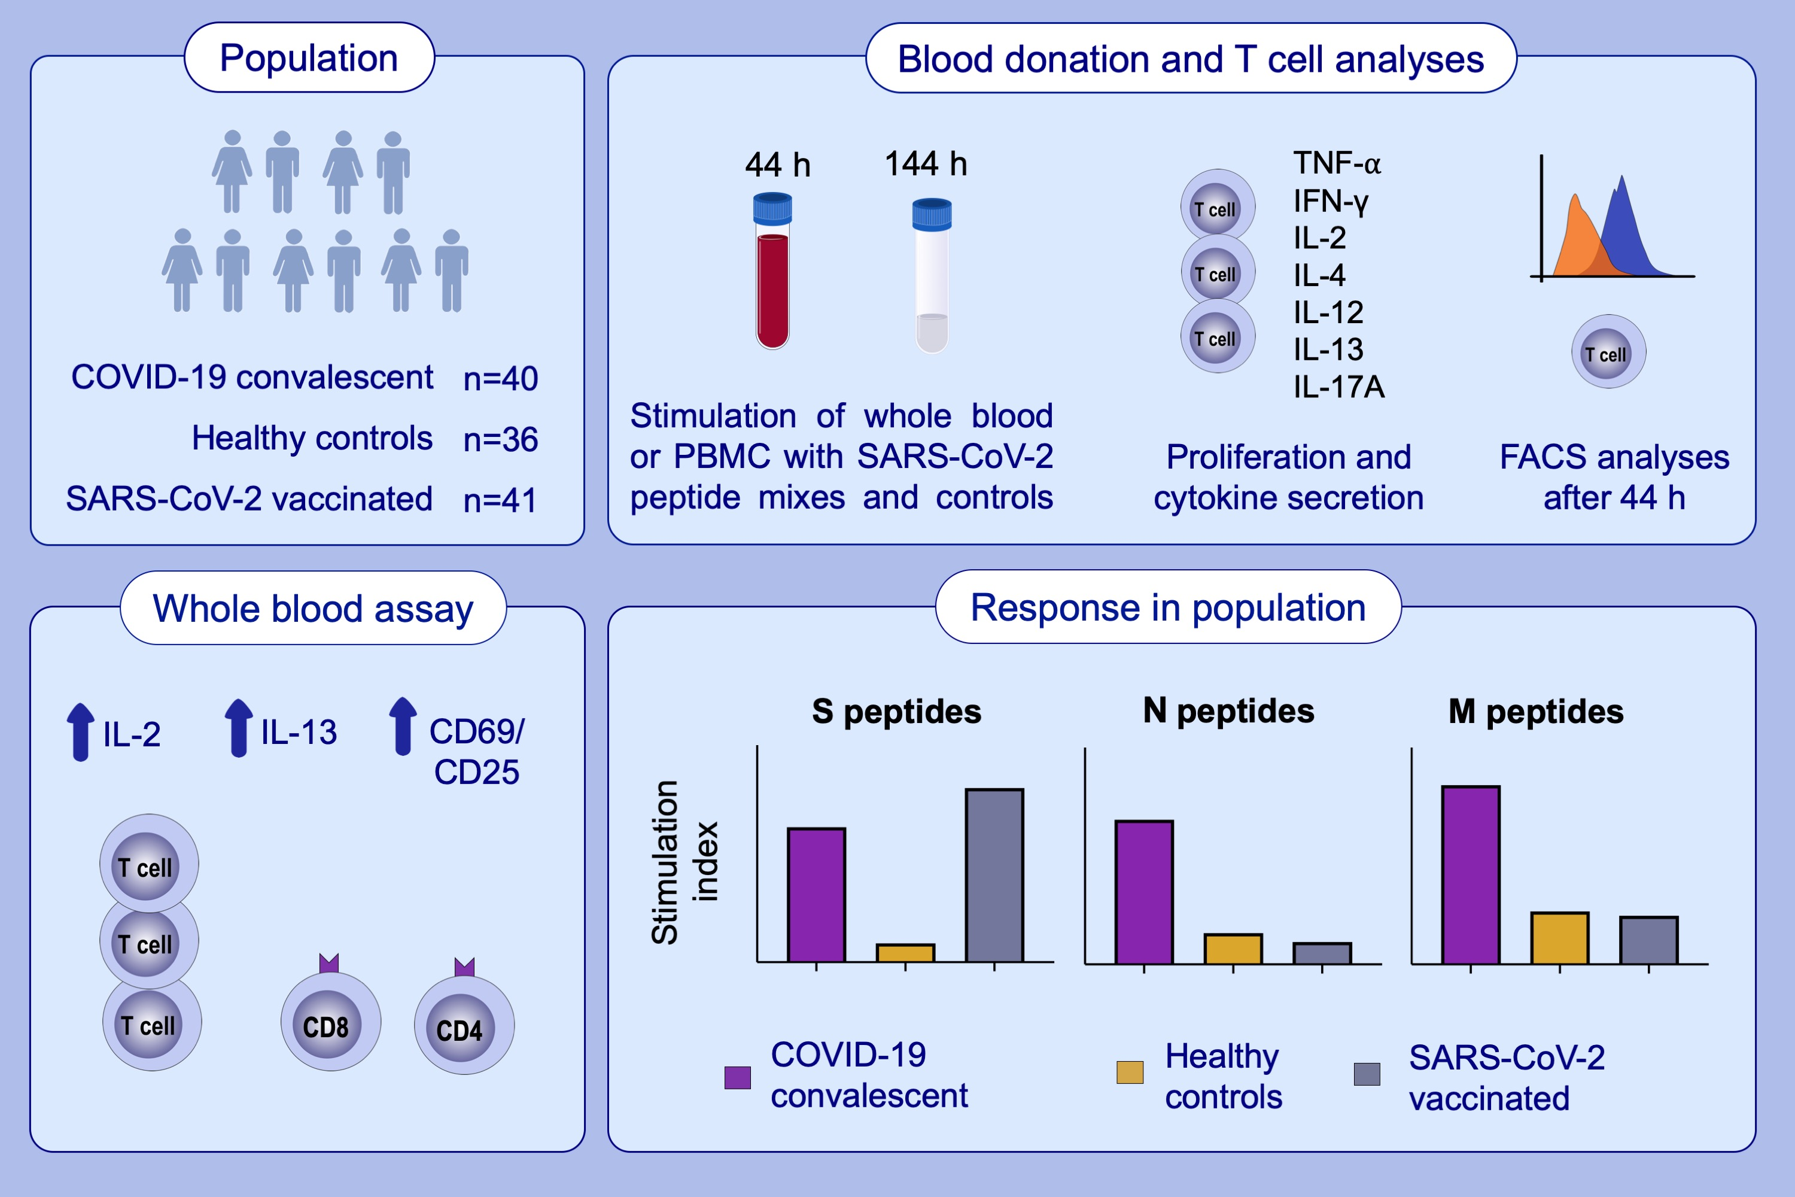
Combined assessment of S- and N-specific IL-2 and IL-13 secretion and CD69 neo-expression for discrimination of post–infection and post-vaccination cellular SARS-CoV-2-specific immune response
Bernhard Kratzer, Larissa C. Schlax, Pia Gattinger, Petra Waidhofer-Söllner, Doris Trapin et al.
Allergy. 2022; pages: 2482-2497
https://doi.org/10.1111/all.15406
© 2019 EAACI and John Wiley and Sons A/S. Published by John Wiley and Sons Ltd.
Notes:
HIGHLIGHTS
S- versus N- and M-derived SARS-CoV-2 peptides allow discrimination between SARS-CoV-2 post-vaccination and post-infection cellular immune responses.
T cell responses to SARS-CoV-2 peptides are accurately determined by a short-term WB assay by analysis of secreted IL-2 and IL-13 along with CD69 and CD25 expression on T cells.
The fast whole blood assay has a better performance than proliferation and cytokine secretion assays performed with gradient-isolated PBMC.
Abbreviations: CD, cluster of differentiation; COVID-19, coronavirus disease 2019; FACS, fluorescence activated cell sorting; IFN- γ, interferon gamma; IL, interleukin; PBMC, peripheral blood mononuclear cells; SARS-CoV-2, severe acute respiratory syndrome coronavirus 2; TNF-α, tumor necrosis factor alpha

