Slide 1
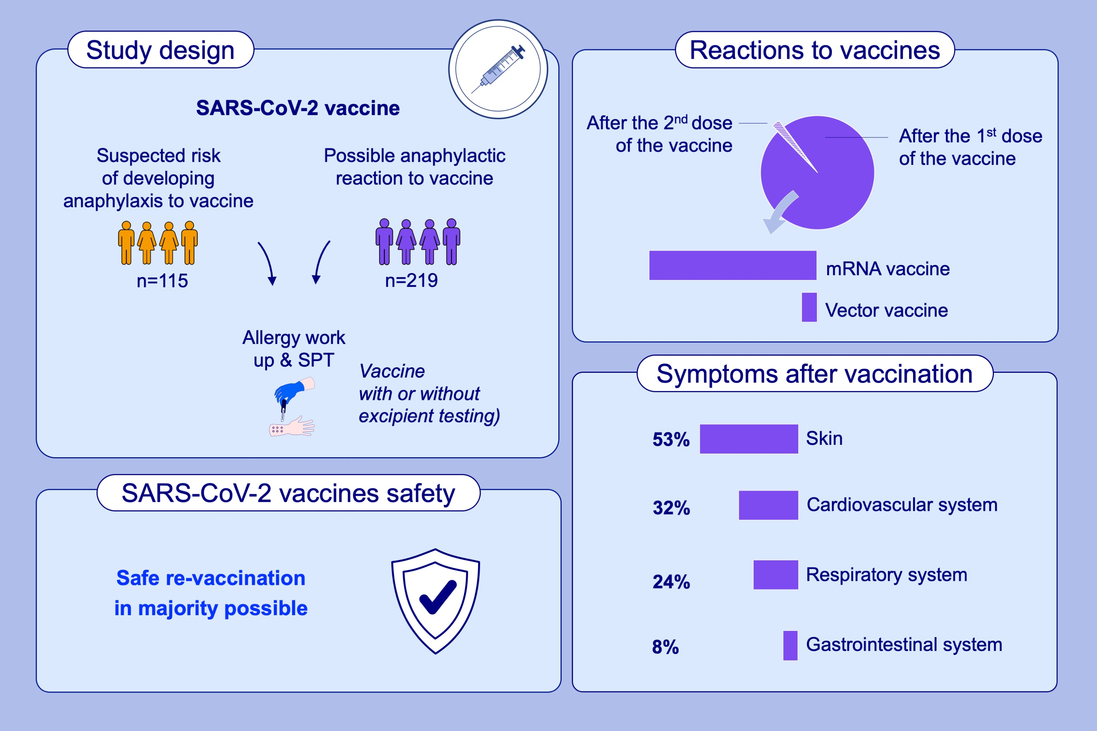
Management of suspected and confirmed COVID-19 (SARS-CoV-2) vaccine hypersensitivity
Margitta Worm, Aikaterina Alexiou, Andrea Bauer, Regina Treudler, Gerda Wurpts, et al.
Allergy. 2022; pages: 3426-3434
https://doi.org/10.1111/all.15414
© 2019 EAACI and John Wiley and Sons A/S. Published by John Wiley and Sons Ltd.
Notes:
HIGHLIGHTS
This study assesses the management and outcome of suspected SARS-CoV-2 vaccine hypersensitivity in 334 individuals who underwent an allergy work up.
Of the 219 individuals who experienced symptoms suspicious for a hypersensitivity reaction after vaccination, 214 were reported after the first vaccination with a mRNA vaccine and 18 with a vector vaccine. 5 cases were reported after the second vaccination.
IgE-mediated hypersensitivity to SARS-CoV-2 vaccines is extremely rare and not increased in comparison to the reported hypersensitivity rates for other vaccines.
Abbreviations: COVID-19, coronavirus disease 2019; SARS-CoV-2, severe acute respiratory syndrome coronavirus 2

