Slide 1
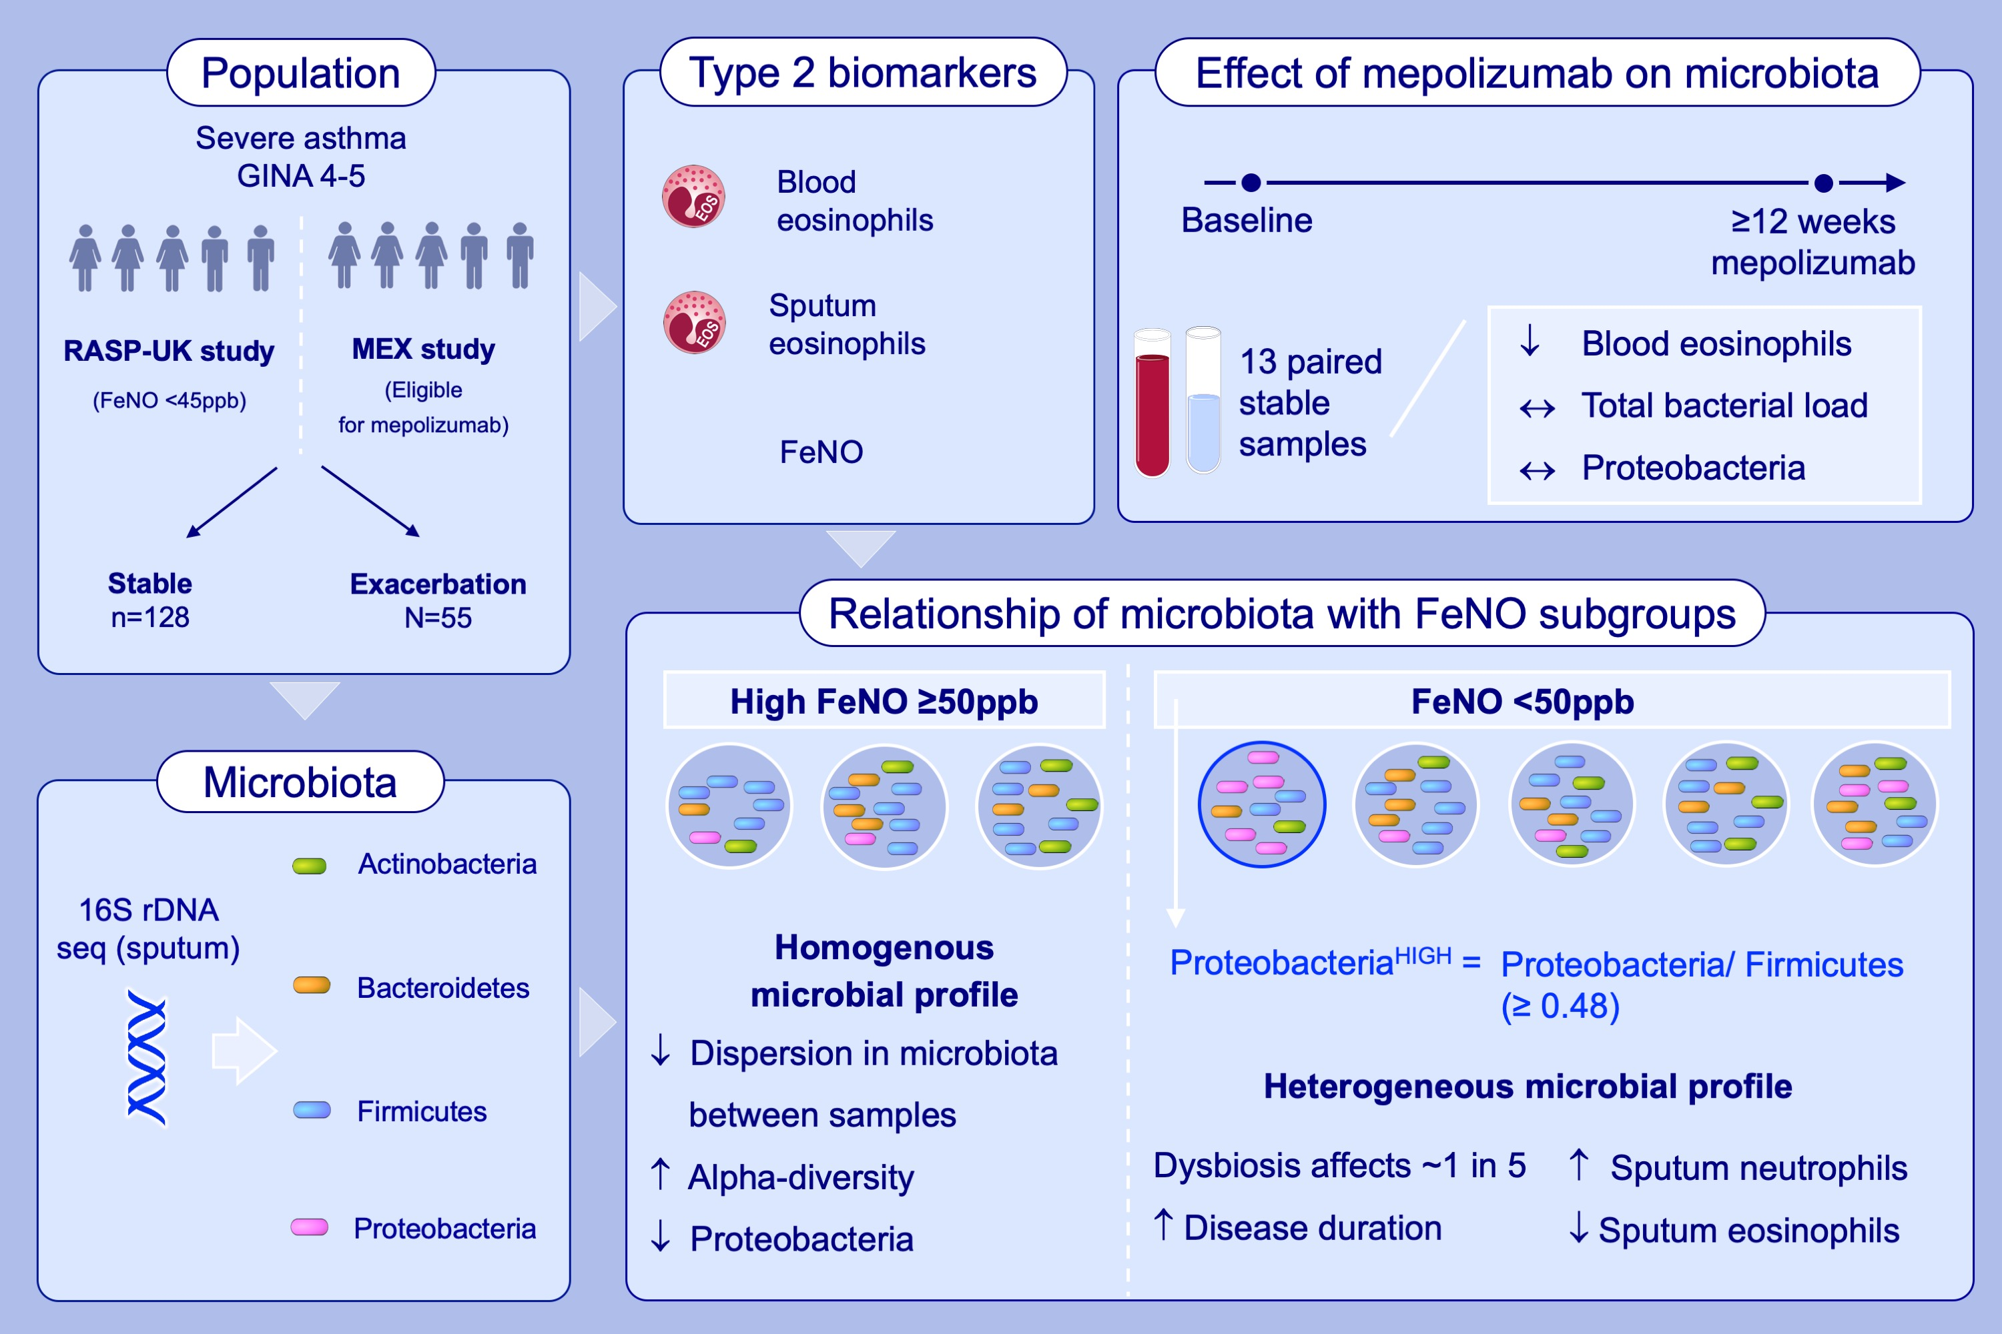
Relationship between inflammatory status and microbial composition in severe asthma and during exacerbation
Sarah Diver, Koirobi Haldar, Pamela Jane McDowell, John Busby, Vijay Mistry, et al.
Allergy. 2022; pages: 3362-3376
https://doi.org/10.1111/all.15425
© 2019 EAACI and John Wiley and Sons A/S. Published by John Wiley and Sons Ltd.
Notes:
HIGHLIGHTS
FeNO ≥50ppb, when stable and at exacerbation, indicates a subgroup with an even microbial composition, with high alpha-diversity measures and low relative abundance of Proteobacteria.
Proteobacteria^{HIGH} severe asthmatics are neutrophilic, and have a longer duration of disease than those who are Proteobacteria^{LOW}.
In a small subset with paired data at baseline and ≥12 weeks, mepolizumab suppressed blood eosinophils but did not increase total airway bacterial load or lead to increased proportions of Proteobacteria.
Abbreviations: FeNO, fractional exhaled nitric oxide; GINA, Global Initiative for Asthma; MEX, Exploring Asthma Exacerbations in Mepolizumab Treated Patients; ppb, parts per billion; RASP-UK, A Pragmatic Trial of Corticosteroid Optimisation in Severe Asthma; rDNA, ribosomal DNA; seq, sequencing

