Slide 1
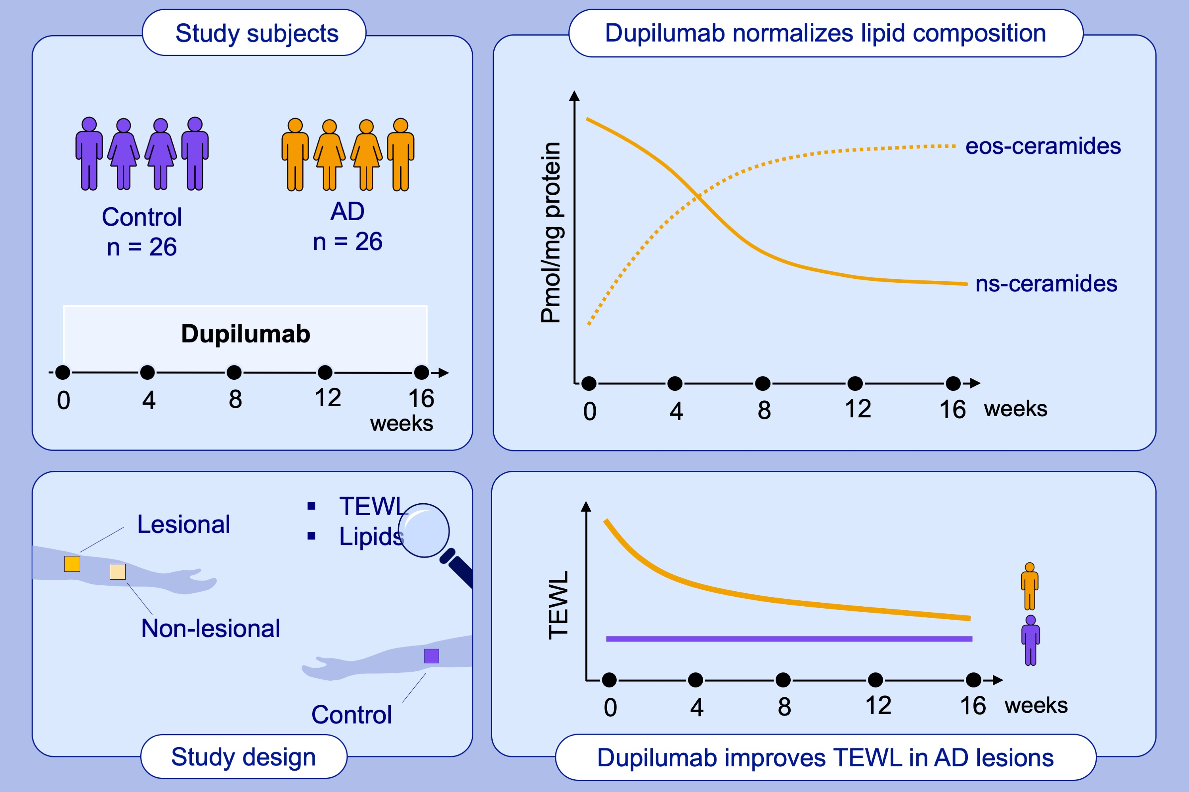
Dupilumab significantly improves skin barrier function in patients with moderate-to-severe atopic dermatitis
Evgeny Berdyshev, Elena Goleva, Robert Bissonnette, Irina Bronova, Anna Sofia Bronoff et al.
Allergy. 2022; pages: 3388-3397
https://doi.org/10.1111/all.15432
© 2019 EAACI and John Wiley and Sons A/S. Published by John Wiley and Sons Ltd.
Notes:
HIGHLIGHTS
Skin barrier function is in part determined by stratum corneum lipids.
Their composition is impaired in AD skin due to excessive signaling by IL-4 and IL-13.
Blocking IL-4/IL-13 signaling by a biologic dupilumab restores stratum corneum lipid composition and skin barrier function in AD patients.
Abbreviations: AD, atopic dermatitis; EOS-ceramides, ceramides containing esterified omega hydroxy fatty acids and sphingosine; IL, interleukin; NS-ceramides, ceramides with non-hydroxy fatty acids and sphingosine; TEWL, transepidermal water loss

