Slide 1
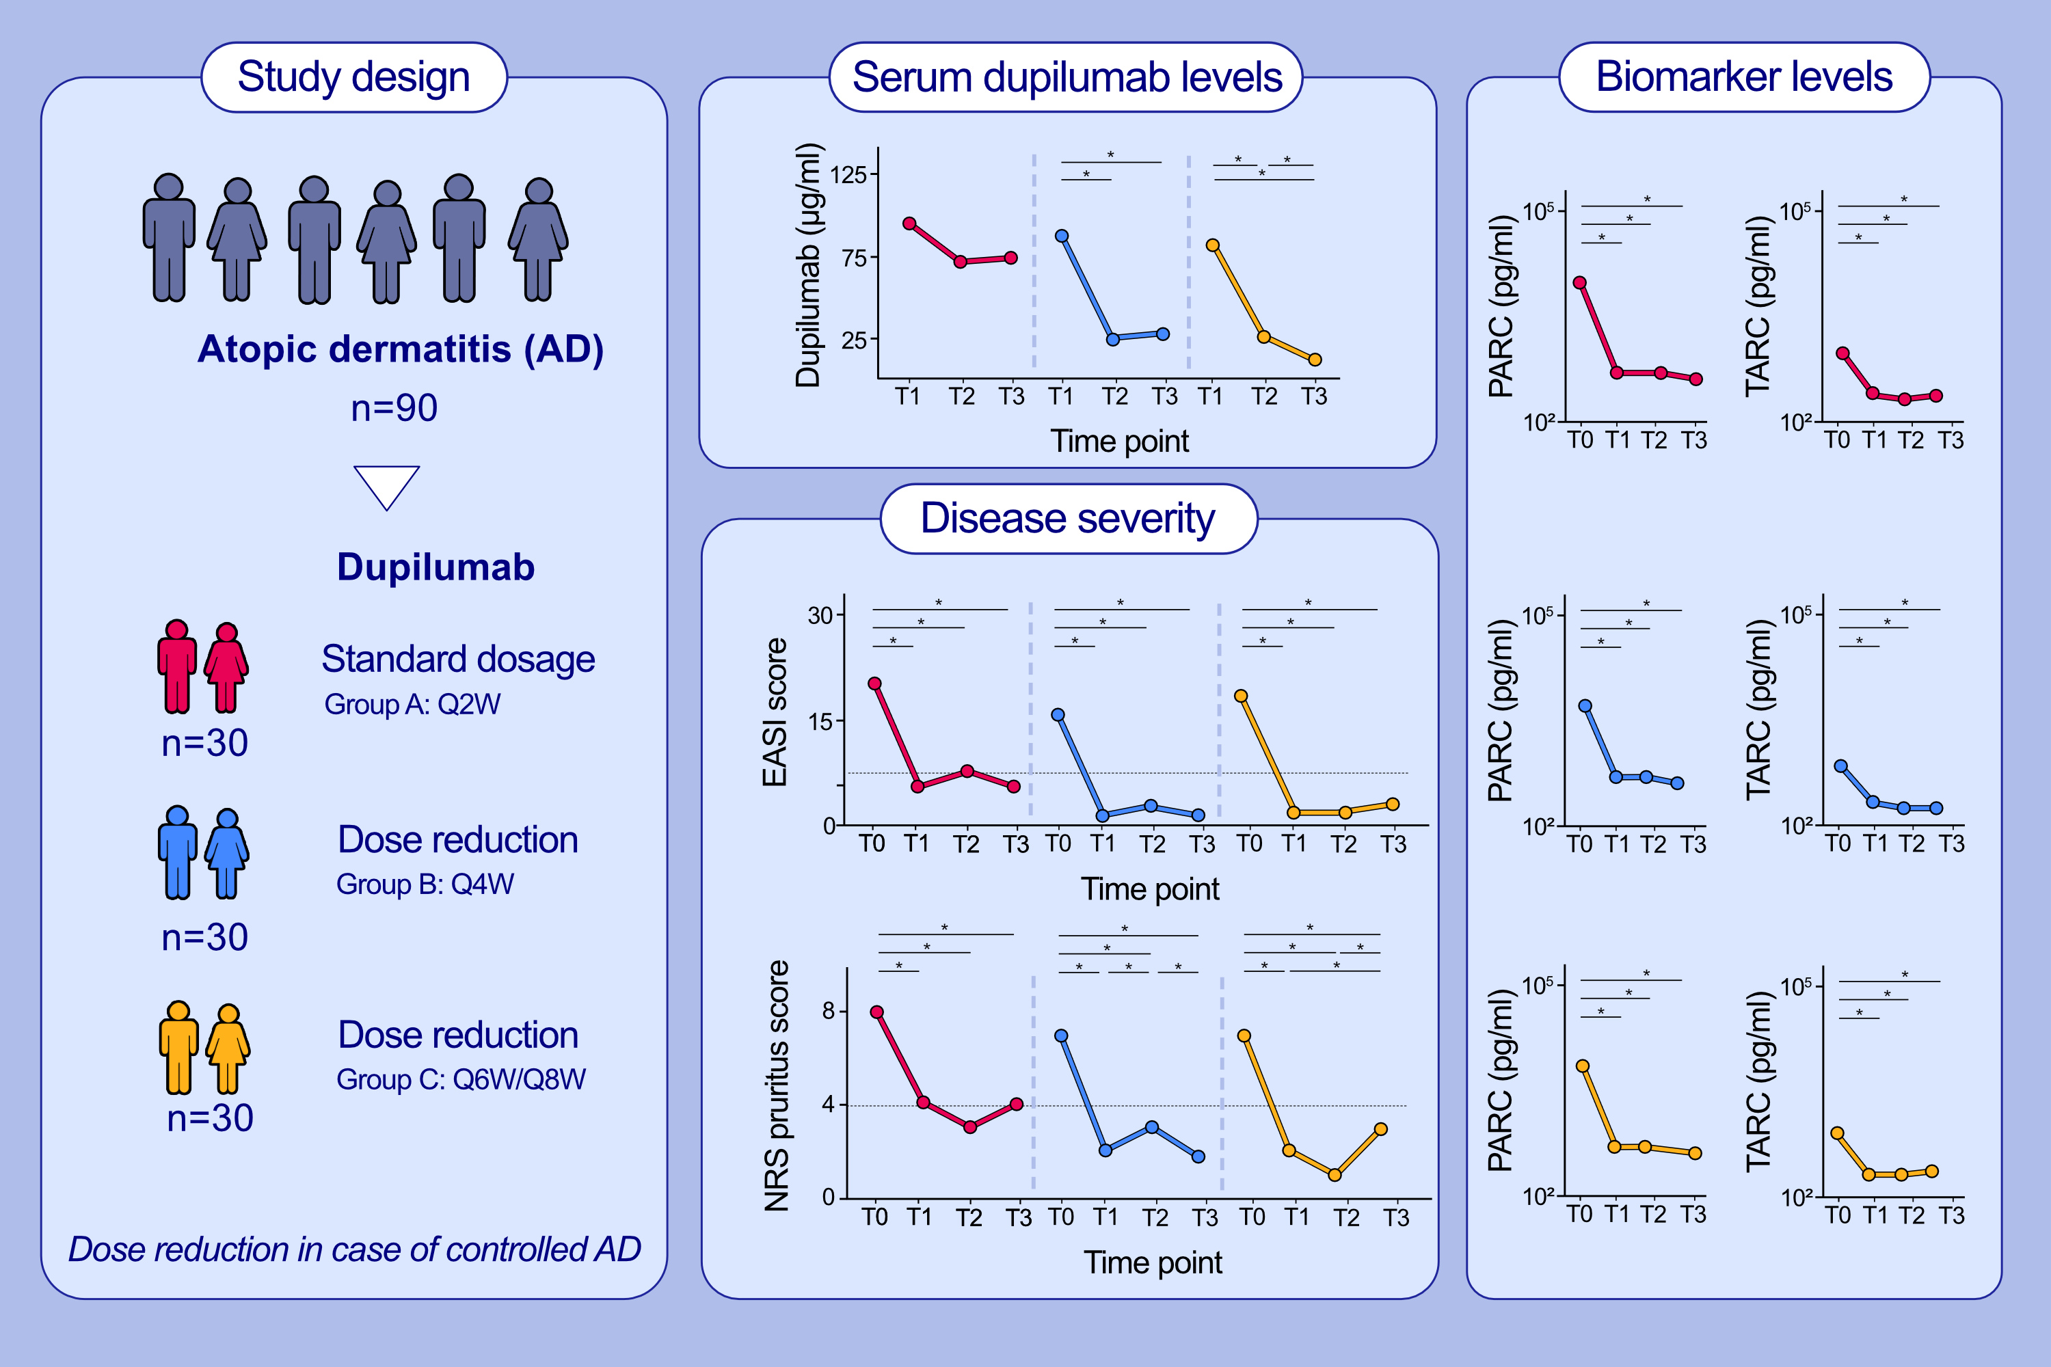
Patient-centered dupilumab dosing regimen leads to successful dose reduction in persistently controlled atopic dermatitis
Lotte S. Spekhorst, Daphne Bakker, Julia Drylewicz, Theo Rispens, Floris Loeff, et al.
Allergy. 2022; pages: 3398-3407
https://doi.org/10.1111/all.15439
© 2019 EAACI and John Wiley and Sons A/S. Published by John Wiley and Sons Ltd.
Notes:
HIGHLIGHTS
Dose reduction was successful in a subgroup of controlled AD patients by using a patient-centered dupilumab dosing regimen.
Despite significantly lower dupilumab levels, the EASI-score and disease severity biomarkers (TARC/CCL17 and PARC/CCL18) in group B (Q4W) and C (Q6W/Q8W) remained low and stable.
These findings are the first step towards personalized dupilumab treatment for controlled AD patients in clinical practice.
Abbreviations: AD, atopic dermatitis; EASI, eczema area and severity index; PARC (CCL18), pulmonary and activation-regulated chemokine; PROMs, patient-reported outcome measures; Q2W, every two weeks; Q4W, every four weeks; Q6W, every six weeks; Q8W, every eight weeks; TARC (CCL17), thymus and activation-regulated chemokine

