Slide 1
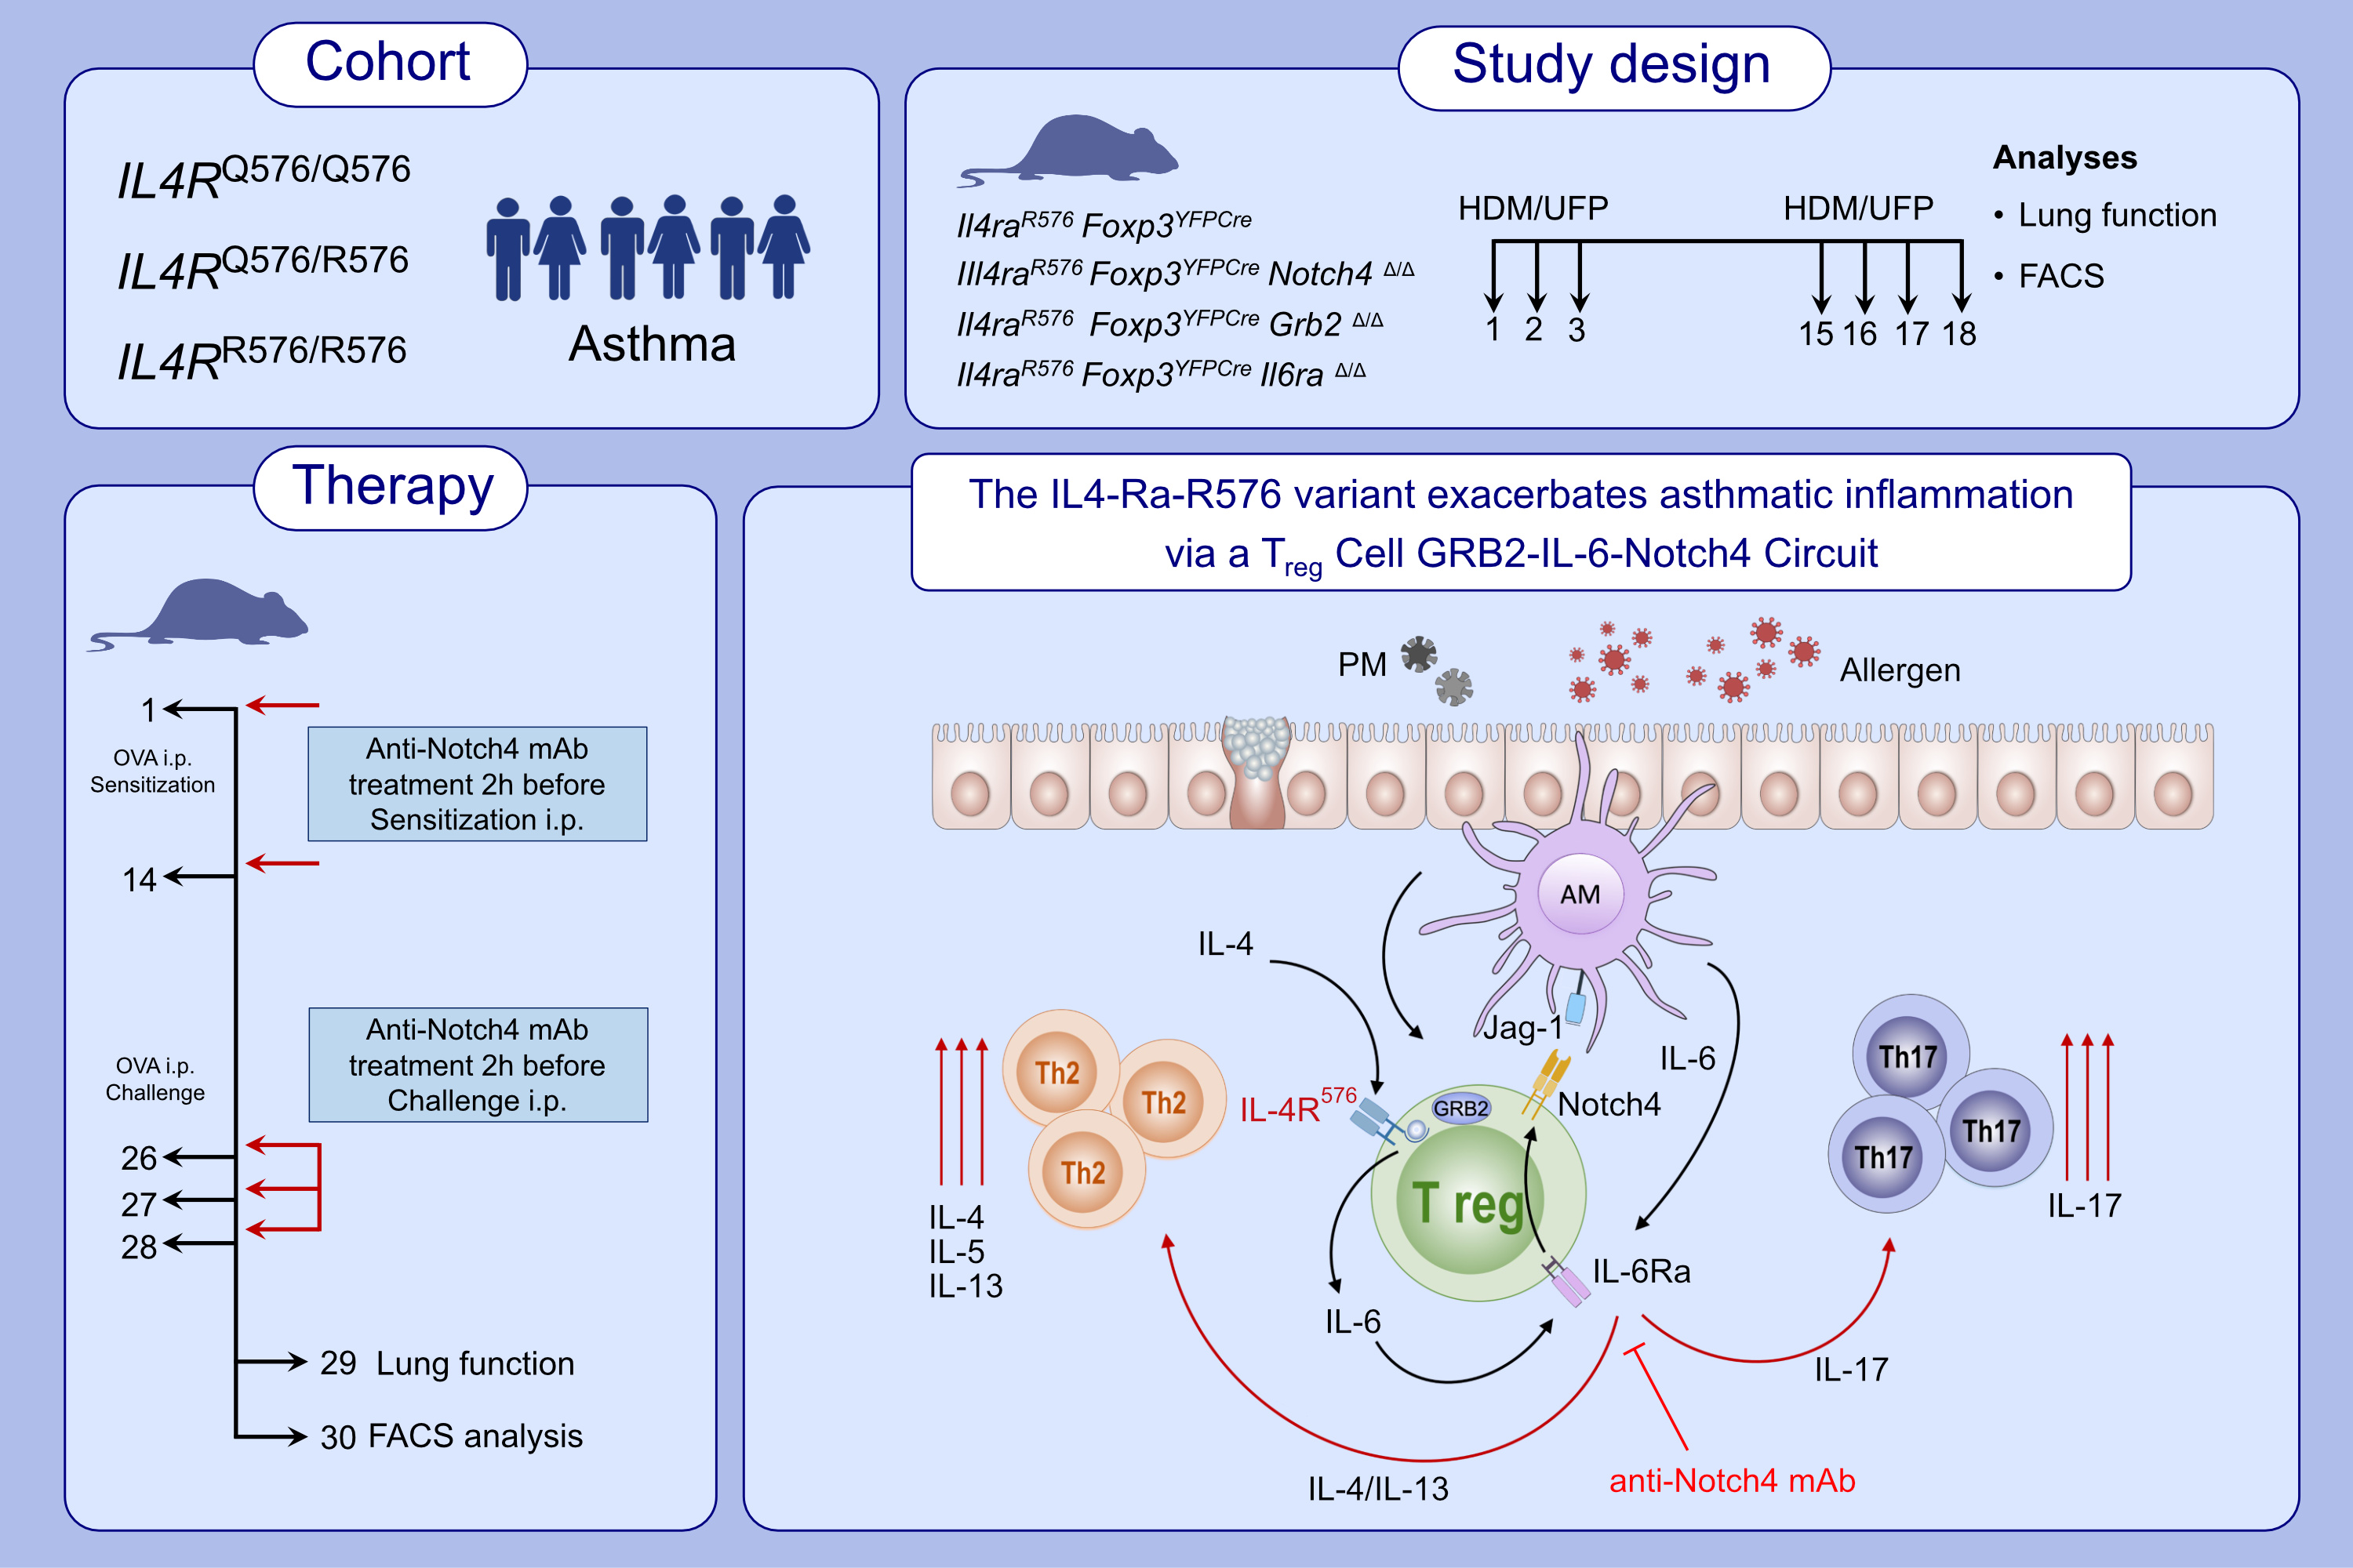
A Common IL-4 Receptor Variant Promotes Asthma Severity via a T reg Cell
GRB2-IL-6-Notch4 Circuit
Mehdi Benamar, Hani Harb, Qian Chen, Muyun Wang, Tsz Man Fion Chan, et al.
Allergy. 2022; pages: 3377-3387
https://doi.org/10.1111/all.15444
© 2019 EAACI and John Wiley and Sons A/S. Published by John Wiley and Sons Ltd.
Notes:
HIGHLIGHTS
Asthmatics carrying the IL4Ra^{R576} variant have increased Notch4 expression on their circulating Treg cells as a function of disease severity and serum IL-6 concentrations.
IL-4Ra^{R576} acts via GRB2 and IL6R in Treg cells to upregulate Notch4 and its downstream signaling intermediates Yap1 and b-catenin, leading to exacerbated lung inflammation
Treatment with an anti-Notch4 neutralizing antibody inhibits allergic airway inflammation
Abbreviations: FACS, fluorescence-activated cell sorting; Foxp3, forkhead box P3; GRB2, growth factor receptor-bound protein 2; HDM, house dust mite; IL, interleukin; Jag-1, Jagged Canonical Notch Ligand 1; mAb, monoclonal antibodies; Notch4, Notch Receptor 4; OVA, ovalbumin; PM, particulate matter; Treg, regulatory T cell; UFP, ultrafine particles

