Slide 1
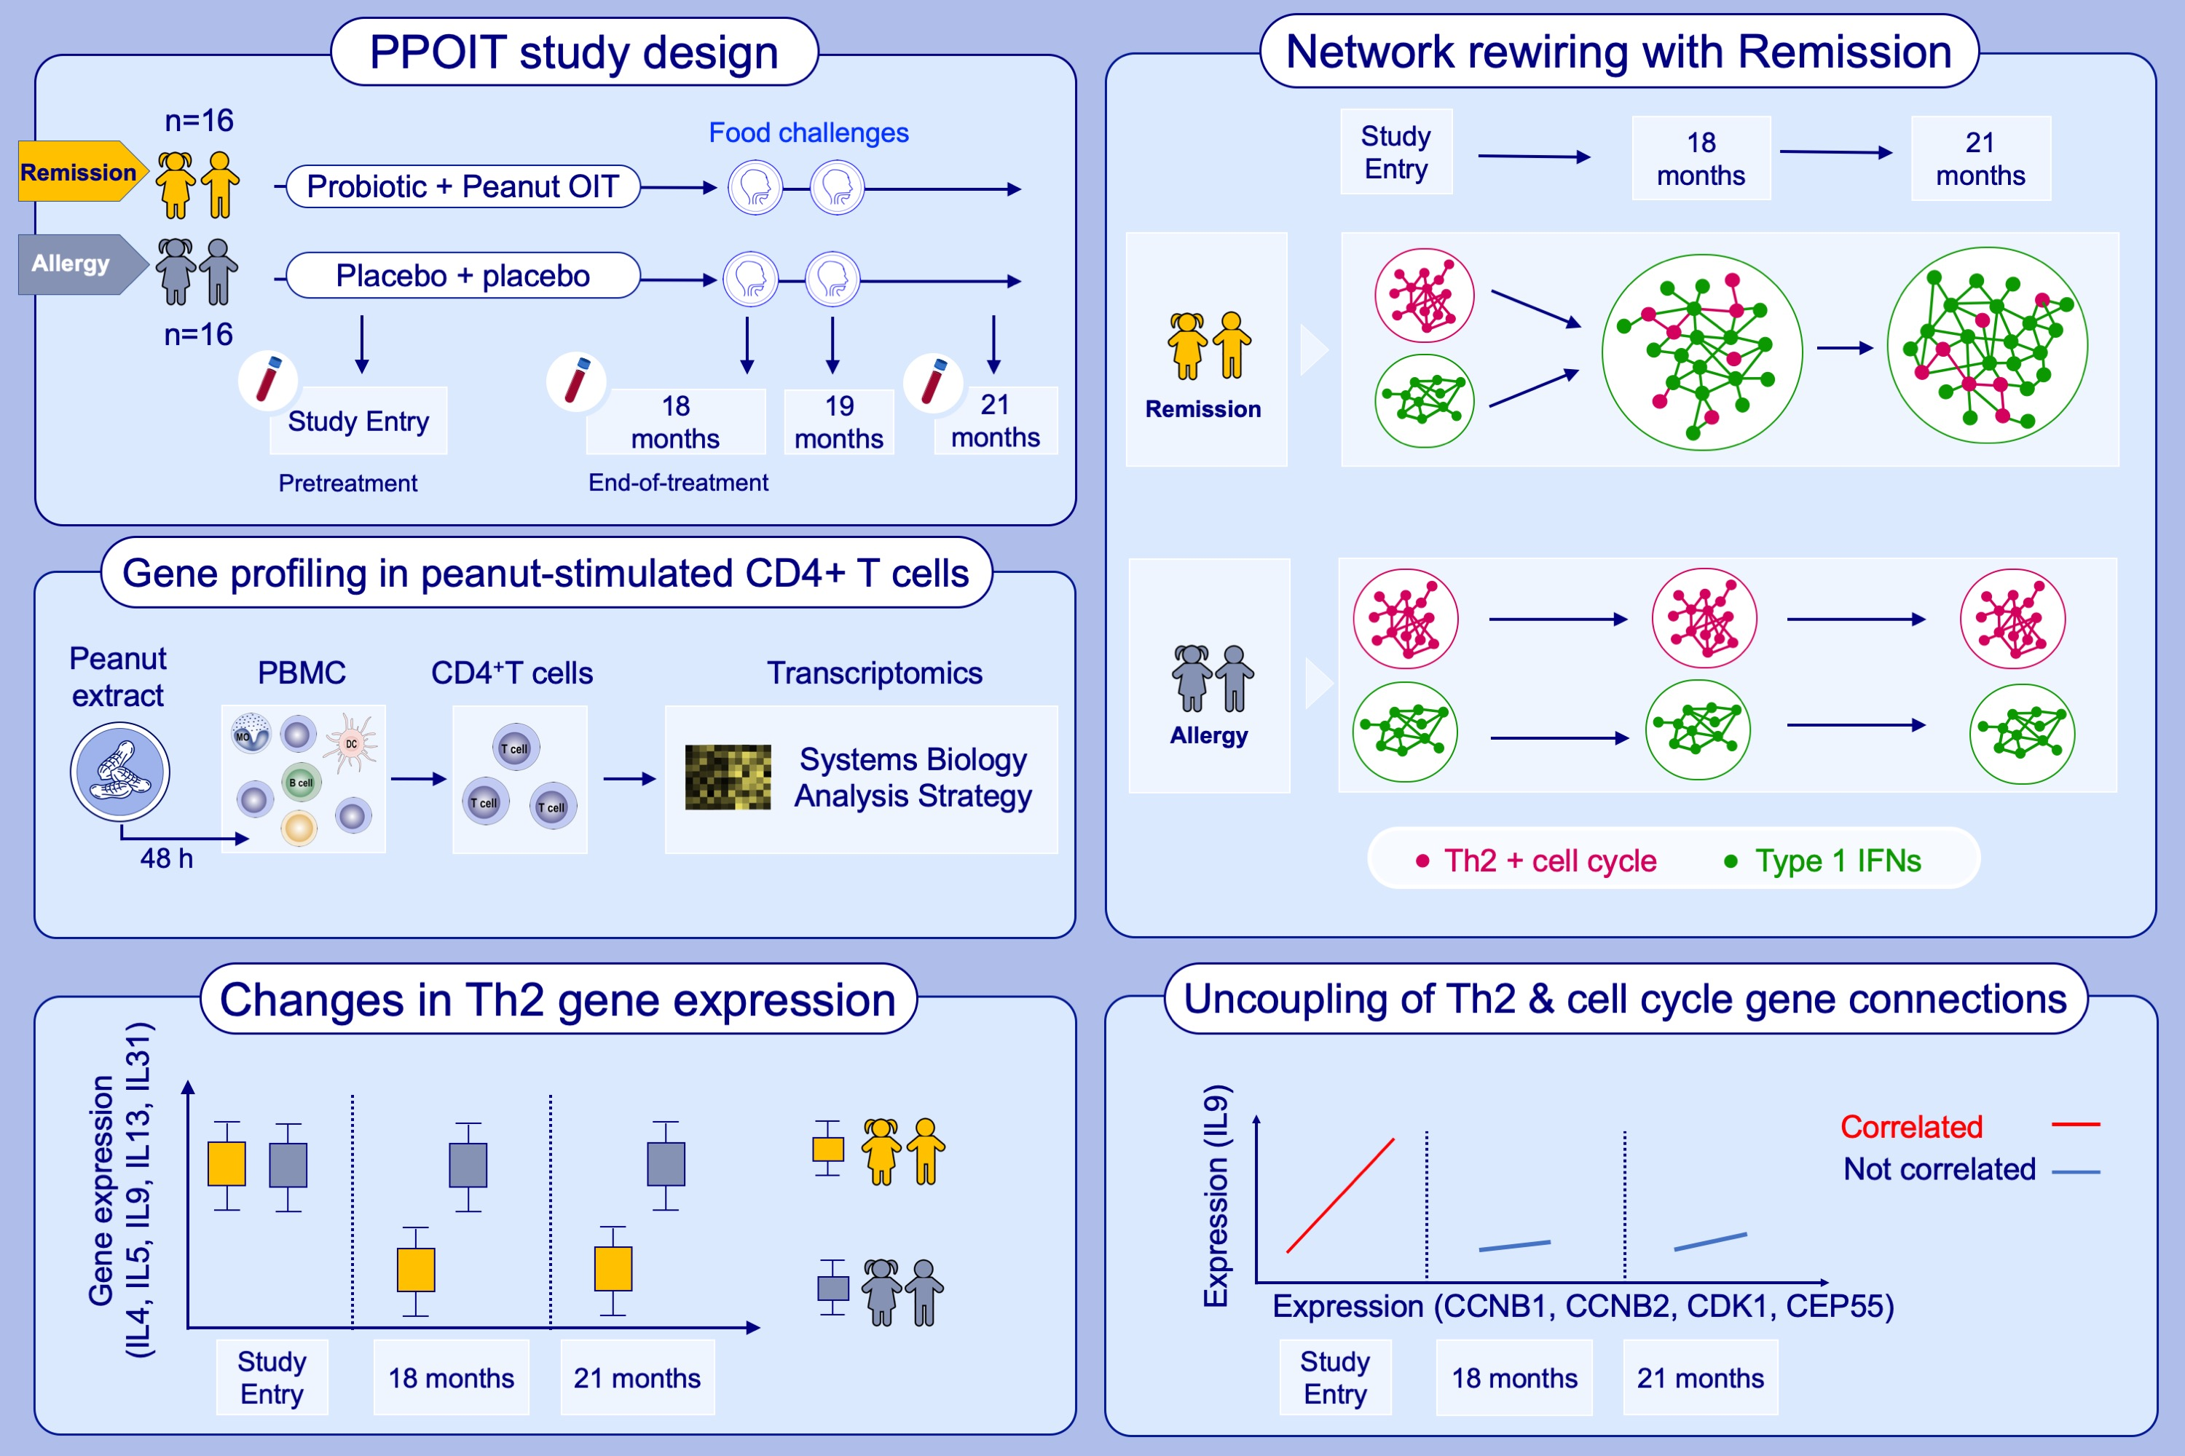
Remission of peanut allergy is associated with rewiring of allergen-driven
T helper 2-related gene networks
Sarah E. Ashley, Anya C. Jones, Denise Anderson, Patrick G. Holt, Anthony Bosco, Mimi L. K. Tang
Allergy. 2022; pages: 3015-3027
https://doi.org/10.1111/all.15324
© 2019 EAACI and John Wiley and Sons A/S. Published by John Wiley and Sons Ltd.
Notes:
HIGHLIGHTS
We examined longitudinal changes in gene co-expression networks in peanut-specific CD4+ T cells from participants with remission following OIT (n=16), and placebo-treated who remained allergic (n=16).
Remission was associated with emergence of a regulatory module dominated by type 1 interferon signalling and collapse of the allergic T helper 2 module, with Th2 genes incorporated within the regulatory module.
Findings provide insight into immune mechanisms driving the acquisition of remission following oral immunotherapy.
Abbreviations: CCNB, cyclin B; CDK1, cyclin dependent kinase 1; CEP55, centrosomal protein 55; DC, dendritic cell; IFN, interferon; IL, interleukin; PBMC, peripheral blood mononuclear cell; PPOIT, probiotic + peanut oral immunotherapy; Th2, T helper 2

