Slide 1
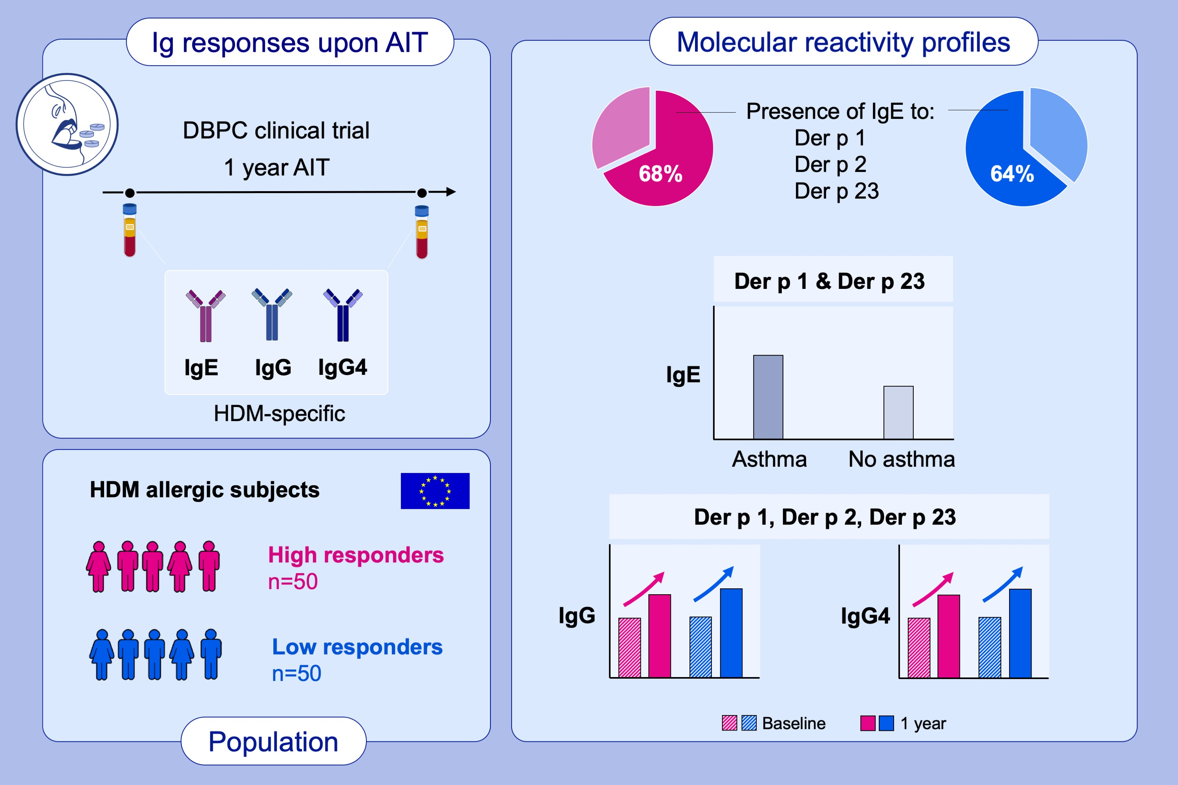
Molecular reactivity profiling upon immunotherapy with a 300 IR sublingual house dust mite tablet reveals marked humoral changes towards major allergens
Ekaterina Potapova, Véronique Bordas-Le Floch, Thomas Schlederer, Susanne Vrtala, et al.
Allergy. 2022; pages: 3084-3095
https://doi.org/10.1111/all.15327
© 2019 EAACI and John Wiley and Sons A/S. Published by John Wiley and Sons Ltd.
Notes:
HIGHLIGHTS
This study evaluated humoral responses to HDM allergen panel in a subset of clinically defined high and low responder patients from a DBPC AIT trial using sublingual HDM tablets.
Der p 1, Der p 2 and Der p 23 were the most frequently recognized allergens in the study population. Patients with HDM-related asthma had significantly higher Der p 1- and Der p 23-specific IgE levels compared to non-asthmatic.
Upon AIT, an increase in allergen-specific IgG and IgG4 was observed, in particular Der p 1-, Der p 2- and Der p 23-specific.
Abbreviations: AIT, allergen immunotherapy; DBPC, double-blind placebo-controlled; HDM, house dust mite; Ig, immunoglobulin

