Slide 1
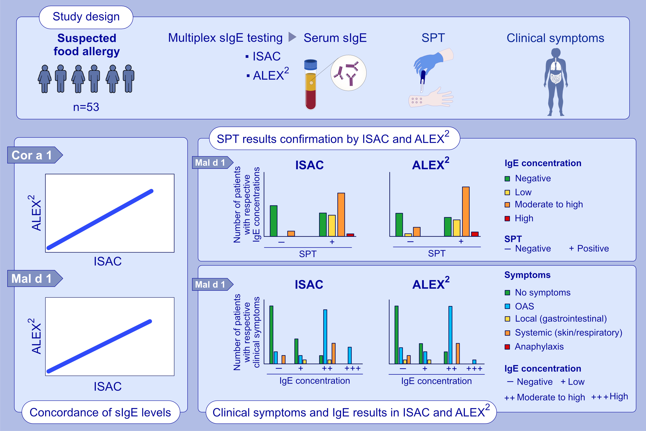
Real-life evaluation of molecular multiplex IgE test methods in the diagnosis of pollen associated food allergy
Luisa Diem, Bellinda Neuherz, Johanna Rohrhofer, Larissa Koidl, Riccardo Asero, et al.
Allergy. 2022; pages: 3028-3040
https://doi.org/10.1111/all.15329
© 2019 EAACI and John Wiley and Sons A/S. Published by John Wiley and Sons Ltd.
Notes:
HIGHLIGHTS
This study compared two molecular tests, ISAC and ALEX², in the context of pollen food syndrome diagnosis in a real-life scenario and assessed the benefit of multiplex testing.
When directly comparing sIgE levels determined by ISAC and ALEX², Spearman’s correlation coefficient was significant for all six evaluated allergens.
Mutiplex IgE testing supported diagnosis of pollen food syndrome patients and showed a good correlation with skin prick test results and clinical symptoms.
Abbreviations: ALEX², Allergy Explorer, version 2; Cor a 1, hazelnut allergen; ISAC, ImmunoCAP ISAC; Mal d 1, apple allergen; OAS, oral allergy syndrome; sIgE, specific IgE; SPT, skin prick test

