Slide 1
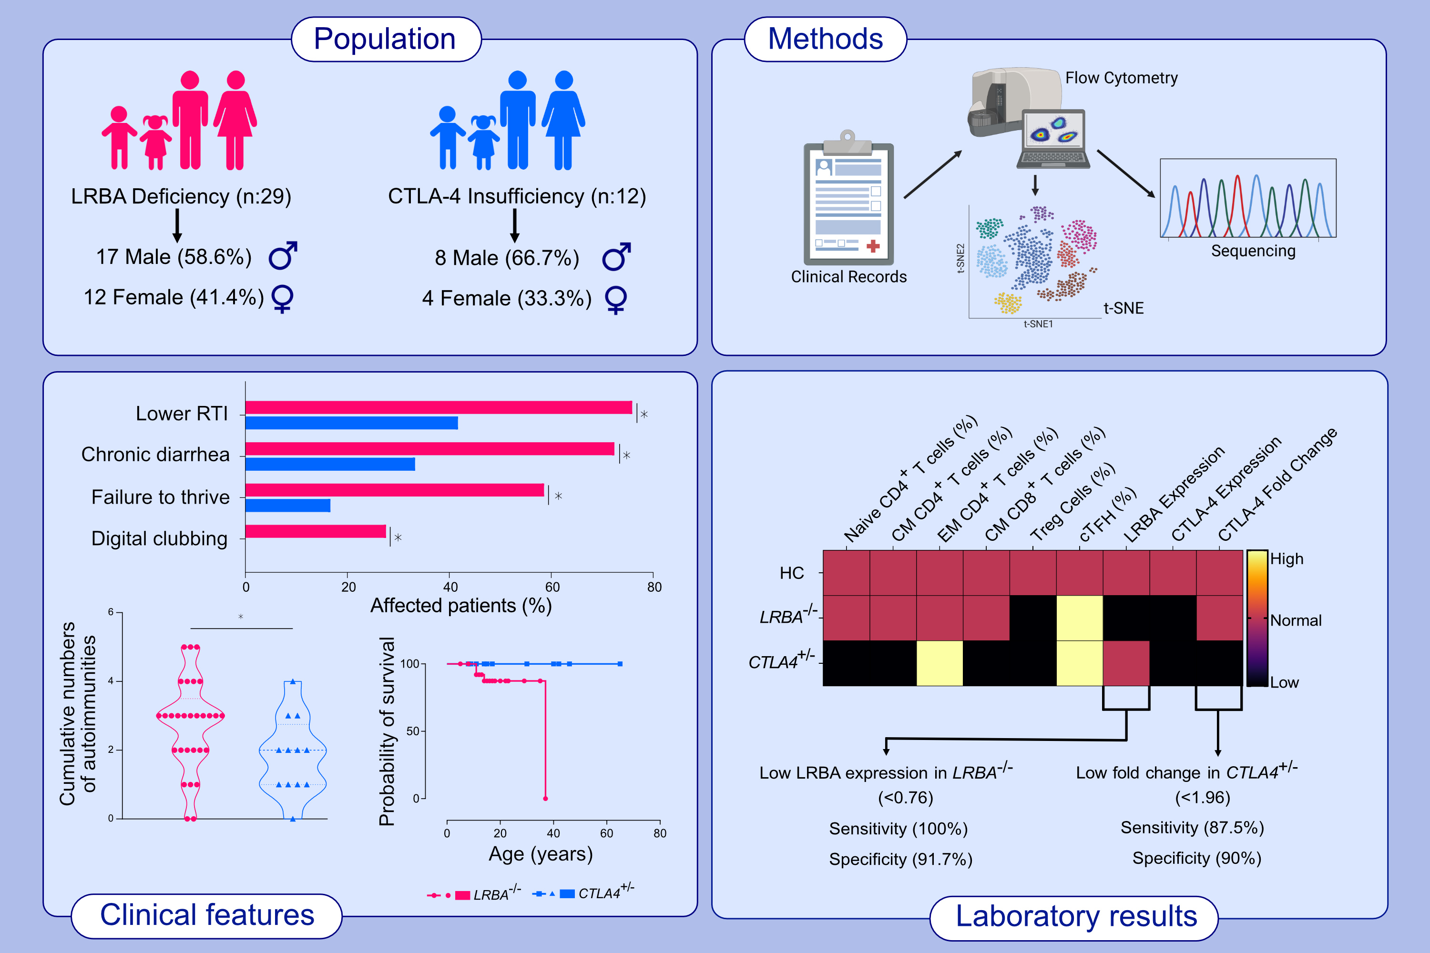
Comparing the levels of CTLA-4 dependent biological defects in patients with LRBA deficiency and CTLA-4 insufficiency
Mehmet C. Catak, Bengu Akcam, Sevgi Bilgic Eltan, Royala Babayeva,, et al.
Allergy. 2022; pages: 3108-3123
https://doi.org/10.1111/all.15331
© 2019 EAACI and John Wiley and Sons A/S. Published by John Wiley and Sons Ltd.
Notes:
HIGHLIGHTS
This study analyses cord-blood derived mast cells and human mast cell line LAD-2 challenged by SUCNR1 ligands for activation and mediator release.
Succinate challenge or cES challenge renders mast cells hypersensitive to IgE-dependent activation, resulting in augmented degranulation and histamine release, de novo biosynthesis of eicosanoids and cytokine secretion.
The succinate-potentiated mast cell reactivity is attenuated by SUCNR1 knockdown and selective SUCNR1 antagonists and could be tuned by pharmacologically targeting protein kinase C and extracellular signal-regulated kinase. Activation of SUCNR1 potentiates mast cell-dependent bronchoconstriction.
Abbreviations: AA, amino acid; cES, cis-epoxysuccinate; cPLA₂, cytosolic phospholipase A2; Cys-LTs, cysteinyl leukotrienes; ERK, extracellular signal-regulated kinase; GM-CSF, granulocyte-macrophage colony-stimulating factor; Gq, heterotrimetric G protein; IL, interleukin; IgE, immunoglobulin E; LAD-2, laboratory of allergic diseases 2; PGD₂, prostaglandin D2; SUCNR1, succinate receptor 1; TNF, tumor necrosis factor; TXA₂, thromboxane A2; XT1, selective SUCNR1 antagonist

