Slide 1
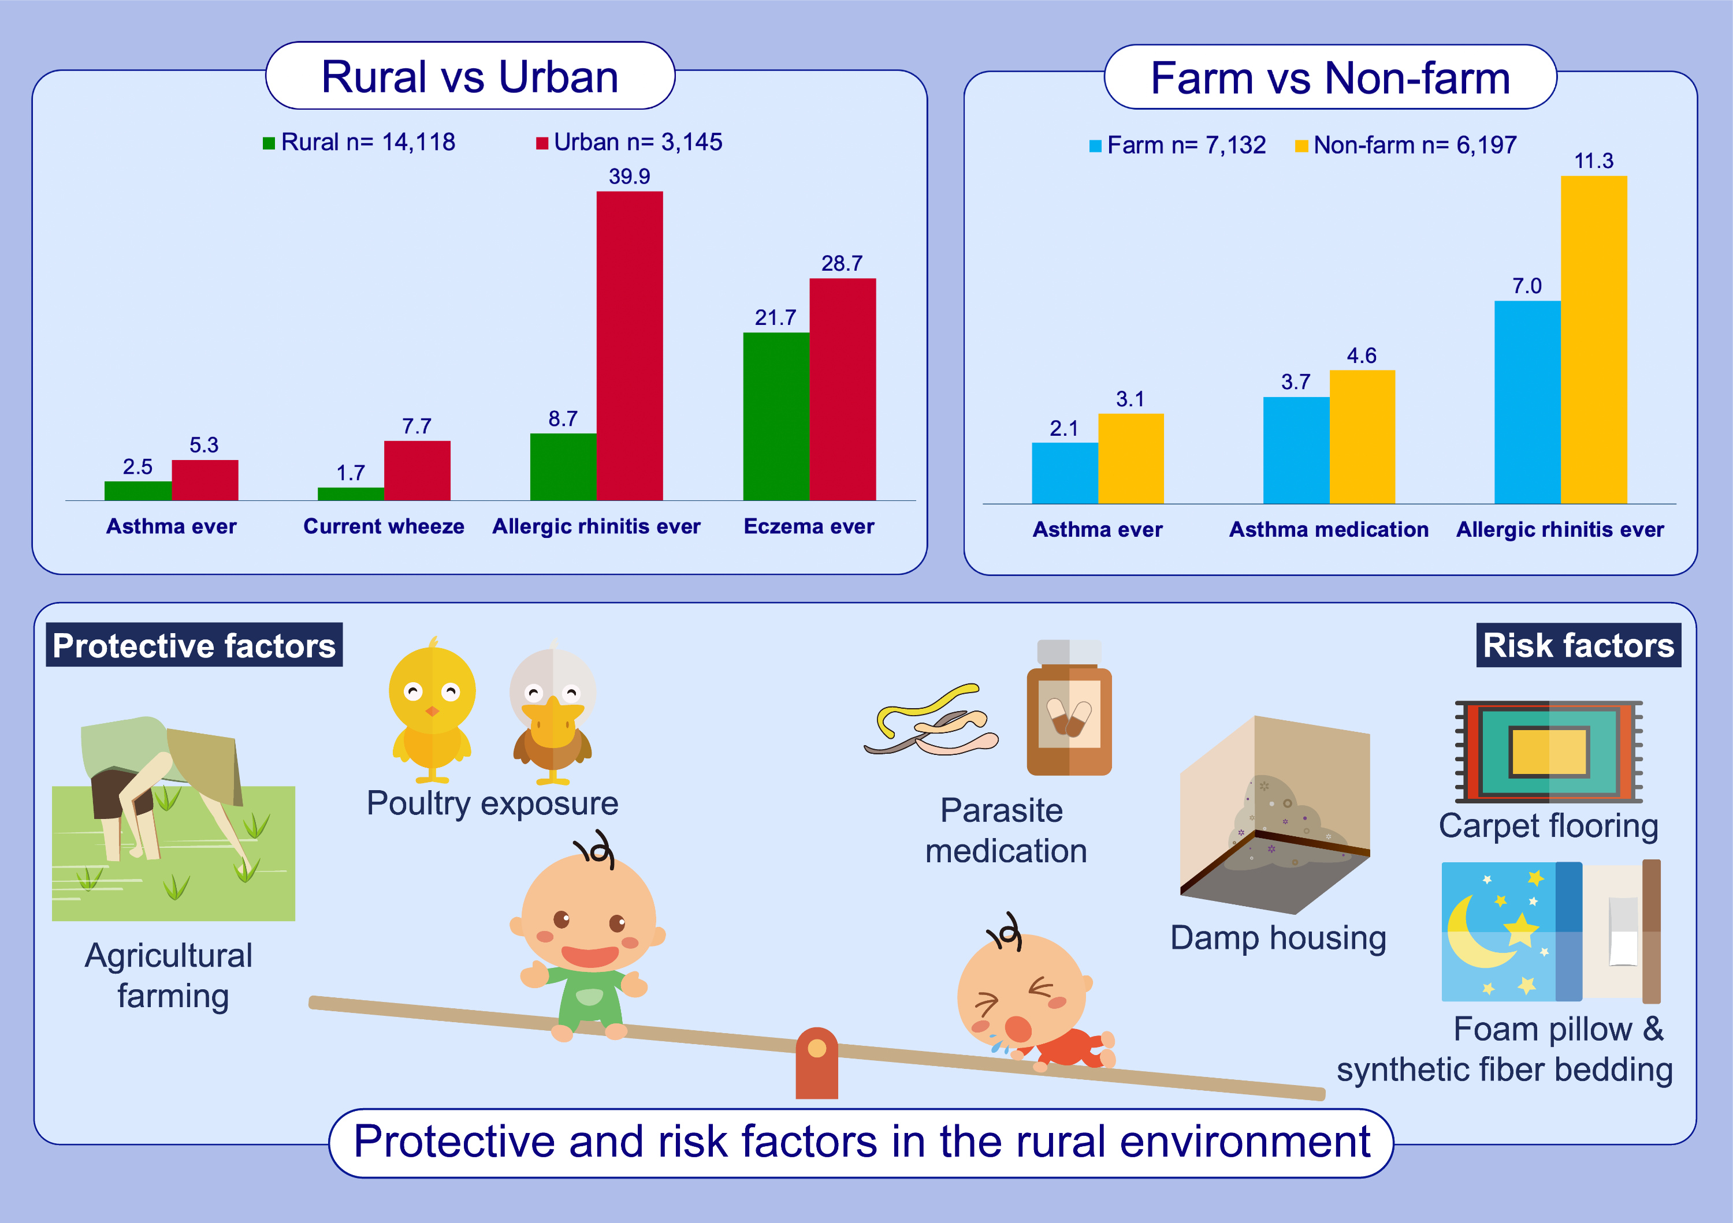
Poultry exposure and environmental protection against asthma in rural children
Yuhan Xing, Maggie H. Wang, Ting-Fan Leung, Chun-Kwok Wong, Marjut Roponen, et al.
Allergy. 2022; pages: 2949-2960
https://doi.org/10.1111/all.15365
© 2019 EAACI and John Wiley and Sons A/S. Published by John Wiley and Sons Ltd.
Notes:
HIGHLIGHTS
The prevalence of asthma and related atopic disorders was significantly lower in rural children when compared with their urban counterparts.
Living in a farm provided further protection against asthma among rural children.
Poultry exposure was the most important factor associated with asthma protection conferred by living in the rural area.

