Slide 1
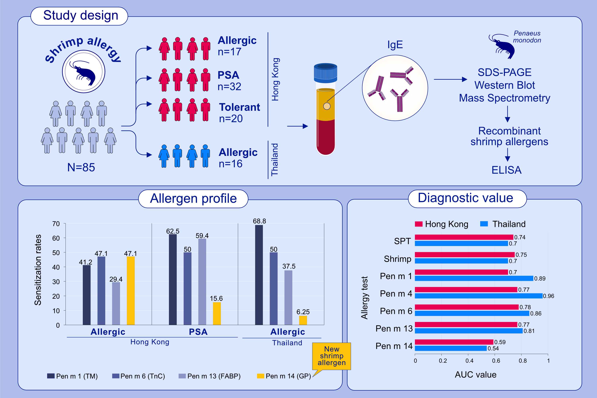
Activation of succinate receptor 1 boosts human mast cell reactivity and allergic bronchoconstriction
Xiao Tang, Elin Rönnberg, Jesper Säfholm, Madhuranayaki Thulasingam, Mette Trauelsen, et al.
Allergy. 2022; pages: 3041-3051
https://doi.org/10.1111/all.15370
© 2019 EAACI and John Wiley and Sons A/S. Published by John Wiley and Sons Ltd.
Notes:
HIGHLIGHTS
Glycogen phosphorylase (GP, Pen m 14) is identified as a new shrimp allergen.
Troponin C (Pen m 6), fatty acid-binding protein (Pen m 13) and Pen m 14 are major allergens apart from tropomyosin (Pen m 1) in shrimp allergic subjects from Hong Kong and Thailand.
Molecular diagnostics better predicts shrimp allergy but relevant biomarker is population dependent.
Abbreviations: AUC, area under curve; ELISA, enzyme-linked immunosorbent assay; FABP, fatty acid-binding protein; GP, glycogen phosphorylase; PSA, probably shrimp allergy; SPT, skin prick test; SDS-PAGE, sodium dodecyl-sulfate polyacrylamide gel electrophoresis; TM, tropomyosin; TnC, troponin C

