Slide 1
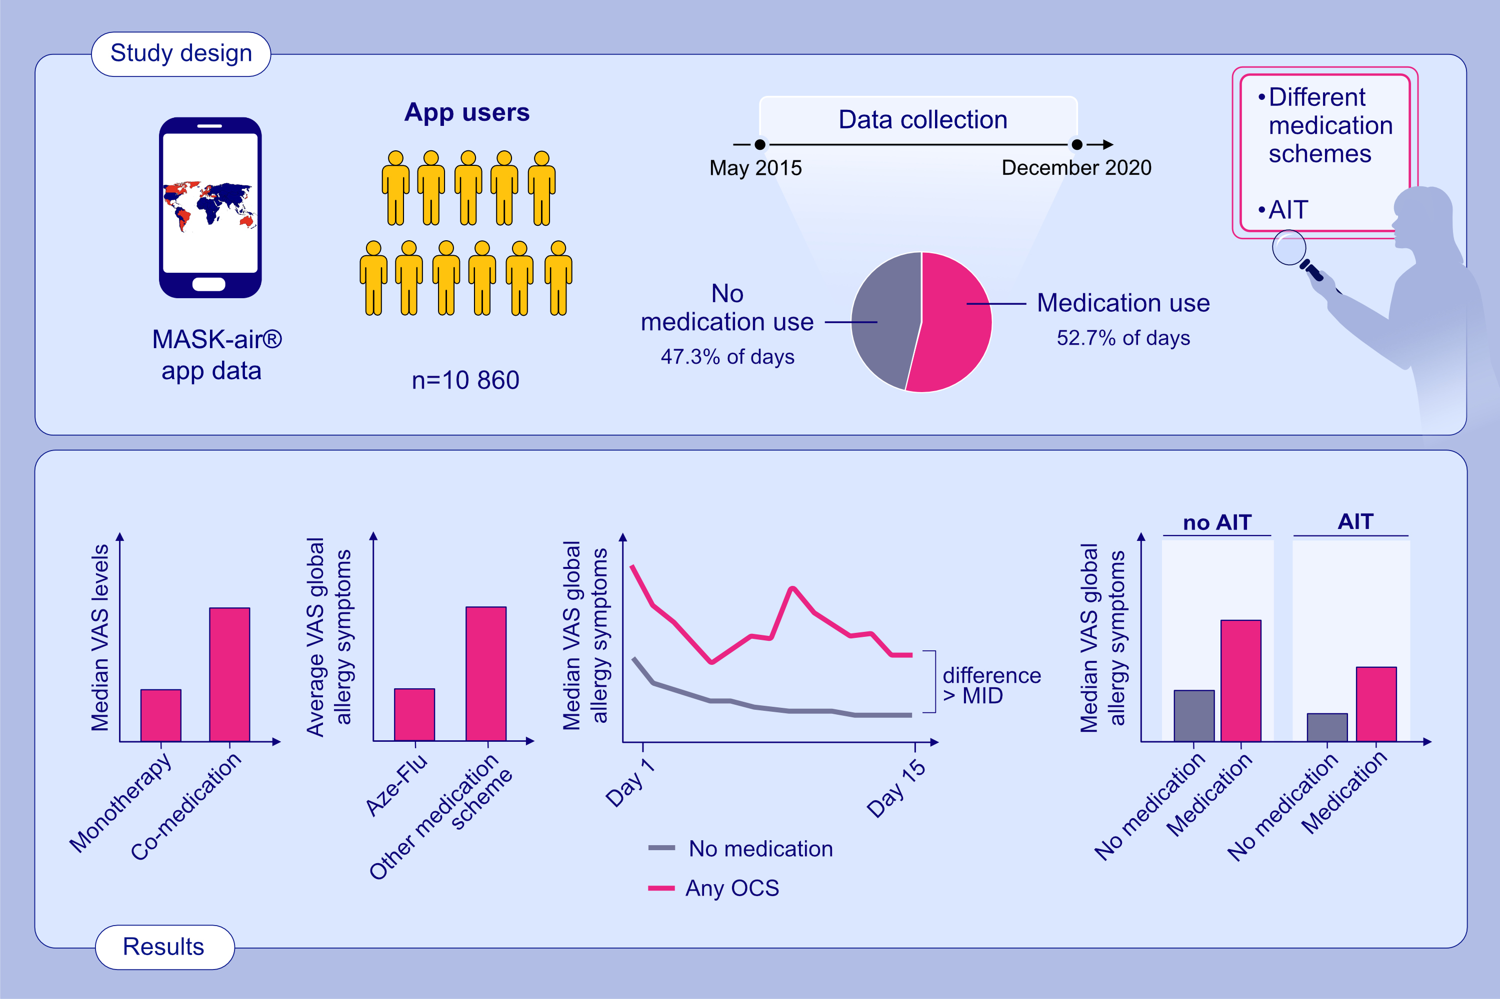
Comparison of rhinitis treatments using MASK-air® data and considering the Minimal Important Difference
Bernardo Sousa-Pinto, Holger J. Schünemann, Ana Sá-Sousa, Rafael José Vieira, Rita Amaral, et al.
Allergy. 2022; pages: 3002-3014
https://doi.org/10.1111/all.15371
© 2019 EAACI and John Wiley and Sons A/S. Published by John Wiley and Sons Ltd.
Notes:
HIGHLIGHTS
Median VAS levels for allergy symptoms are significantly higher in co-medication than in monotherapy schemes. Aze-Flu is associated with lower average VAS allergy symptoms and with lower chances of being used in co-medication than all other medication schemes.
A difference larger than MID is observed for the comparison between oral steroids versus no medication.
AIT is associated with decrease in VAS allergy symptoms in days with no medication or with medication.
Abbreviations: AIT, allegen immunotherapy; Aze-Flu, Azelastine-Fluticasone; INCS, intranasal corticosteroids; INHS, intranasal antihistamines; MID, minimal important difference; OAH, oral antihistamines; OCS, oral corticosteroids; VAS, visual analogue scale

