Slide 1
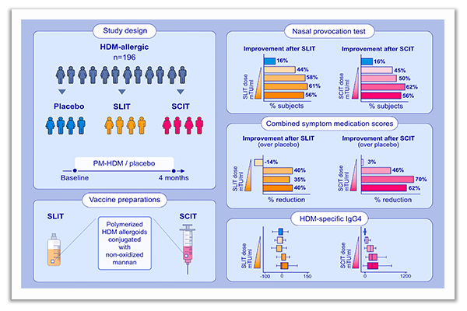
First-in-human phase 2 trial with mite allergoids coupled to mannan in subcutaneous and sublingual immunotherapy
Antonio Nieto, Ángel Mazón, María Nieto, Ethel Ibáñez, Dah-Tay Jang, et al.
Allergy. 2022; pages: 3096-3107
https://doi.org/10.1111/all.15374
© 2019 EAACI and John Wiley and Sons A/S. Published by John Wiley and Sons Ltd.
Notes:
HIGHLIGHTS
This first-in-human study evaluates safety and optimal dose of PM-HDM in SCIT and SLIT.
PM-HDM is safe and shows dose-dependent clinical efficacy outcomes in SCIT and SLIT.
A dose-response in specific IgG4 to HDM is observed in SCIT, but not SLIT.
Abbreviations: AIT, allergy immunotherapy; PM-HDM, polymerized house dust mite allergoids conjugated with mannan; SCIT, subcutaneous immunotherapy; SLIT, sublingual immunotherapy

