Slide 1
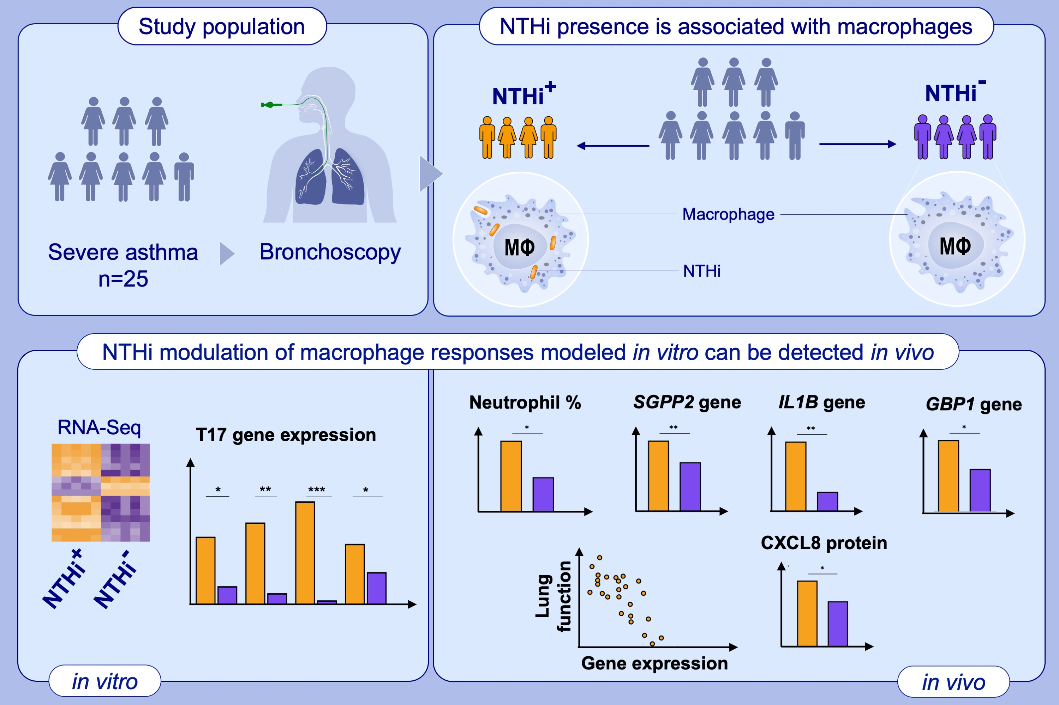
Nontypeable Haemophilus influenzae infection of pulmonary macrophages drives neutrophilic inflammation in severe asthma
Jodie Ackland, Clair Barber, Ashley Heinson, Adnan Azim, David W. Cleary, et al.
Allergy. 2022; pages: 2677-2687
https://doi.org/10.1111/all.15375
© 2019 EAACI and John Wiley and Sons A/S. Published by John Wiley and Sons Ltd.
Notes:
HIGHLIGHTS
Visualisation of NTHi presence in the severe asthmatic airway demonstrates NTHi association with BAL macrophages, suggesting a mechanism of airway persistence.
Modelling NTHi-macrophage interactions in vitro identifies upregulation of macrophage T17 responses.
NTHi modulation of airway inflammation can be detected in vivo, with BAL macrophage gene expression correlated with decreased lung function in NTHi+ patients, as well as increased neutrophilic inflammation detected in those with NTHi airway presence, suggesting that NTHi-infected macrophages may contribute to the complex chronic inflammatory environment in asthma.
Abbreviations: BAL, bronchoalveolar lavage; CXCL8, C-X-C Motif Chemokine Ligand 8; GBP1, guanylate binding protein 1; IL1B, interleukin 1 beta; NTHi, nontypeable Haemophilus influenzae; RNA-Seq, RNA sequencing; SGPP2, sphingosine-1-phosphate phosphatase 2

