Slide 1
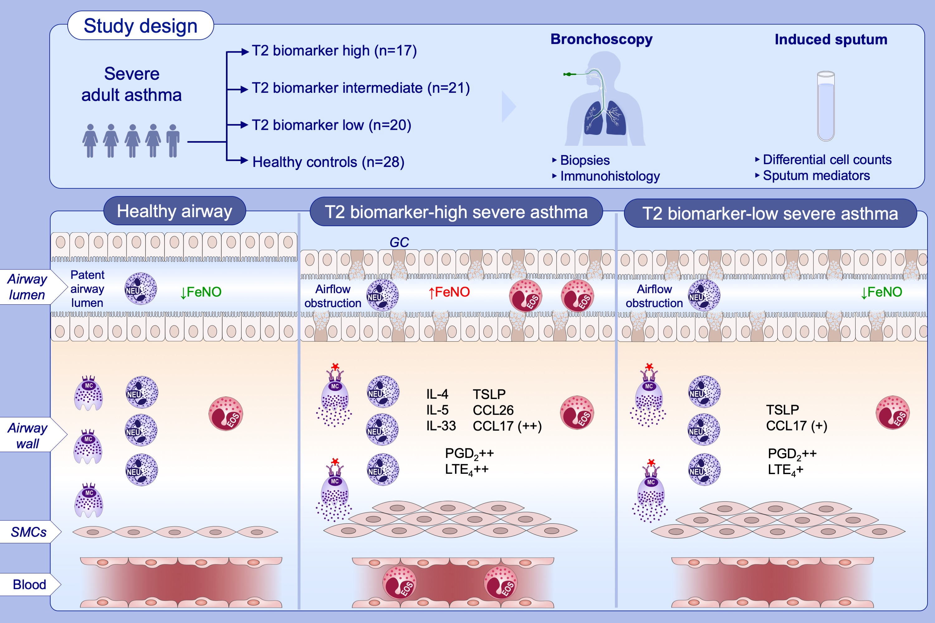
Airway remodeling rather than cellular infiltration characterizes both type 2 cytokine biomarker-high and -low severe asthma
Latifa Khalfaoui, Fiona A. Symon, Simon Couillard, Beverley Hargadon, Rekha Chaudhuri, et al.
Allergy. 2022; pages: 2974-2986
https://doi.org/10.1111/all.15376
© 2019 EAACI and John Wiley and Sons A/S. Published by John Wiley and Sons Ltd.
Notes:
HIGHLIGHTS
People with T2-high and T2-low severe asthma, and healthy controls, have similar airway tissue inflammatory cells counts, but sputum T2 cytokines persist in T2-high asthma, likely driving eosinophilic exacerbations through recruitment of blood eosinophils.
In both T2-high and T2-low asthma, extensive airway wall remodelling is present, and likely contributes to residual disease expression beyond T2 exacerbations.
As bronchoconstriction and mucus plugging are the predominant causes of airflow obstruction driving asthma symptoms, exacerbations and death, the factors that sustain these abnormal pathological features should be a priority for future research and drug development for severe asthma.
Abbreviations: CCL, C-C motif chemokine ligand; Eos, eosinophil; FeNO, fraction of exhaled nitric oxide; GC, goblet cell expressing MUC5AC; IL, interleukin; LTE₄, leukotriene E4; MC, mast cell; Neu, neutrophil; T2, type2 cytokine; PGD₂, prostaglandin D2; TSLP, thymic stromal lymphopoietin

