Slide 1
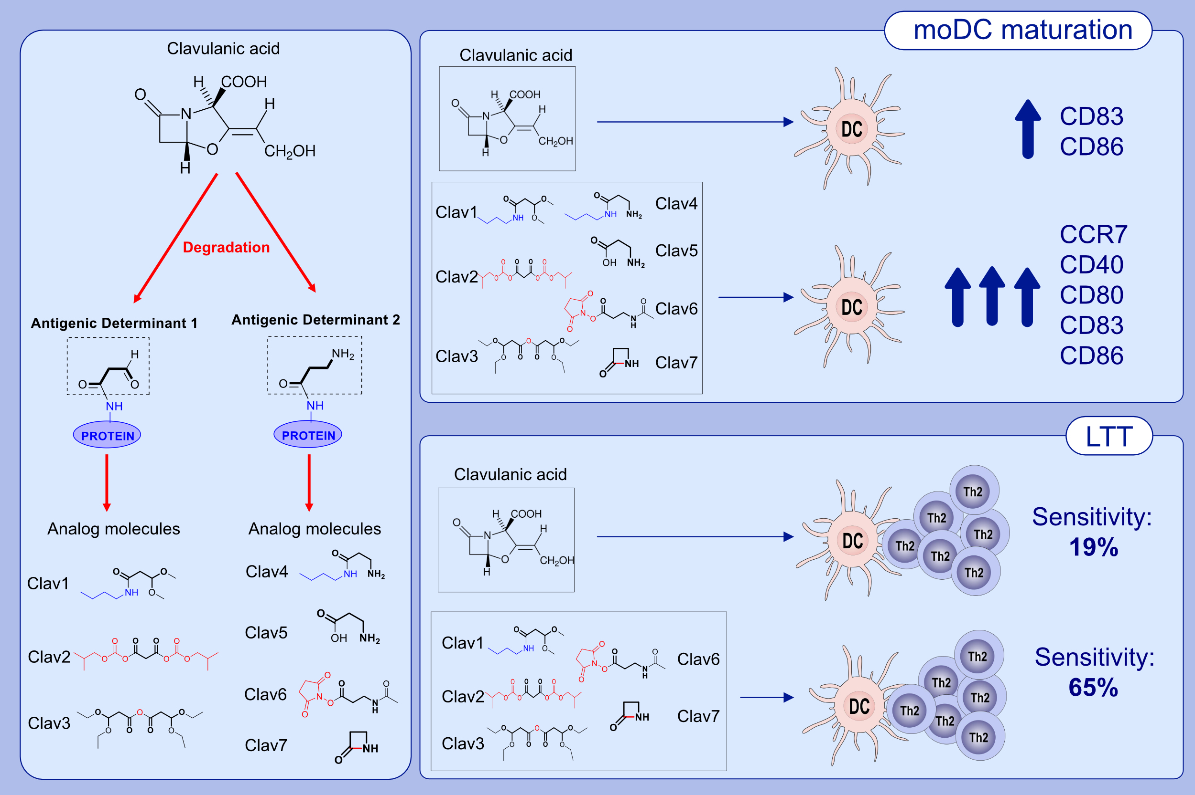
Synthetic antigenic determinants of clavulanic acid induce dendritic cell maturation and specific T cell proliferation in patients with immediate hypersensitivity reactions
Ruben Fernandez-Santamaria, Gador Bogas, Maria Isabel Montañez, Adriana Ariza, Maria Salas, et al.
Allergy. 2022; pages: 3070-3083
https://doi.org/10.1111/all.15383
© 2019 EAACI and John Wiley and Sons A/S. Published by John Wiley and Sons Ltd.
Notes:
HIGHLIGHTS
CLV synthetic antigenic determinants (AD-I and AD-II) are efficiently recognised by moDCs from CLV allergic patients.
Some CLV-ADs induce the expression of activation, maturation, and migration markers on moDCs from allergic patients.
Pre-stimulated moDCs with some CLV-ADs induces CD4⁺Th2 cell proliferation. The combination of the results from different CLV-AD analogues increases LTT sensitivity to 65%.
Abbreviations: ADs, antigenic determinants; CCR7, C-C chemokine receptor type 7; CLV, clavulanic acid; LTT, lymphocyte transformation test; moDCs, monocyte-derived dendritic cells

