Slide 1
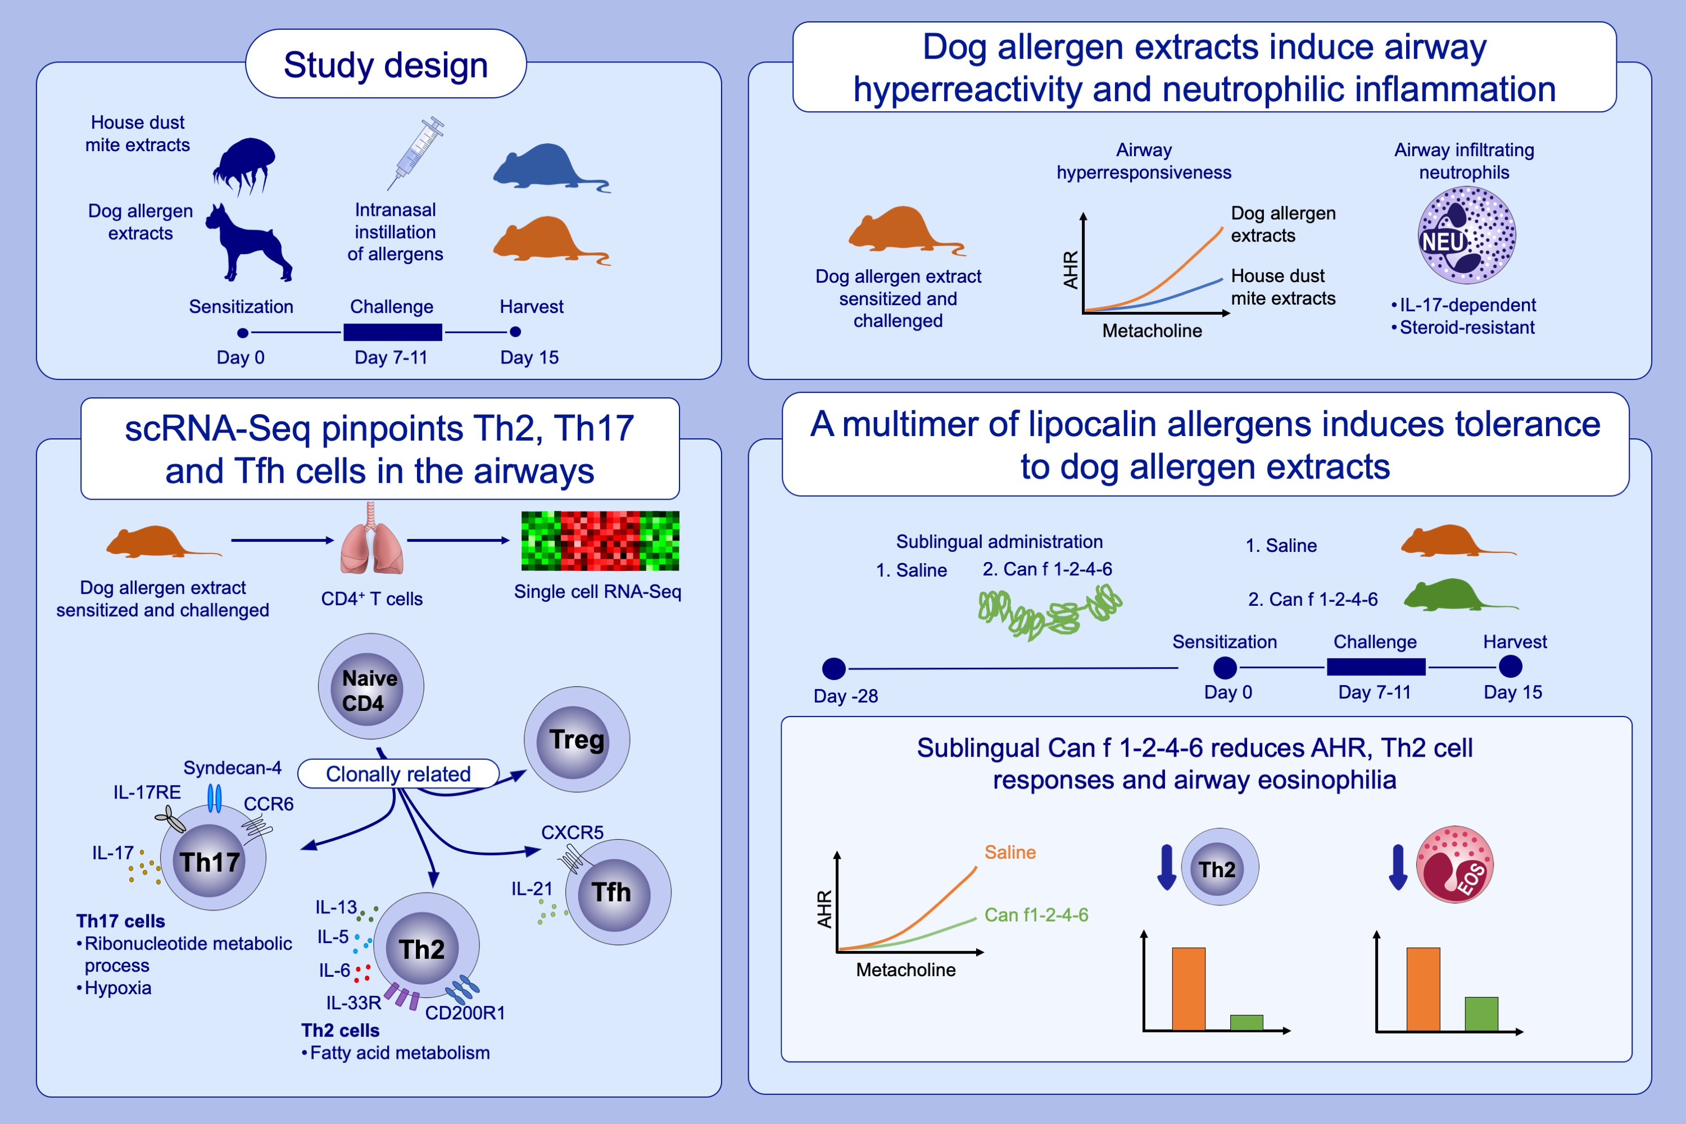
Recombinant multimeric dog allergen prevents airway hyperresponsiveness in a model of asthma marked by vigorous Th2 and Th17 cell responses
Julian M. Stark, Jielu Liu, Christopher A. Tibbitt, Murray Christian, Junjie Ma, et al.
Allergy. 2022; pages:2987-3001
https://doi.org/10.1111/all.15399
© 2019 EAACI and John Wiley and Sons A/S. Published by John Wiley and Sons Ltd.
Notes:
HIGHLIGHTS
Intranasal administration of dog allergen extracts induces airway hyperresponsiveness and robust T_{H}17 cell-driven neutrophilia.
Single cell RNA-Sequencing pinpoints distinct gene expression signatures between canonical T_{H} cell subsets and shows considerable clonal overlap between T_{H}2, T_{H}17, T_{reg} and T_{FH} cells.
A recombinant multimer of lipocalin allergens (Can f 1-2-4-6) reduces T_{H}2 cell responses and airway hyperresponsiveness when administered prophylactically.
Abbreviations: AHR, airway hyperresponsiveness; CCR6, C-C motif chemokine receptor 6; CXCR5, C-X-C chemokine receptor 5; EOS, eosinophil; IL, interleukin; NEU, neutrophil; Tfh, follicular T helper cell; Treg, regulatory T helper cell

