Slide 1
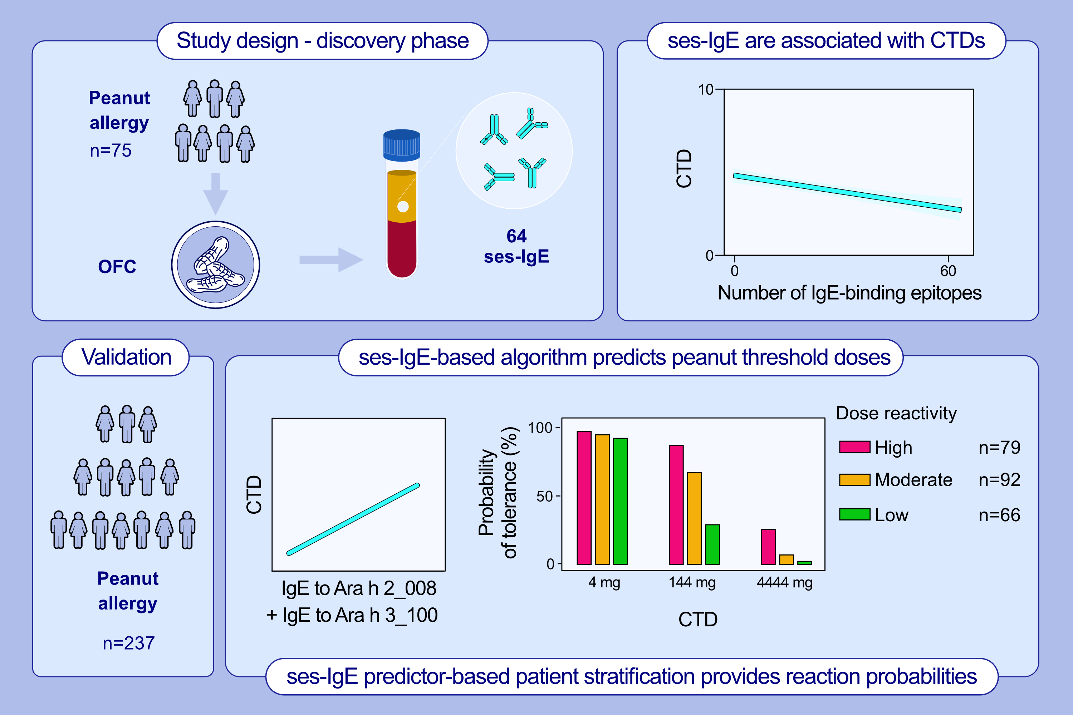
Predicting probability of tolerating discrete amounts of peanut protein in allergic children using epitope-specific IgE antibody profiling
Maria Suprun, Paul Kearney, Clive Hayward, Heather Butler, Robert Getts, , et al.
Allergy. 2022; pages:3061-3069
https://doi.org/10.1111/all.15477
© 2019 EAACI and John Wiley and Sons A/S. Published by John Wiley and Sons Ltd.
Notes:
HIGHLIGHTS
This study evaluates whether ses-IgE profiling can predict probability of tolerating discrete doses of peanut protein in allergic subjects.
There is a moderate negative correlation between the number of IgE epitopes and CTDs. The pair of ses-IgE (Ara h 2_008 and Ara h 3_100) provide the best prediction of CRD.
On average, subjects in the high-dose reactivity group are 4 times more likely to tolerate a specific dose, compared to the low-dose group.
Abbreviations: CRD, cumulative reactive dose; CTD, cumulative tolerated dose; ses-IgE, sequential (linear) epitope-specific immunoglobulin E

