Slide 1
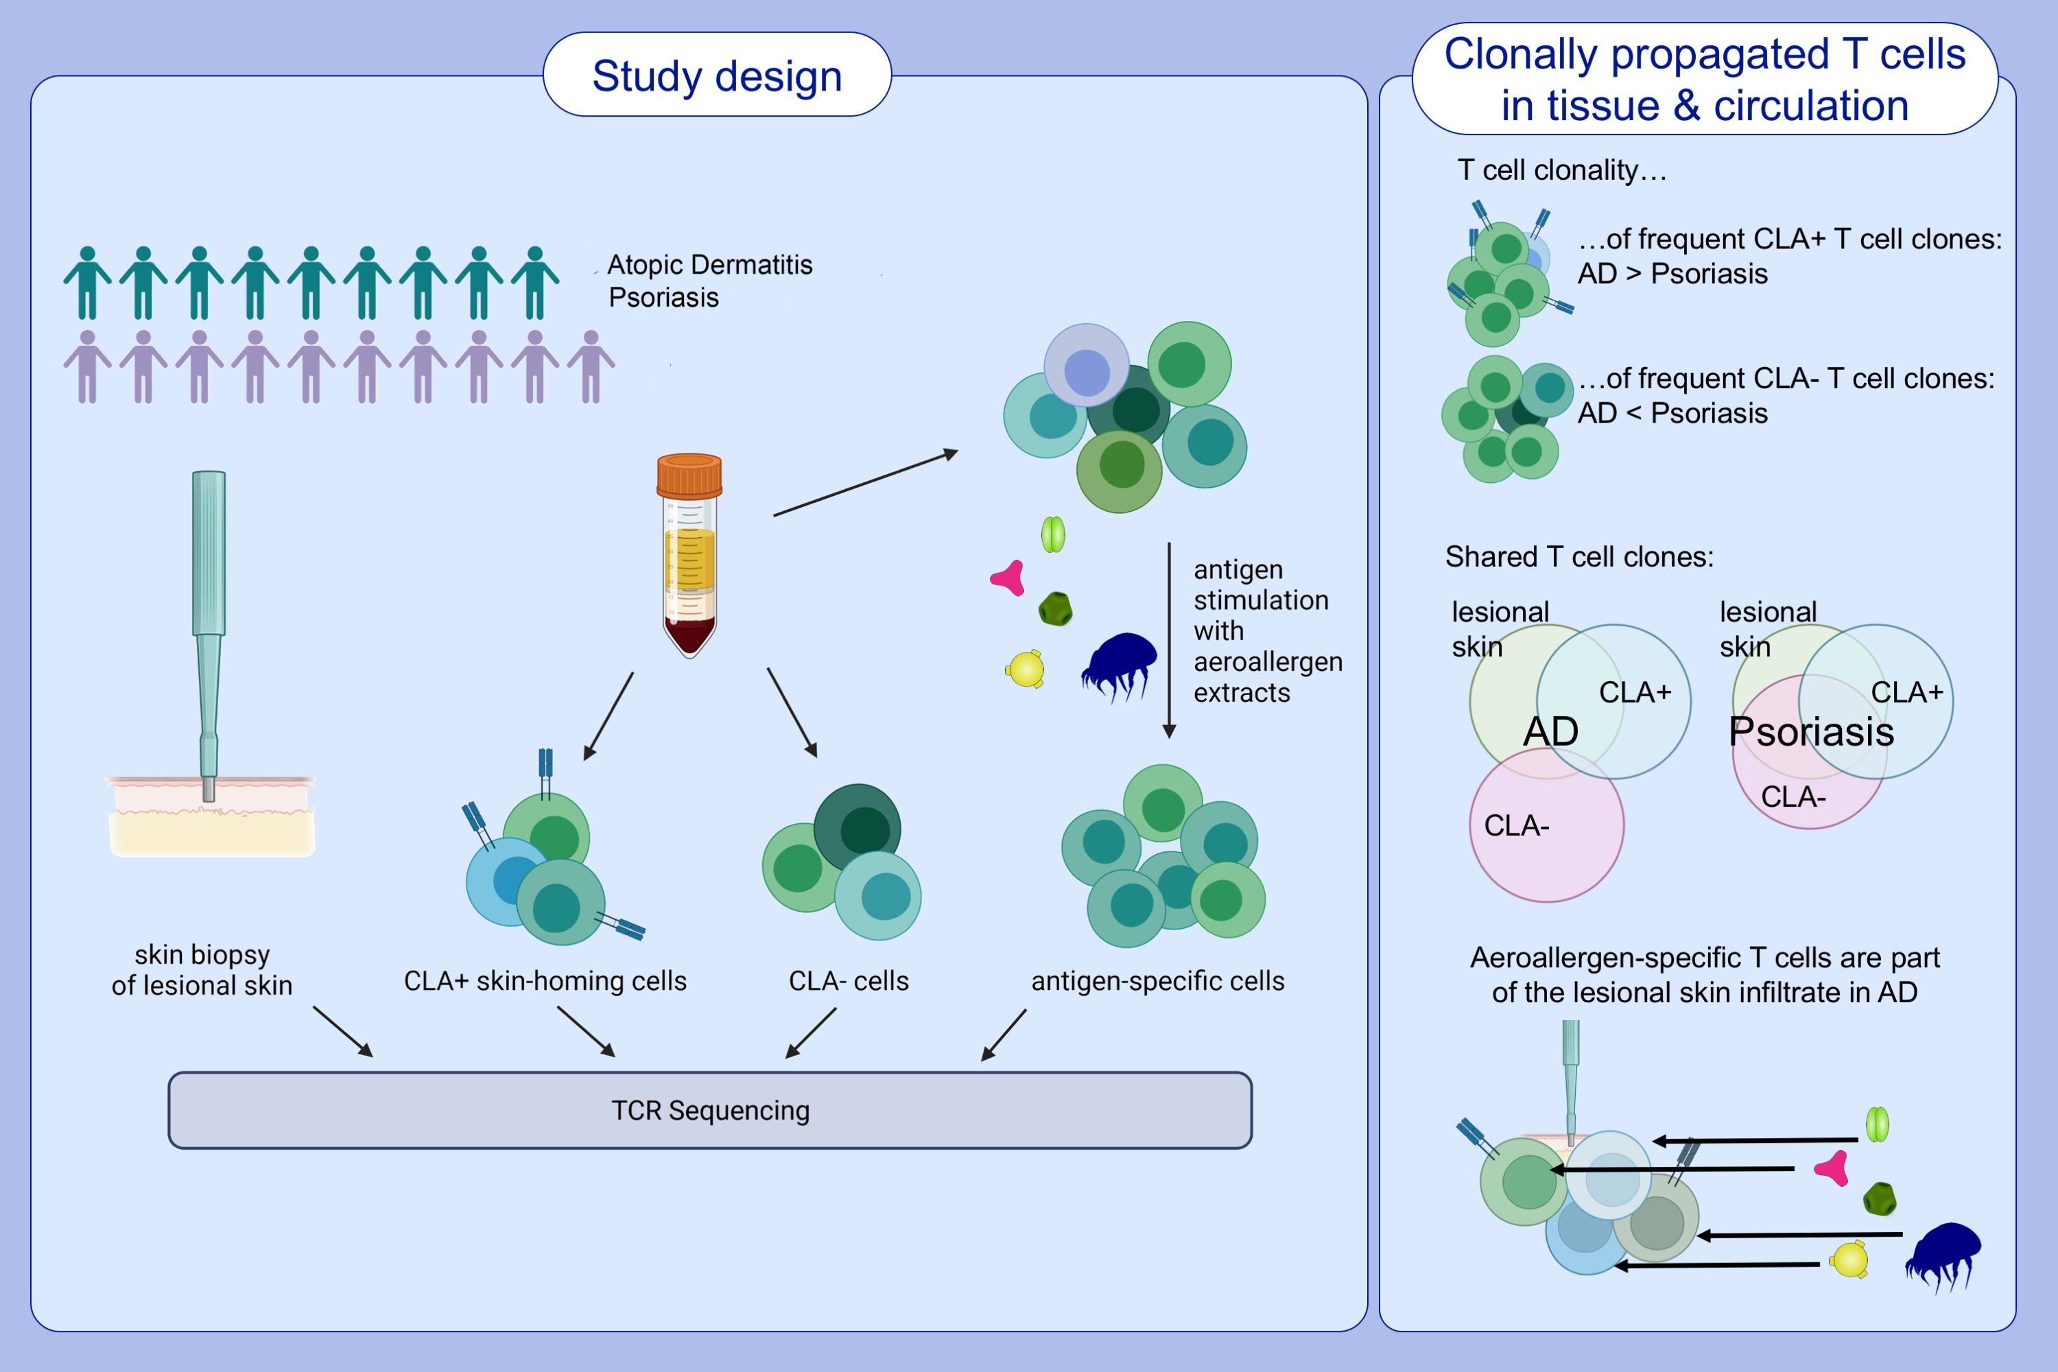
T Cell Receptor Sequencing Specifies Psoriasis As A Systemic And Atopic Dermatitis As A Skin-Focused, Allergen-Driven Disease
Lennart M. Roesner, Ahmed K. Farag, Rebecca Pospich, Stephan Traidl, Thomas Werfel
Allergy. 2022; pages: 2737-2747
https://doi.org/10.1111/all.15272
© 2019 EAACI and John Wiley and Sons A/S. Published by John Wiley and Sons Ltd.
Notes:
HIGHLIGHTS
T cell repertoires of lesional skin of AD and psoriasis are mirrored predominantly by circulating CLA⁺ T cells.
Highly clonally propagated T cells in AD lesional skin are largely derived from circulating CLA⁺ T cells, in contrast to psoriasis.
Aeroallergen-specific T cells are part of the AD skin infiltrate.
Abbreviations: AD, atopic dermatitis; CLA, cutaneous leukocyte antigen; TCR, T cell receptor

