Slide 1
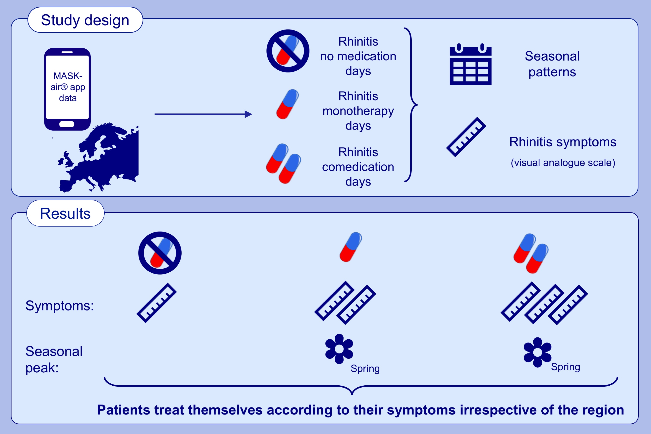
Behavioural patterns in allergic rhinitis medication in Europe: A study using MASK air ® real-world data
Bernardo Sousa-Pinto, Ana Sá-Sousa, Rafael José Vieira, Rita Amaral, Ludger Klimek, et al.
Allergy. 2022; pages: 2699-2711
https://doi.org/10.1111/all.15275
© 2019 EAACI and John Wiley and Sons A/S. Published by John Wiley and Sons Ltd.
Notes:
HIGHLIGHTS
This study aims to assess allergic rhinitis co-medication and its regional patterns in Europe, using real-world data.
Patients tend to treat themselves for allergic rhinitis according to their symptoms rather than according to guidelines' indications.
Medication patterns in patients with allergic rhinitis appear to be similar across European regions.

