Slide 1
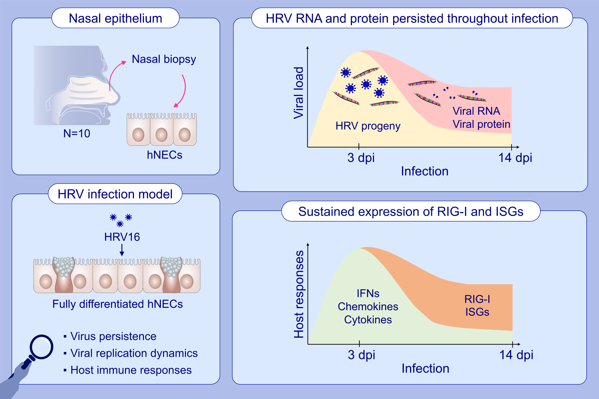
Transcriptomics of rhinovirus persistence reveals sustained expression of RIG-I and interferon-stimulated genes in nasal epithelial cells in vitro
Hsiao Hui Ong, Anand Kumar Andiappan, Kaibo Duan, Josephine Lum, Jing Liu, et al.
Allergy. 2022; pages: 2778-2793
https://doi.org/10.1111/all.15280
© 2019 EAACI and John Wiley and Sons A/S. Published by John Wiley and Sons Ltd.
Notes:
HIGHLIGHTS
Infectious HRV progeny was produced during acute infection but subsided during prolonged infection
Expression of viral RNA and viral protein was sustained throughout prolonged infection
IFNs, chemokines and cytokines expression were reduced alongside with reduced virus progeny production, while persistence of HRV RNA induced sustained expression of RIG-I and ISGs during prolonged infection
Abbreviation: dpi, days post infection; hNECS, human nasal epithelial cells; HRV, human rhinovirus; IFN, interferon; ISGs, interferon-stimulated genes; RIG-I, retinoic acid-inducible gene I.

