Slide 1
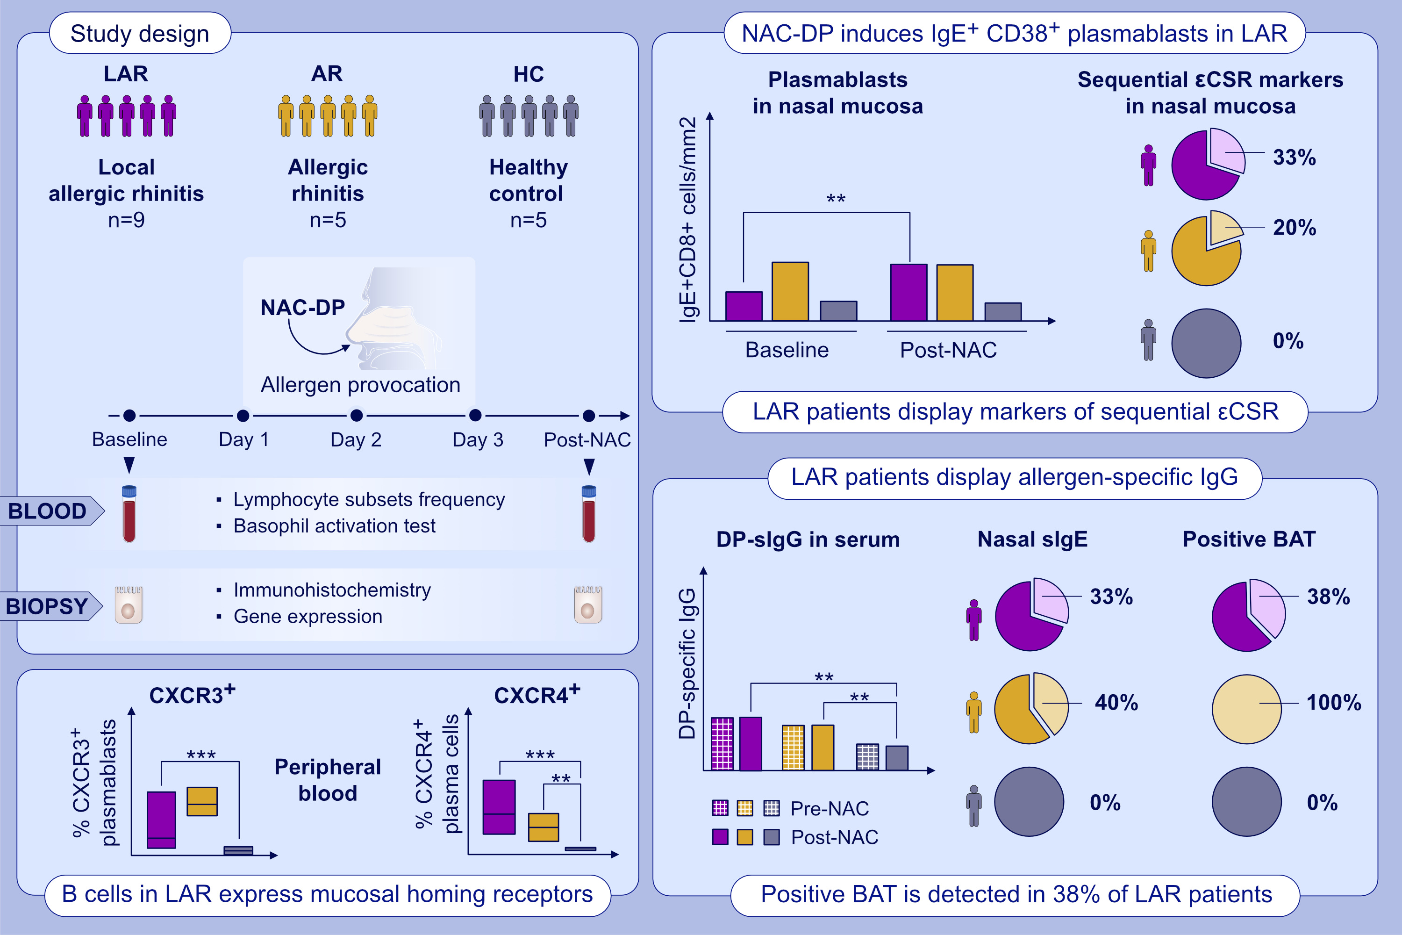
Sequential class switch recombination to IgE and allergen-induced accumulation of IgE+ plasmablasts occur in the nasal mucosa of local allergic rhinitis patients
Almudena Testera-Montes, Francisca Palomares, Raquel Jurado-Escobar, Ruben Fernandez-Santamaria, et al.
Allergy. 2022; pages: 2712-2724
https://doi.org/10.1111/all.15292
© 2019 EAACI and John Wiley and Sons A/S. Published by John Wiley and Sons Ltd.
Notes:
HIGHLIGHTS
Allergen exposure induces the accumulation of IgE+ plasmablasts in the nasal mucosa of LAR patients.
LAR patients display markers of sequential class switch recombination to IgE (IgM->IgG->IgE) in the nasal mucosa.
LAR patients can have allergen-specific (s)IgE attached to the membrane of peripheral basophils and a higher level of serum sIgG than healthy individuals.
Abbreviations: BAT, basophil activation test; εCSR, class switch recombination to IgE; CXCR, C-X-C motif chemokine receptors; NAC-DP, nasal allergen challenge with Dermatophagoides pteronyssinus

