Slide 1
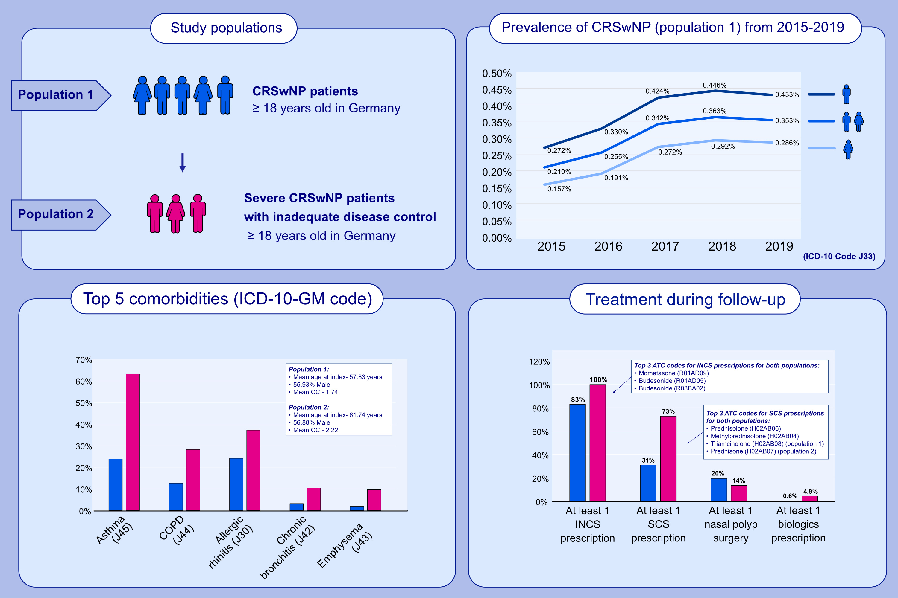
Epidemiology and treatment of patients with Chronic rhinosinusitis with nasal polyps in Germany - A claims data study
Alexandra Starry, Fraence Hardtstock, Thomas Wilke, Julia Weihing, Bernhard Ultsch, et al.
Allergy. 2022; pages: 2725-2736
https://doi.org/10.1111/all.15301
© 2019 EAACI and John Wiley and Sons A/S. Published by John Wiley and Sons Ltd.
Notes:
HIGHLIGHTS
A German claims data analysis was conducted on adult CRSwNP patients and severe CRSwNP patients with inadequate disease control.
The 5-year prevalence (2015-2019) of CRSwNP patients was about 5,500 per million; 83.00% received INCS, 31.32% systemic corticosteroid SCS, and 19,73% surgery.
Severe CRSwNP with inadequate disease control affects about 200 per million.
Abbreviations: ATC, anatomical therapeutic chemical classification system; CCI, Charlson comorbidity index; COPD, chronic obstructive pulmonary disease; CRSwNP, chronic rhinosinusitis with nasal polyps; ICD-10-GM, the international statistical classification of diseases and related health problems, 10th revision, german modification; INCS, intranasal corticosteroids; SCS, systemic corticosteroids

