Slide 1
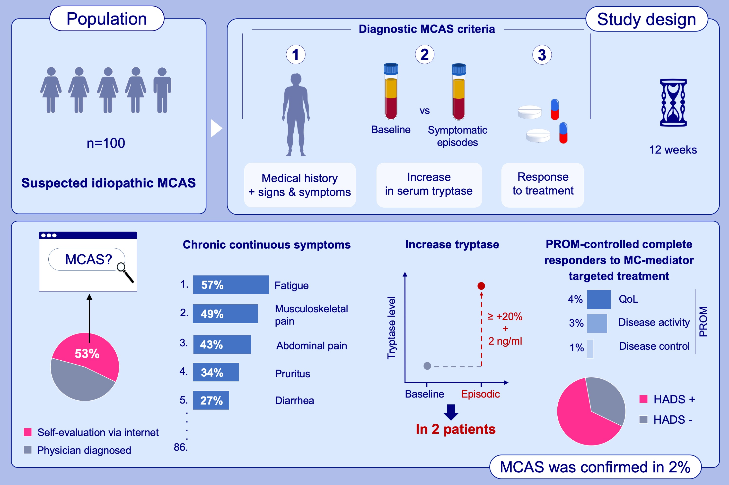
Idiopathic mast cell activation syndrome is more often suspected than diagnosed – A prospective real-life study
Thomas Buttgereit, Sophie Gu, Leonor Carneiro-Leão, Annika Gutsche, Marcus Maurer, Frank Siebenhaar
Allergy. 2022; pages: 2794-2802
https://doi.org/10.1111/all.15304
© 2019 EAACI and John Wiley and Sons A/S. Published by John Wiley and Sons Ltd.
Notes:
HIGHLIGHTS
100 patients with suspected idiopathic MCAS were investigated for the diagnostic criteria over the course of 12 weeks.
Suspicion of MCAS was frequently based on self-evaluation. 87 different, mainly chronic continuous symptoms were reported. Two patients had increased tryptase levels following a symptomatic episode; very few benefited from MC – targeted treatment.
Psychiatric morbidity was frequent.
Abbreviations: HADS, hospital anxiety and depression scale; MC, mast cell; MCAS, mast cell activation syndrome; QoL, quality of life; PROM, patient reported outcome measure

