Slide 1
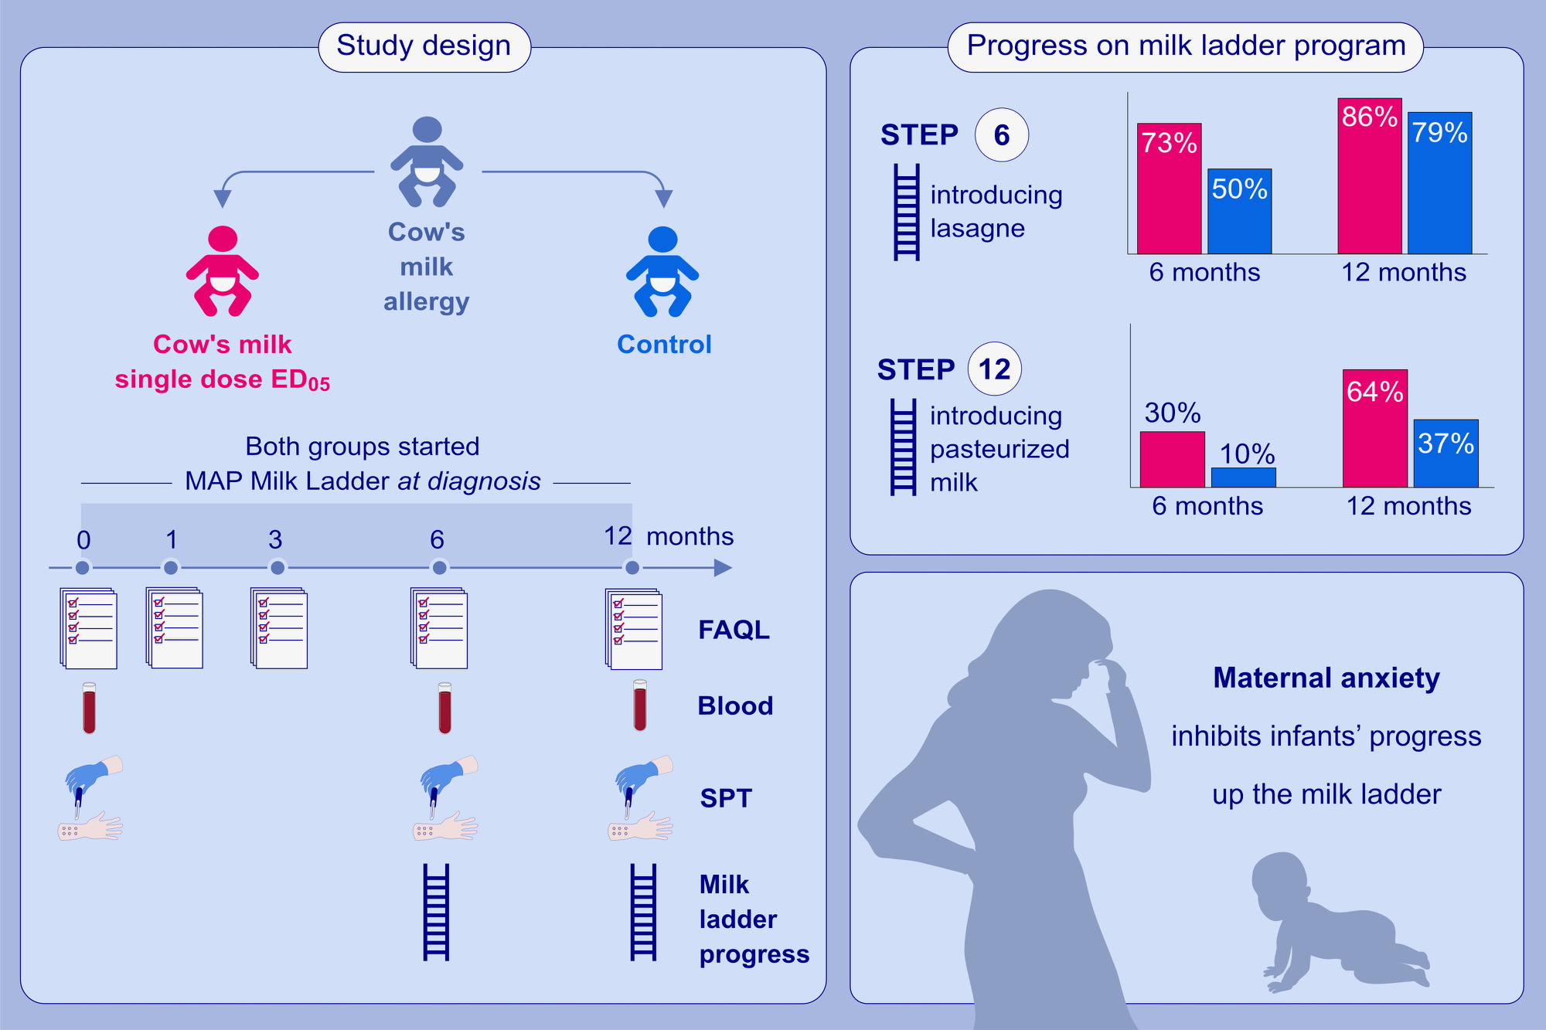
Single low-dose exposure to cow’s milk at diagnosis accelerates cow’s milk allergic infants’ progress on a milk ladder programme
Yvonne M. d’Art, Lisa Forristal, Aideen M. Byrne, John Fitzsimons, Ronald van Ree, et al.
Allergy. 2022; pages: 2760-2769
https://doi.org/10.1111/all.15312
© 2019 EAACI and John Wiley and Sons A/S. Published by John Wiley and Sons Ltd.
Notes:
HIGHLIGHTS
This study evaluates the impact on gradual home introduction of foods containing cow’s milk after a supervised, single low dose exposure to whole milk at time of diagnosis.
Step 6 or above on the milk ladder was reached by 73% intervention subjects and 50% control subjects. Step 12 was reached by 6 month by 30% intervention subjects and 10% of the controls.
Babies of mothers with higher levels of maternal anxiety at baseline made poorer progress on the milk ladder during the 12-month study period.
Abbreviations: ED₀₅, eliciting dose for 5% of subjects tested; FAQL, food allergy related quality of life; MAP, milk allergy in primary care guideline; SPT, skin prick test

