Slide 1
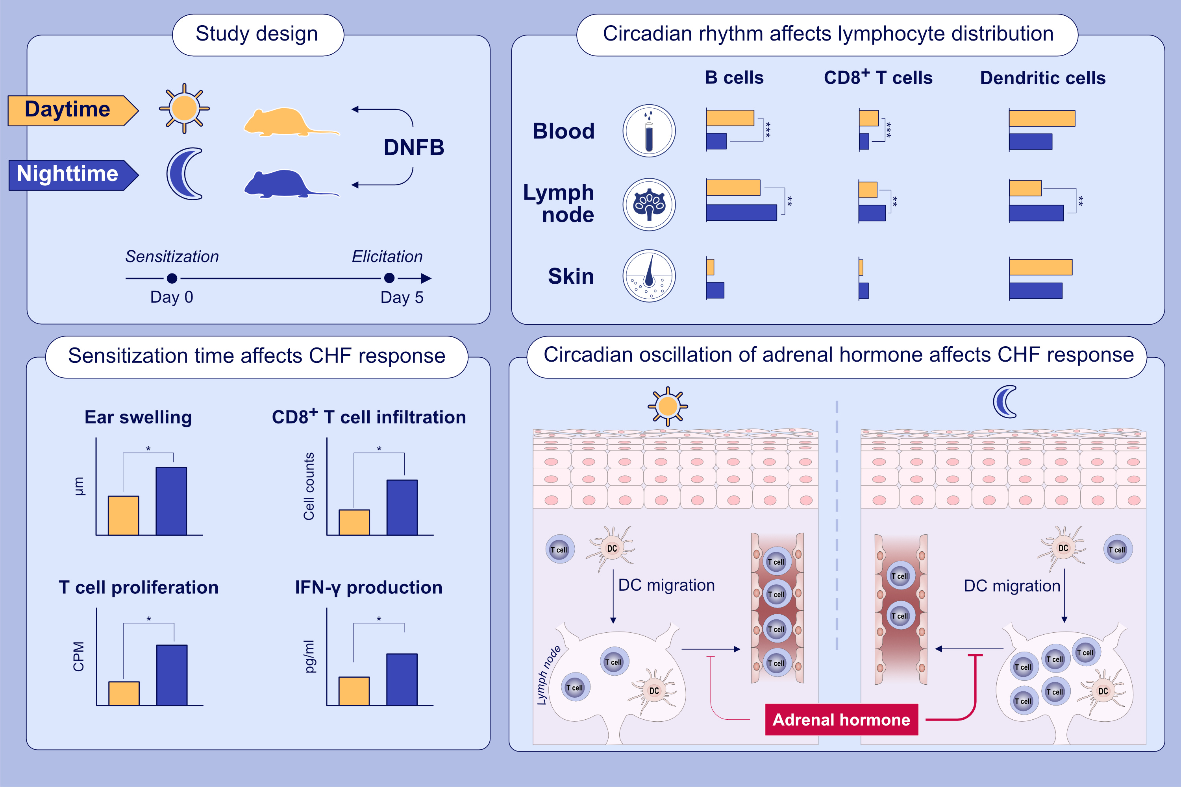
Circadian rhythm affects the magnitude of contact hypersensitivity response in mice
Toshiya Miyake, Gyohei Egawa, Zachary Chow, Ryota Asahina, Masayuki Otsuka, et al.
Allergy. 2022; pages: 2748-2759
https://doi.org/10.1111/all.15314
© 2019 EAACI and John Wiley and Sons A/S. Published by John Wiley and Sons Ltd.
Notes:
HIGHLIGHTS
The severity of CHS response increases when mice were sensitized at night compared with those sensitized in the daytime.
Cell proliferation and cytokine production in the draining lymph nodes are promoted in mice sensitized at night.
Leukocyte distribution in the body shows diurnal oscillation.
Abbreviations: CHS, contact hypersensitivity, CPM, counts per minute; DC, dendritic cell; DNFB, dinitrofluorobenzene; IFN-γ, interferon-γ

