Slide 1
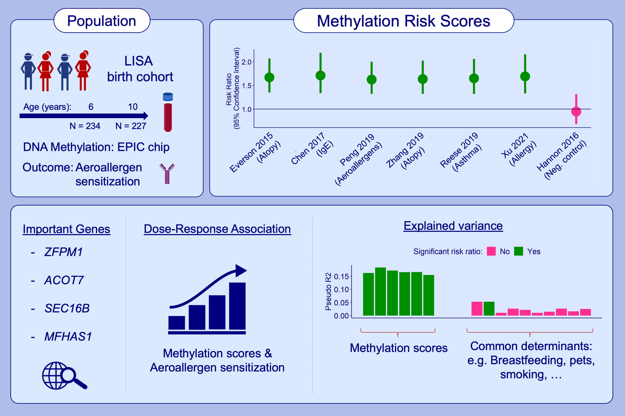
Methylation risk scores for childhood aeroallergen sensitization: Results from the LISA birth cohort
Anna Kilanowski, Junyu Chen, Todd Everson, Elisabeth Thiering, Rory Wilson, et al.
Allergy. 2022; pages: 2803-2817
https://doi.org/10.1111/all.15315
© 2019 EAACI and John Wiley and Sons A/S. Published by John Wiley and Sons Ltd.
Notes:
HIGHLIGHTS
We calculated six MRS for allergy-related phenotypes and present their association with childhood aeroallergen sensitization.
All six allergy-related MRS were highly correlated and seven CpGs were overlapping between the MRS, all located in genes associated with allergic diseases.
A clear dose-response relationship with levels of aeroallergen sensitization could be established cross-sectionally, but not prospectively.
Abbreviations: ACOT7, acyl-CoA thioesterase 7; CpG, cytosine–guanosine dinucleotide; LISA, influence of life-style factors on development of immune system and allergies in east and west Germany study; MFHAS1, multifunctional ROCO family signaling regulator; MRS, methylation risk score; SEC16B, SEC16 homolog B, endoplasmic reticulum export factor; ZFPM1, zinc finger protein, FOG family member 1

