Slide 1
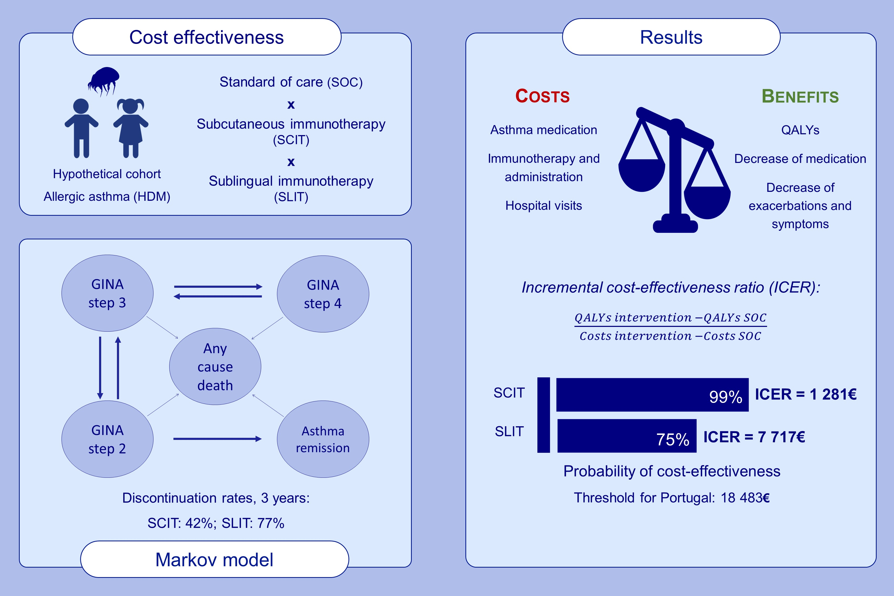
Cost-effectiveness analysis of house dust mite allergen immunotherapy in children with allergic asthma
Mariana Farraia, Inês Paciência, Francisca Castro Mendes, João Cavaleiro Rufo, Mohamed H. Shamji, et al.
Allergy. 2022; pages: 2688-2698
https://doi.org/10.1111/all.15321
© 2019 EAACI and John Wiley and Sons A/S. Published by John Wiley and Sons Ltd.
Notes:
HIGHLIGHTS
We used a Markov model, based on GINA steps, to compare the cost-effectiveness of subcutaneous and sublingual tablets immunotherapy against standard of care in children with house dust mite allergic asthma.
Both therapies diminished asthma medication and exacerbations while quality of life increased.
Both therapies were cost-effective, but SCIT showed a higher probability of cost-effectiveness.
Abbreviations: GINA, global initiative for asthma; HDM, house dust mite; ICER, incremental cost-effectiveness ratio; QALYs, quality-adjusted life-years; SCIT, subcutaneous immunotherapy; SLIT, sublingual immunotherapy; SOC, standard of care
­­

