Slide 1
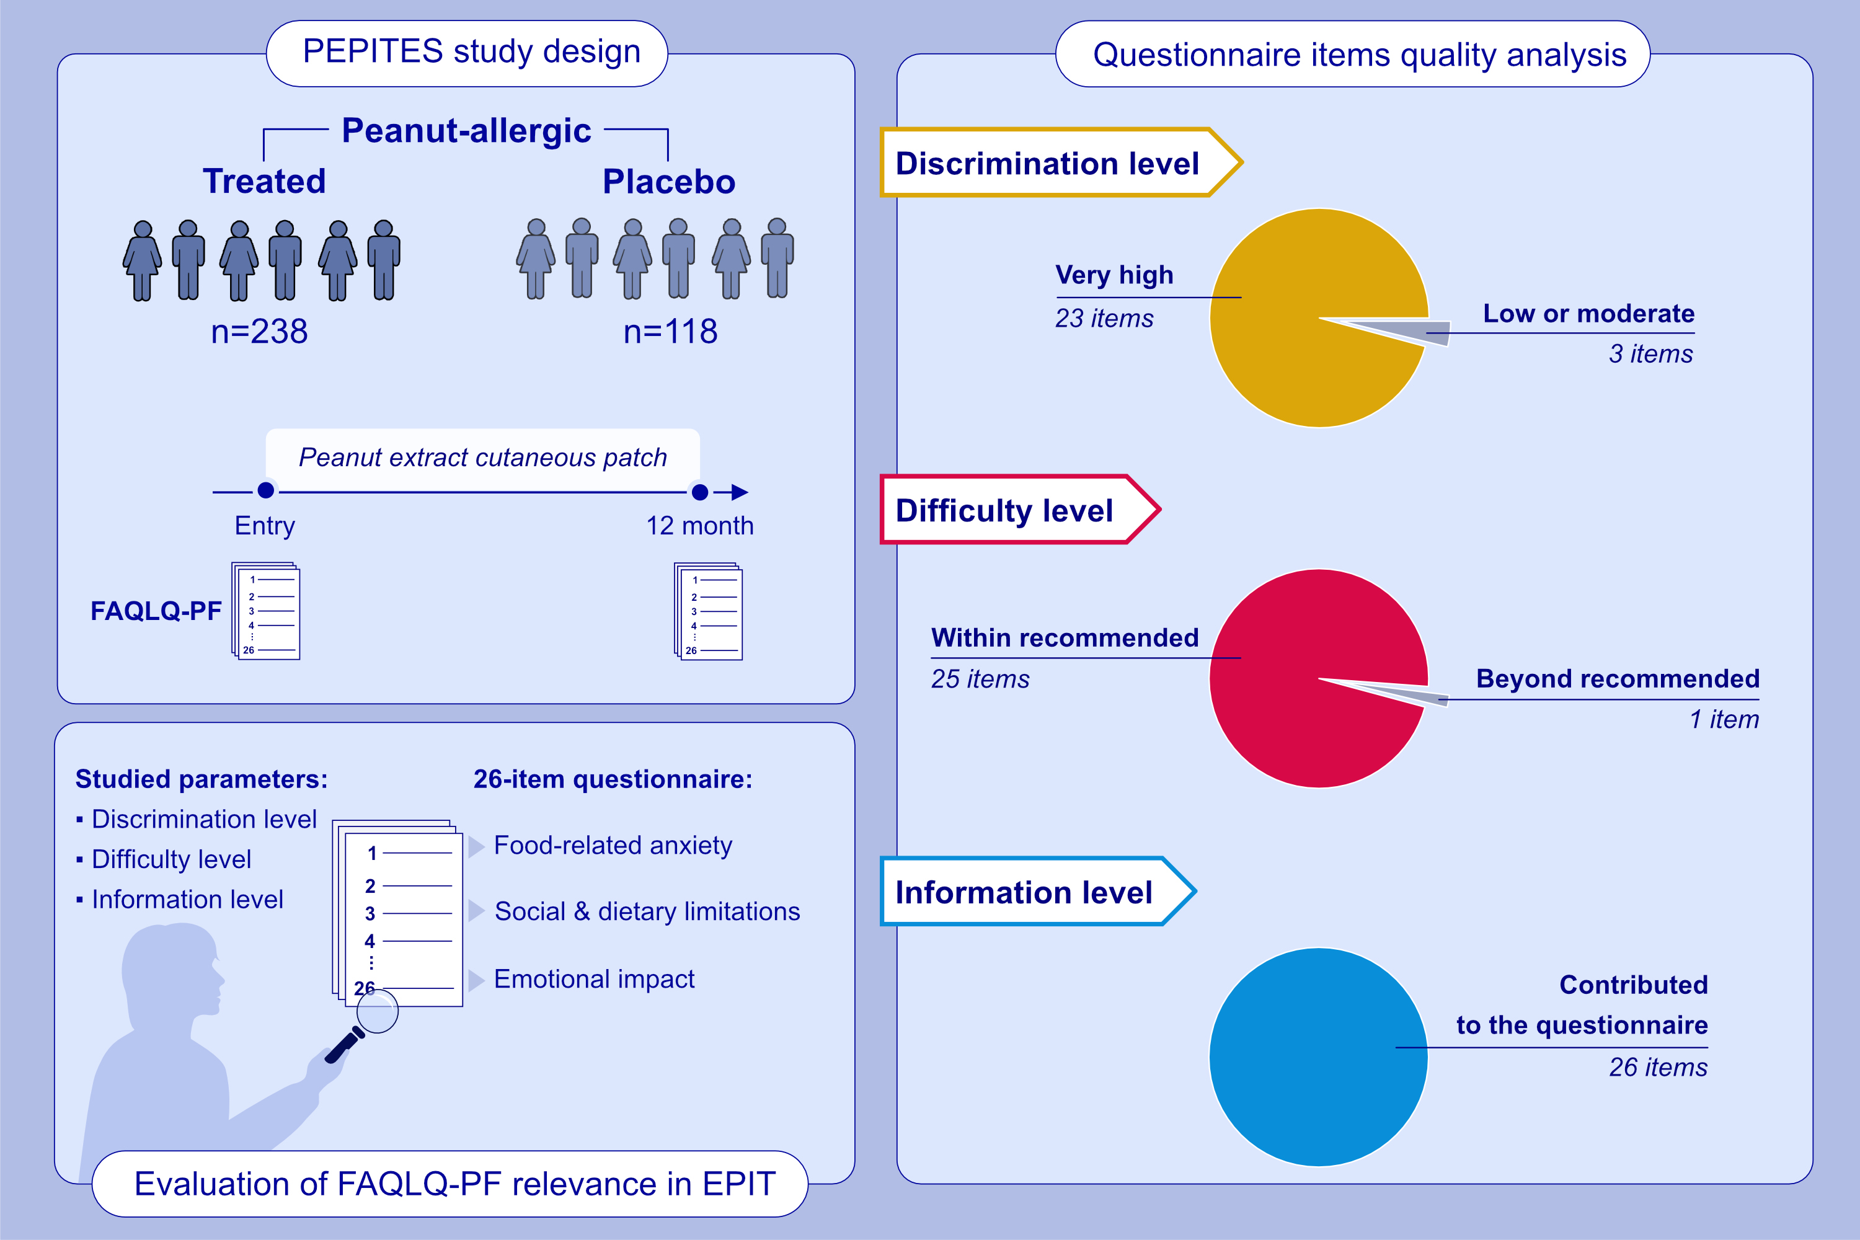
Psychometric Parameters of Food Allergy Quality of Life During an Allergen Immunotherapy Trial
Gabriel Lins de Holanda Coelho, Audrey DunnGalvin, Matthew Greenhawt, Jonathan O'B Hourihane, David M. Fleischer, et al.
Allergy. 2022; pages: 2770-2777
https://doi.org/10.1111/all.15323
© 2019 EAACI and John Wiley and Sons A/S. Published by John Wiley and Sons Ltd.
Notes:
HIGHLIGHTS
We examined the item parameters of the FAQLQ - Parental form, using a sample
of parents of children engaged in an EPIT clinical trial.
23 of 26 items presented very high discrimination levels; 25 fell within the recommended difficulty threshold; all 26 items were associated with reasonable information level.
The tool is suitable for longitudinal measurements in food allergy treatment trials.
Abbreviations: EPIT, epicutaneous immunotherapy; FAQLQ-PF, Food Allergy Quality of Life Questionnaire-Parent Form; PEPITES, Efficacy and Safety of Viaskin Peanut in Children With Immunoglobulin E (IgE)-Mediated Peanut Allergy

