Slide 1
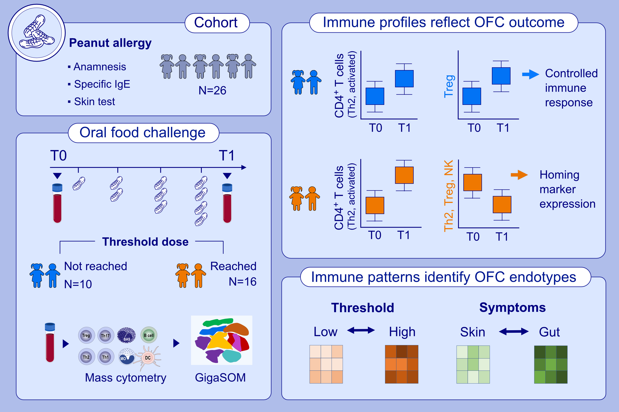
High-dimensional immune profiles correlate with phenotypes of peanut allergy during food-allergic reactions
Julia Klueber, Rebecca Czolk, Françoise Codreanu-Morel, Guillem Montamat, Dominique Revets, , et al.
Allergy. 2023; pages:1020-1035
https://doi.org/10.1111/all.15408
© 2019 EAACI and John Wiley and Sons A/S. Published by John Wiley and Sons Ltd.
Notes:
HIGHLIGHTS
Changes of peripheral immune profiles through OFC-course distinguish negative from positive outcome based on Th2/non-Th2 phenotypes.
Symptom development correlates with inflammatory immune cell decrease and tissue migration characterized by homing marker expression.
Discriminatory immune signatures reflect clinical endotypes of threshold dose reactivity and organ involvement.
Abbreviation: GigaSOM, computational analysis tool for unsupervised clustering and dimension reduction; NK, natural killer cell; OFC, oral food challenge; Th, T helper cell; Treg, regulatory T cell

