Slide 1
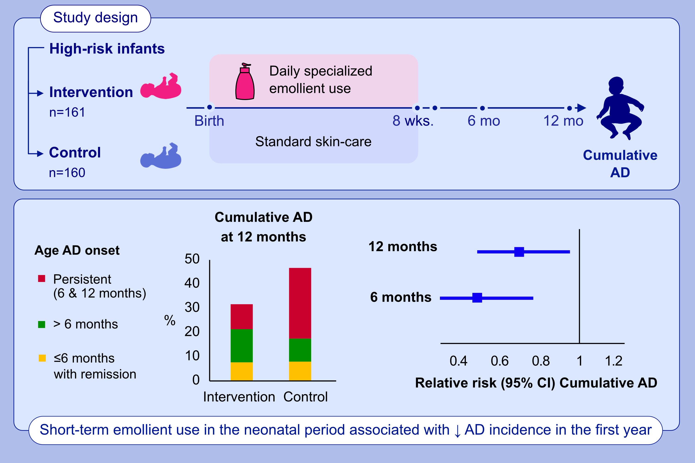
Early initiation of short-term emollient use for the prevention of atopic dermatitis in high risk infants – the STOP AD randomised controlled trial
Carol Ní Chaoimh, Dhanis Lad, Claudio Nico, Gerwin J. Puppels, X. F. Colin C. Wong, et al.
Allergy. 2023; pages: 984-994
https://doi.org/10.1111/all.15491
© 2019 EAACI and John Wiley and Sons A/S. Published by John Wiley and Sons Ltd.
Notes:
HIGHLIGHTS
This randomized controlled trial investigates if daily emollient use from birth to 2 months can reduce the incidence of AD in high risk infants.
The cumulative incidence of AD at 12 months is 32.8% in the intervention group vs. 46.4% in the control group.
A short-term intervention involving early initiation (within 4 days of birth) of daily specialized emollient use until 8 weeks is associated with an approximately 50% and 29% lower risk of cumulative AD at 6 and 12 months, respectively.
Abbreviations: AD, atopic dermatitis; CI, confidence interval; mo, month; wks, weeks

