Slide 1
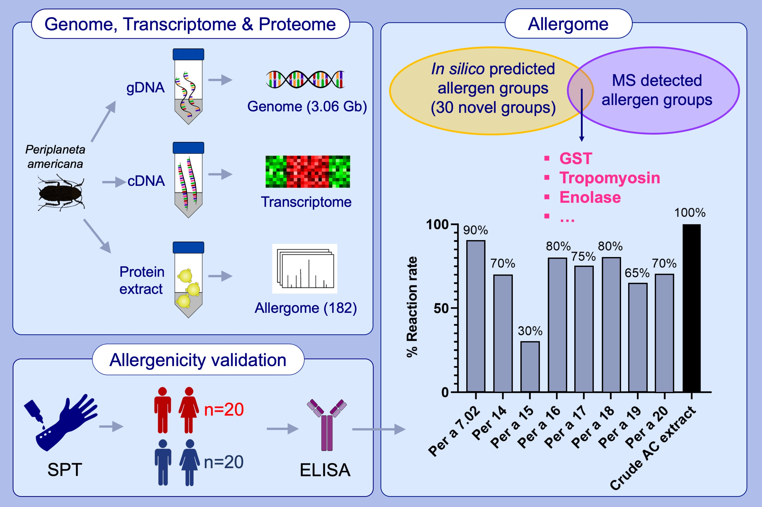
Genome assembly and annotation of Periplaneta americana reveal a comprehensive cockroach allergen profile
Lingyi Wang, Qing Xiong, Nawannaporn Saelim, Lin Wang, Wenyan Nong,et al.
Allergy. 2023; pages: 1088-1103
https://doi.org/10.1111/all.15531
© 2019 EAACI and John Wiley and Sons A/S. Published by John Wiley and Sons Ltd.
Notes:
HIGHLIGHTS
Our high-quality genome (3.06 Gb) and precisely annotated proteome (29,939) of the American cockroach help revealed a broader allergen spectrum.
Seven novel allergen groups Per a 14 to Per a 20 and one isoallergens (Per a 7.02), were validated using ELISA in Thai cohort.
Comparative analysis of P. americana with the closely related Blattodea species revealed the possibility of cross-reaction.
Abbreviations: ELISA, enzyme-linked immunosorbent assay; gDNA, genomic DNA; GST, glutathione S-transferases; SPT, skin prick test; MS, mass spectrometry

