Slide 1
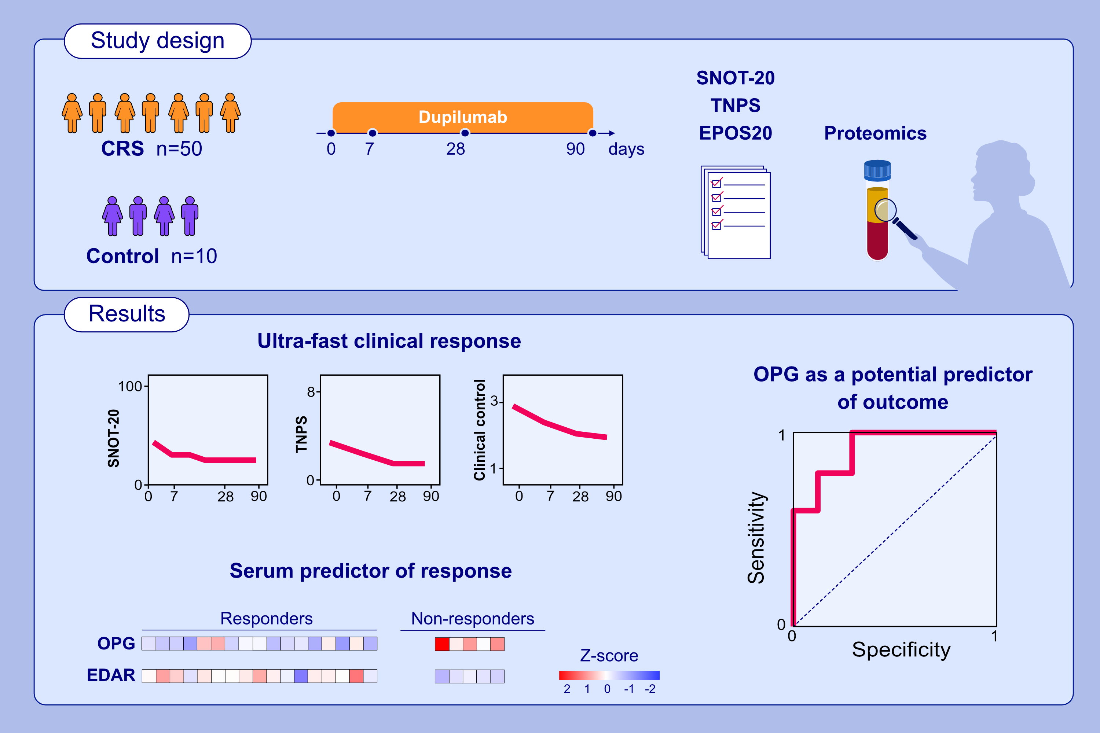
Predicting Dupilumab Treatment Outcome in Patients with Primary diffuse Type 2 Chronic Rhinosinusitis
Michael B. Soyka, Fabio S. Ryser, Catrin Brühlmann, Danielle Fehr, Jacqueline Dülgeroglu, et al.
Allergy. 2023; pages: 1036-1046
https://doi.org/10.1111/all.15532
© 2019 EAACI and John Wiley and Sons A/S. Published by John Wiley and Sons Ltd.
Notes:
HIGHLIGHTS
This study identifies clinical and serological markers associated with a treatment response to dupilumab in patients suffering from uncontrolled CRS.
Both SNOT-20 and TNPS show significant decrease 7 days after the first injection
and the positive effect is sustained during the 3-month follow-up.
Proteomics analysis reveals downregulation of OPG and upregulation of EDAR
in patients who responded well to treatment. Serum levels of OPG in dupilumab-treated patients may serve as a predictor of the clinical outcome.
Abbreviations: CRS, chronic rhinosinusitis; EDAR, ectodysplasin A receptor; OPG, osteoprotegrin; SNOT-20, sino-nasal outcome test-20; TNPS, total nasal polyp score

