Slide 1
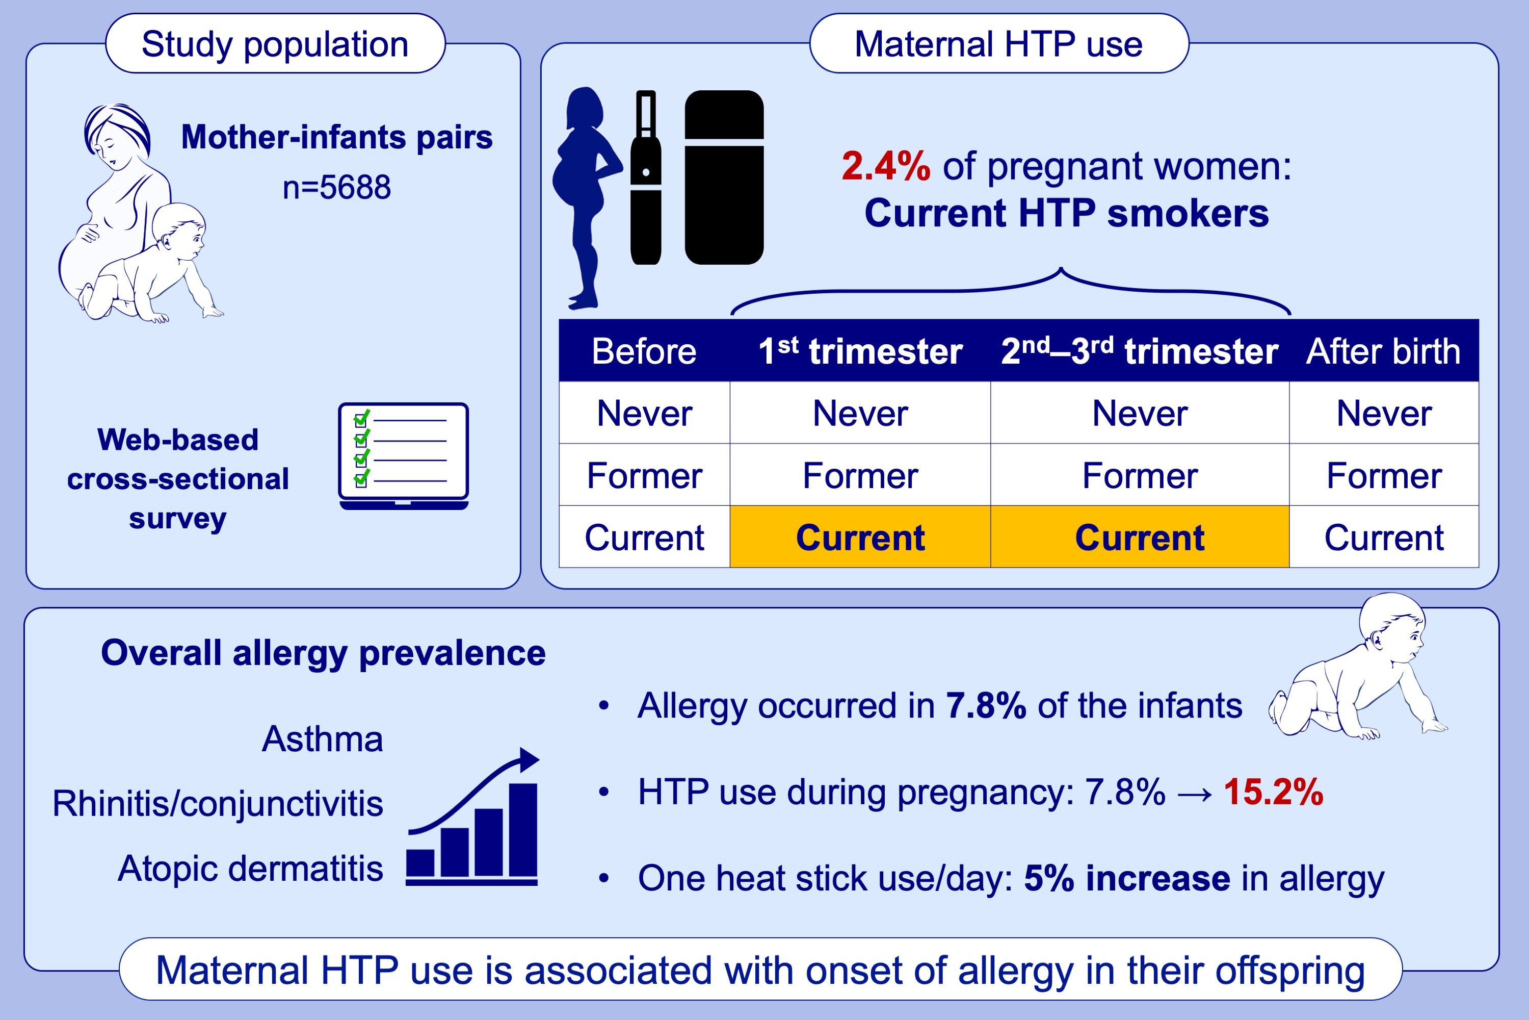
Maternal heated tobacco product use during pregnancy and allergy in offspring
Masayoshi Zaitsu, Kenta Kono, Yoshihiko Hosokawa, Manabu Miyamoto, Keiko Nanishi et al.
Allergy. 2023; pages:1104-1112
https://doi.org/10.1111/all.15536
© 2019 EAACI and John Wiley and Sons A/S. Published by John Wiley and Sons Ltd.
Notes:
HIGHLIGHTS
We sought to determine whether maternal HTP smoking is associated with allergy in their offspring.
Overall, 2.4% women smoked HTPs during pregnancy. Allergy occurred in 7.8% of the infants.
The onset of allergy increased among the infants of current HTP smokers during pregnancy at 15.2%, with a dose-response association (a 5% increase in allergy onset by one heat stick use/day).
Abbreviation: HTP, heated tobacco product.

