Slide 1
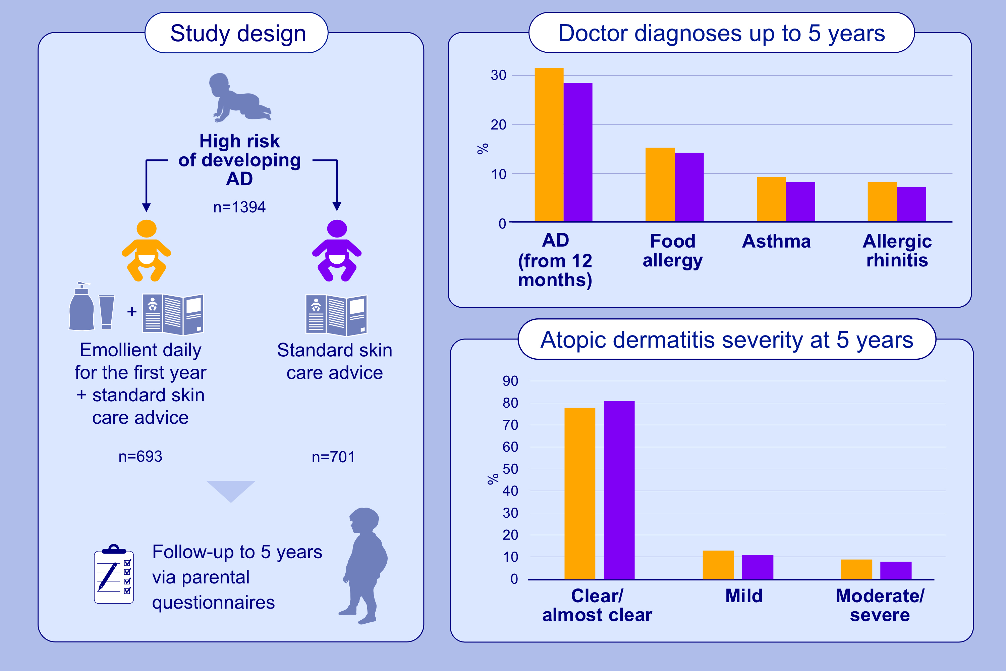
Emollients for prevention of atopic dermatitis; 5-year findings from the BEEP randomised trial
Lucy E. Bradshaw, Laura A. Wyatt, Sara J. Brown, Rachel H. Haines, Alan A. Montgomery, et al.
Allergy. 2023; pages:477-487
https://doi.org/10.1111/all.15555
© 2019 EAACI and John Wiley and Sons A/S. Published by John Wiley and Sons Ltd.
Notes:
HIGHLIGHTS
1394 newborns at high risk of atopic dermatitis randomised to either daily emollients (Doublebase Gel (Dermal Laboratories) or Diprobase Cream (Bayer)) for 12 months or standard skin care advice.
Regular emollients did not prevent atopic dermatitis, food allergy, asthma or allergic rhinitis during the first 5 years of life.
Severity of atopic dermatitis similar in the two groups at 5 years.
Abbreviation: AD, atopic dermatitis

