Slide 1
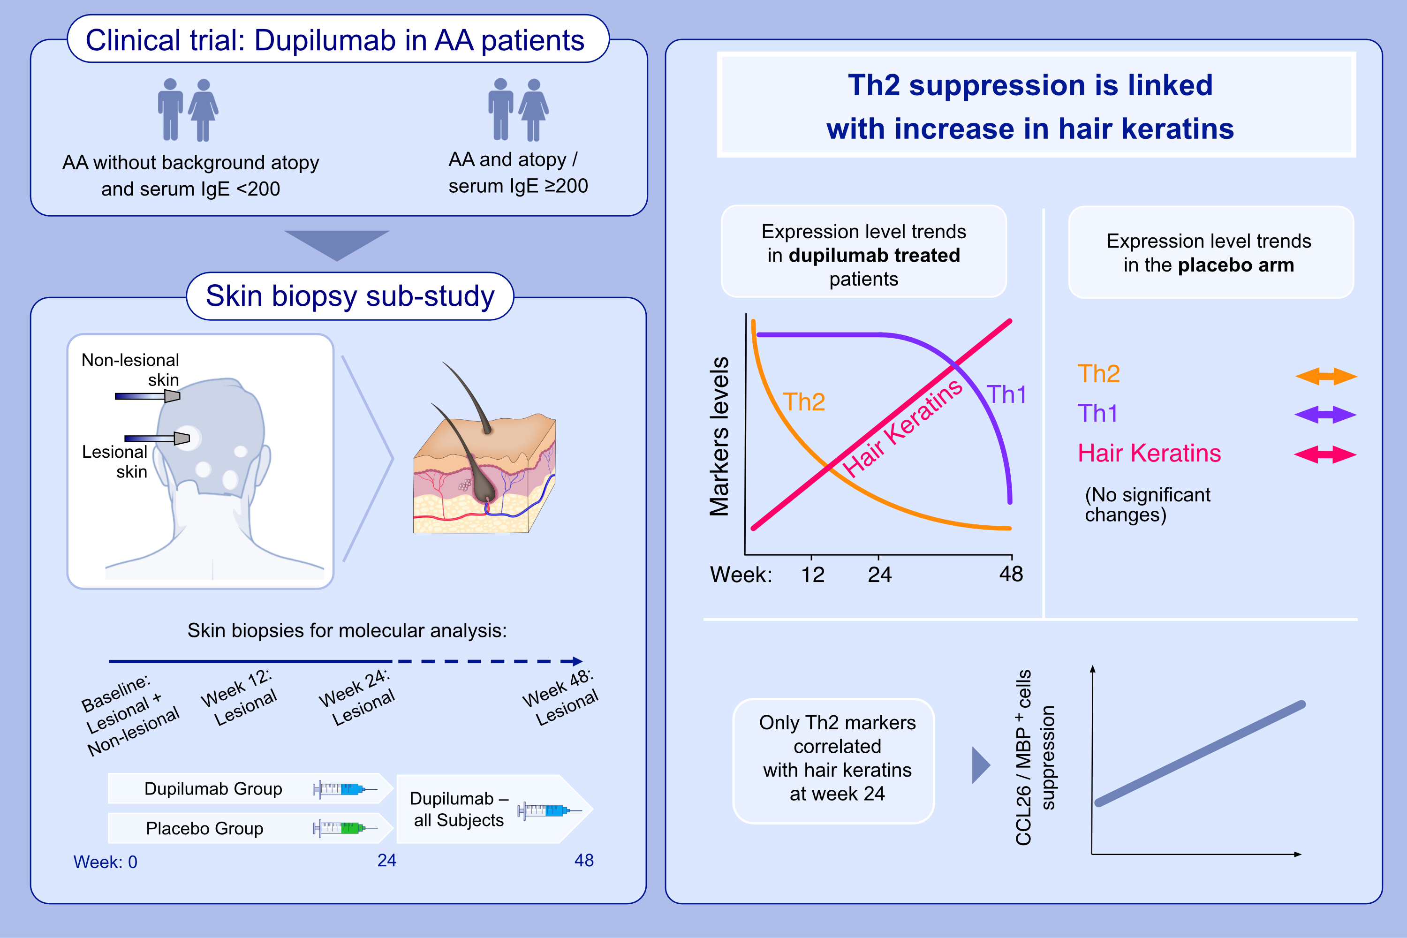
­­­Scalp Biomarkers During Dupilumab Treatment Support Th2 Pathway Pathogenicity in Alopecia Areata
Yael Renert-Yuval, Ana B. Pavel, Ester Del Duca, Paola Facheris, Angel D. Pagan, et al.
Allergy. 2023; pages:1047-1059
https://doi.org/10.1111/all.15561
© 2019 EAACI and John Wiley and Sons A/S. Published by John Wiley and Sons Ltd.
Notes:
HIGHLIGHTS
This biopsy sub-study provides a unique opportunity to explore the pathogenicity of Th2-related activation in alopecia areata.
Only dupilumab-treated patients presented Th2 pathway suppression, coupled with significant upregulation in hair keratins. Th1-related suppression was evident later (week 48).
At week 24, increases in hair keratins correlated only with decreases in Th2-related markers, underscoring the role of Th2 in AA.
Abbreviations: AA, alopecia areata; CCL26, C-C motif chemokine ligand 26; MBP, major basic protein.

