Slide 1
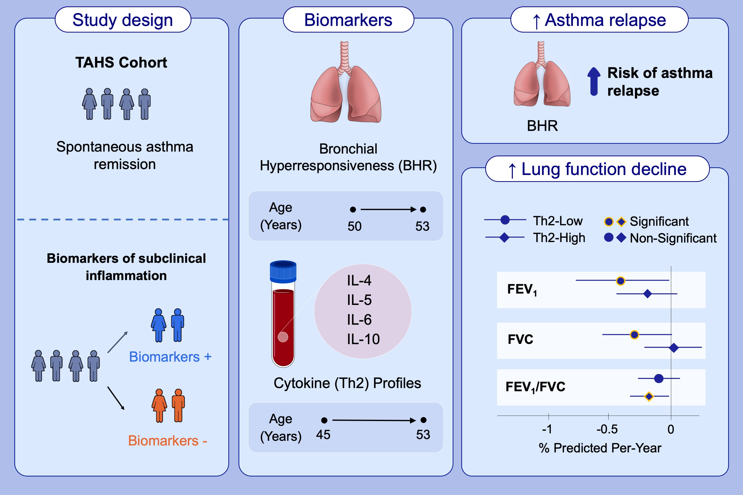
Biomarkers of asthma relapse and lung function decline in adults with spontaneous asthma remission: a population-based cohort study
Daniel J. Tan, Caroline J. Lodge, Eugene Haydn Walters, Adrian J. Lowe, Dinh S. Bui, et al.
Allergy. 2023; pages:957-967
https://doi.org/10.1111/all.15566
© 2019 EAACI and John Wiley and Sons A/S. Published by John Wiley and Sons Ltd.
Notes:
HIGHLIGHTS
This study examines the relationship between sub-clinical inflammation in adults with spontaneous asthma remission and future respiratory outcomes in the Tasmanian Longitudinal Health Study
BHR in adults with spontaneous asthma remission is associated with an increased risk of asthma relapse.
Th2-low and Th2-high cytokine profiles in adults with spontaneous asthma remission are associated with different patterns of accelerated lung function decline.
Abbreviations: BHR, bronchial hyperresponsiveness; FEV₁, forced expiratory volume in one second; FVC, forced vital capacity; IL, interleukin; TAHS, Tasmanian Longitudinal Health Study; Th2, T helper 2.

