Slide 1
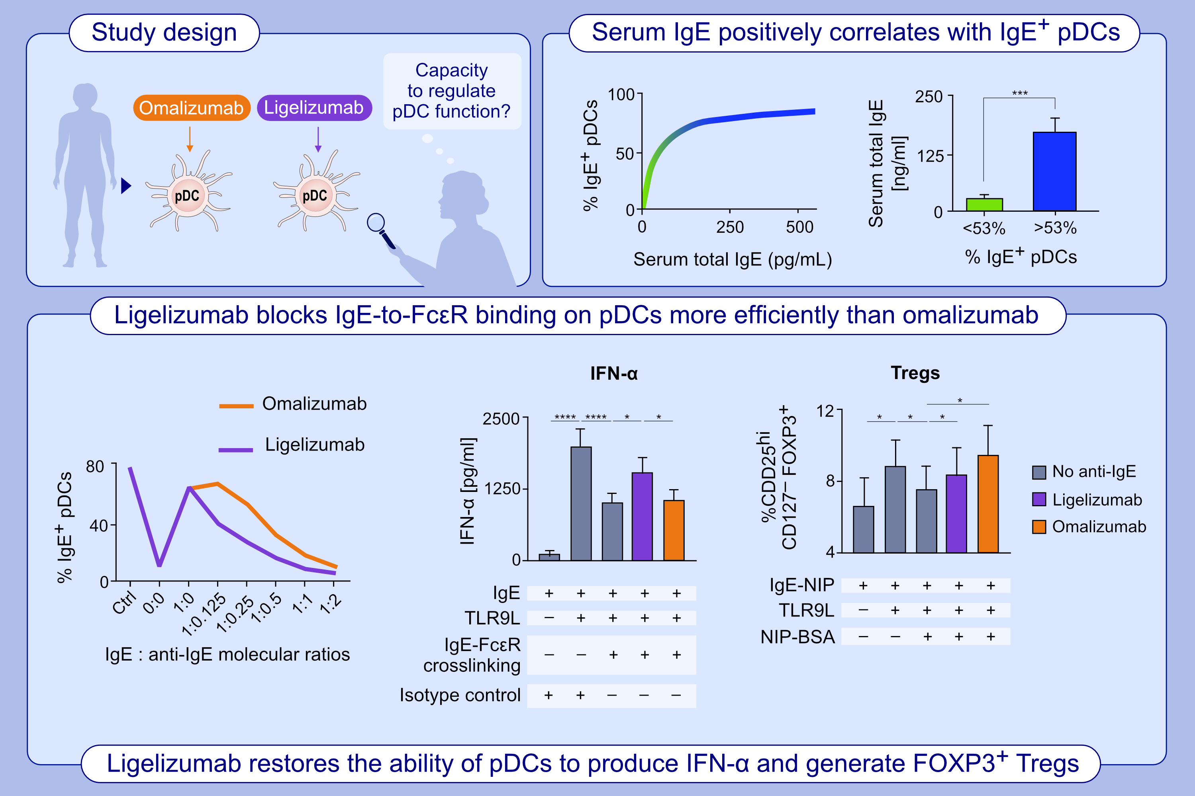
Ligelizumab impairs IgE-binding to plasmacytoid dendritic cells more potently than omalizumab and restores IFN-α production and FOXP3⁺ Treg generation
Cristina Benito-Villalvilla, Andrés de la Rocha-Muñoz, Jacobo López-Abente, Alexander Eggel, Iván Bottoli, et al.
Allergy. 2022; pages:1060-1072
https://doi.org/10.1111/all.15567
© 2019 EAACI and John Wiley and Sons A/S. Published by John Wiley and Sons Ltd.
Notes:
HIGHLIGHTS
This study investigates the capacity of ligelizumab to regulate functional properties of pDCs in comparison to omalizumab.
The levels of serum total free IgE shows a non-linear positive correlation with the frequency of IgE⁺ pDCs. Donors with circulating IgE⁺ pDCs above 53% display significantly higher serum total IgE levels than those with percentages below 53%.
Ligelizumab blocks the binding of free IgE to FcεRI on pDCs much more efficiently than omalizumab, resulting in restore capacity of pDCs to produce high levels of IFN-α and to generate FOXP3⁺ Tregs.
Abbreviations: BSA, bovine serum albumin; Ctrl, control; FcεRI, Fc ε receptor I; FOXP3, forkhead box P3; IFN, interferon; mAb, monoclonal antibody; NIP, 4-hydroxy-3-iodo-5-nitrophenylacetyl; pDC, plasmacytoid dendritic cell; TLR9, Toll-like receptor 9 ligand; Treg, regulatory T cell

