Slide 1
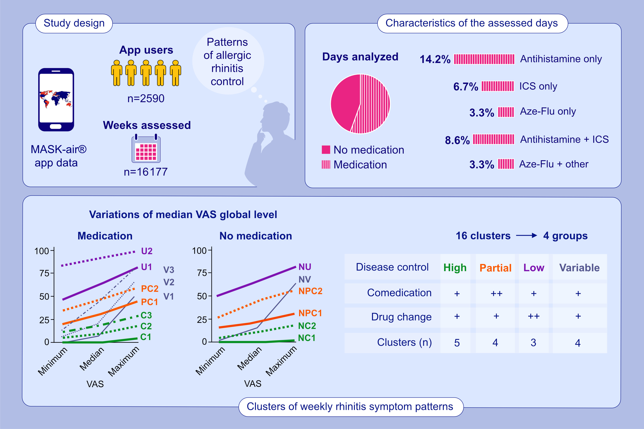
Consistent trajectories of rhinitis control and treatment in 16,177 weeks: The MASK-air® longitudinal study
Bernardo Sousa-Pinto, Holger J. Schünemann, Ana Sá-Sousa, Rafael José Vieira, Rita Amaral, et al.
Allergy. 2022; pages:968-983
https://doi.org/10.1111/all.15574
© 2019 EAACI and John Wiley and Sons A/S. Published by John Wiley and Sons Ltd.
Notes:
HIGHLIGHTS
This study analyzed MASK-air® data longitudinally, analysing and clustering (according to VAS levels) 16177 complete weeks, of which 55.5% involved the use of medication.
Among weeks with medication use, 10 clusters were identified: 7 with low variability in rhinitis control during the week, and 3 with highly- variable control. 6 clusters were identified in weeks when no rhinitis medication was used.
Clusters with poorly-controlled rhinitis displayed higher frequency of co-medication, more frequent changes in medication schemes and more pronounced seasonal patterns.
Abbreviations: Aze-Flu, azelastine-fluticasone; C1-C3, clusters with low median and maximum VAS global during weeks with medication; ICS, intranasal corticosteroid; MASK-air®, Mobile Airways Sentinel NetworK for airway diseases; NC1-NC2, clusters with low median and maximum VAS global during weeks without medication; NPC1-NPC2, clusters with medium VAS global during weeks without medication; NU, cluster with high VAS global during weeks without medication; NV, cluster with large differences between minimum, median and maximum VAS global during weeks without medication; PC1-PC2, clusters with medium VAS global during weeks with medication; U1-U2, clusters with high VAS global during weeks with medication; V1-V3, clusters with large differences between minimum, median and maximum VAS global during weeks with medication; VAS, visual analog scale.

