Slide 1
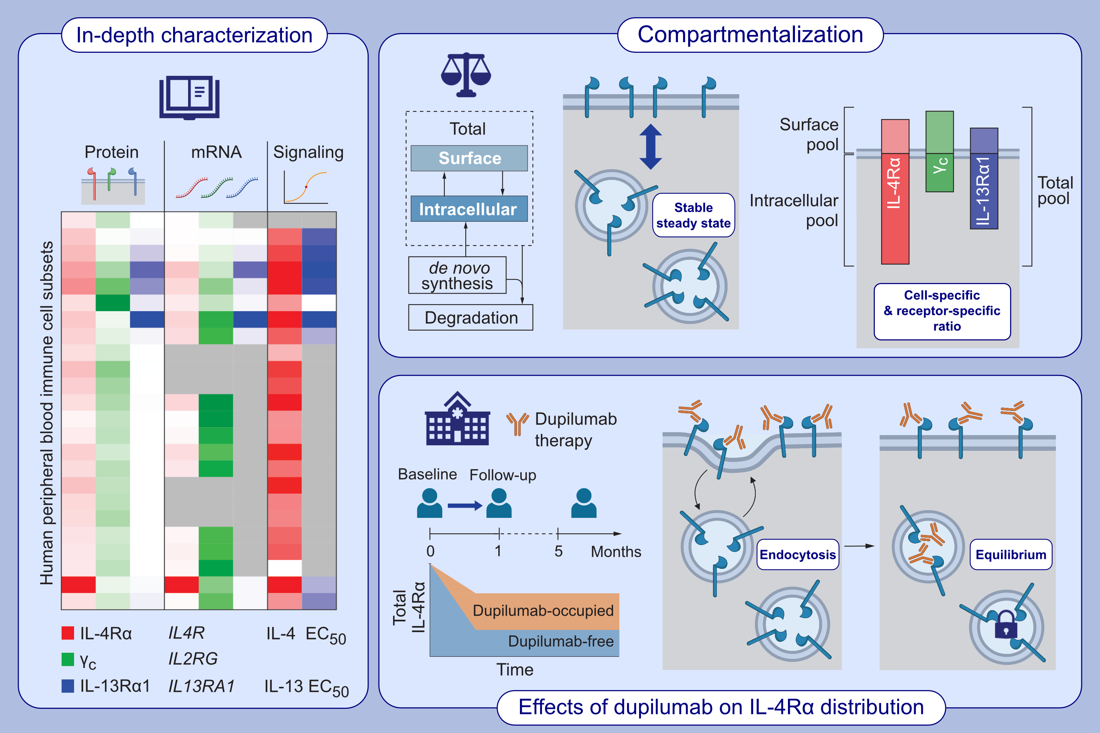
Comprehensive analysis of human IL-4 receptor subunits shows compartmentalization in steady state and dupilumab treatment
Lukas E. M. Heeb, Onur Boyman
Allergy. 2023; pages:1073-1087
https://doi.org/10.1111/all.15576
© 2019 EAACI and John Wiley and Sons A/S. Published by John Wiley and Sons Ltd.
Notes:
HIGHLIGHTS
All human immune cell subsets express interleukin (IL)-4 receptor (IL-4R) subunits at mRNA and protein levels, conferring sensitivity to IL-4 and/or IL-13.
IL-4R subunits compartmentalize in a cell- and IL-4R subunit-specific manner between surface and intracellular location.
Dupilumab therapy results in downregulation of IL-4Rα and endocytosis of dupilumab, but a 'dormant' pool of intracellular IL-4Rα molecules remains unoccupied.
Abbreviations: γ_{c}, common gamma chain; EC50, half-maximal effective concentration; IL-4R, interleukin-4 receptor; IL-4Rα, α subunit of interleukin-4 receptor; IL-13Rα1,
interleukin 13 receptor subunit alpha 1

