Slide 1
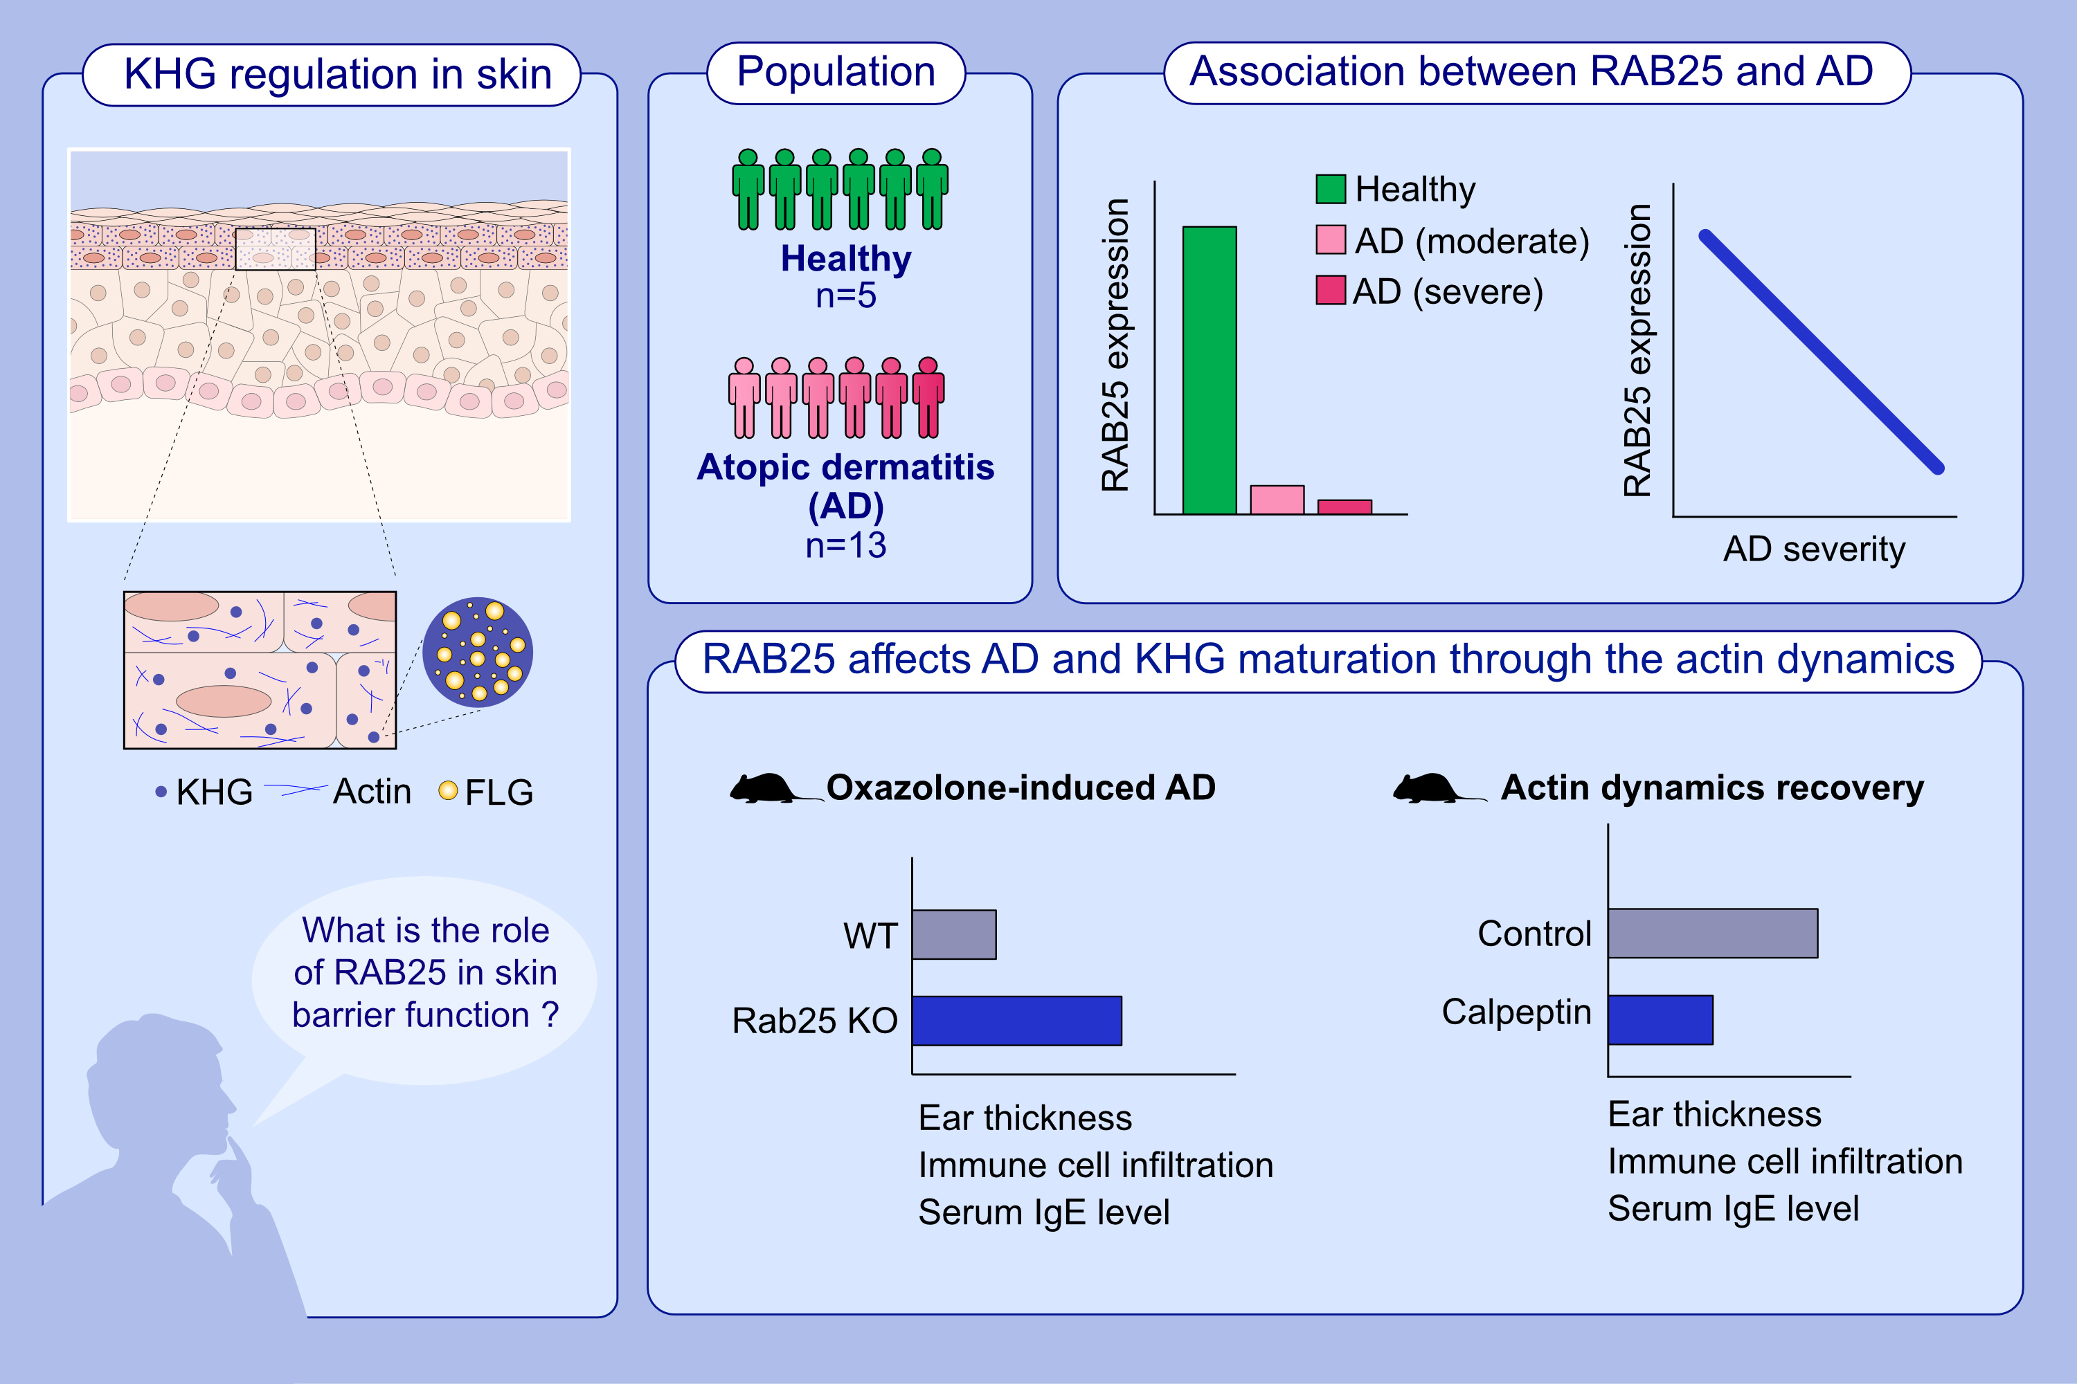
RAB25 coordinates filaggrin-containing keratohyalin granule maturation and affects atopic dermatitis severity
Haengdueng Jeong, Nakyum Lee, Chanyang Uhm, Kyungrae Cho, Heeju Oh, et al.
Allergy. 2023; pages: 1007-1019
https://doi.org/10.1111/all.15582
© 2019 EAACI and John Wiley and Sons A/S. Published by John Wiley and Sons Ltd.
Notes:
HIGHLIGHTS
RAB25 is downregulated in AD patients and is correlates with the severity of AD.
Rab25 KO mice are more susceptible to oxazolone-induced AD compared to WT mice, but recovery of actin dynamics in Rab25 KO mice ameliorates AD severity.
RAB25 modulates FLG-containing KHG maturation by regulating actin dynamics in skin, but defect in RAB25 expression impairs KHG maturation, leading to aberrant FLG expression.
Abbreviations: AD, atopic dermatitis; IgE, immunoglobulin E; KHG, Keratohyalin granule; KO, Knockout; RAB25, Ras-related protein 25; WT, wild-type.

