Slide 1
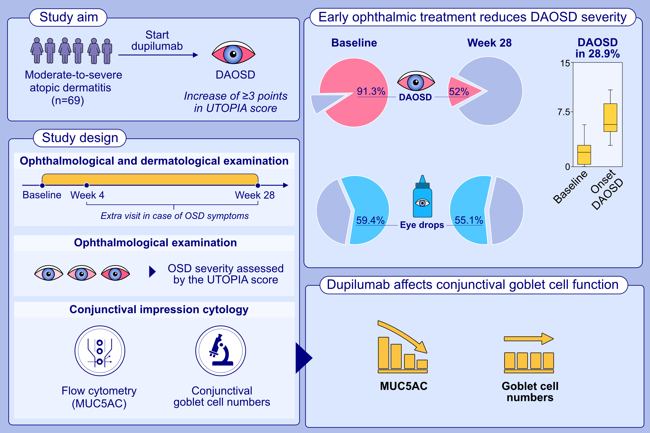
Dupilumab-associated ocular surface disease in atopic dermatitis patients: clinical characteristics, ophthalmic treatment response, and conjunctival goblet cell analysis
Roselie Achten, Judith Thijs, Marlot van der Wal, Chantal van Luijk, Marlies de Graaf, et al.
Allergy. 2023; pages: 2266-2276
https://doi.org/10.1111/all.15717
© 2019 EAACI and John Wiley and Sons A/S. Published by John Wiley and Sons Ltd.
Notes:
HIGHLIGHTS
We investigated the frequency and severity of DAOSD, ophthalmic treatment response, and the effect of dupilumab on conjunctival GCs in 69 moderate-to-severe AD patients.
Many AD patients had OSD before starting dupilumab, and 59.4% started ophthalmic treatment, resulting in less severe (DA)OSD.
28.9% (n=20/69) patients developed DAOSD, with stable but low GC numbers and reduced GC function compared to baseline.
Abbreviations: AD, atopic dermatitis; DAOSD, dupilumab-associated ocular surface disease; GC, goblet cell; MUC5AC, mucin 5AC; OSD, ocular surface disease; UTOPIA, Utrecht Ophthalmic Inflammatory and Allergic disease.

