Slide 1
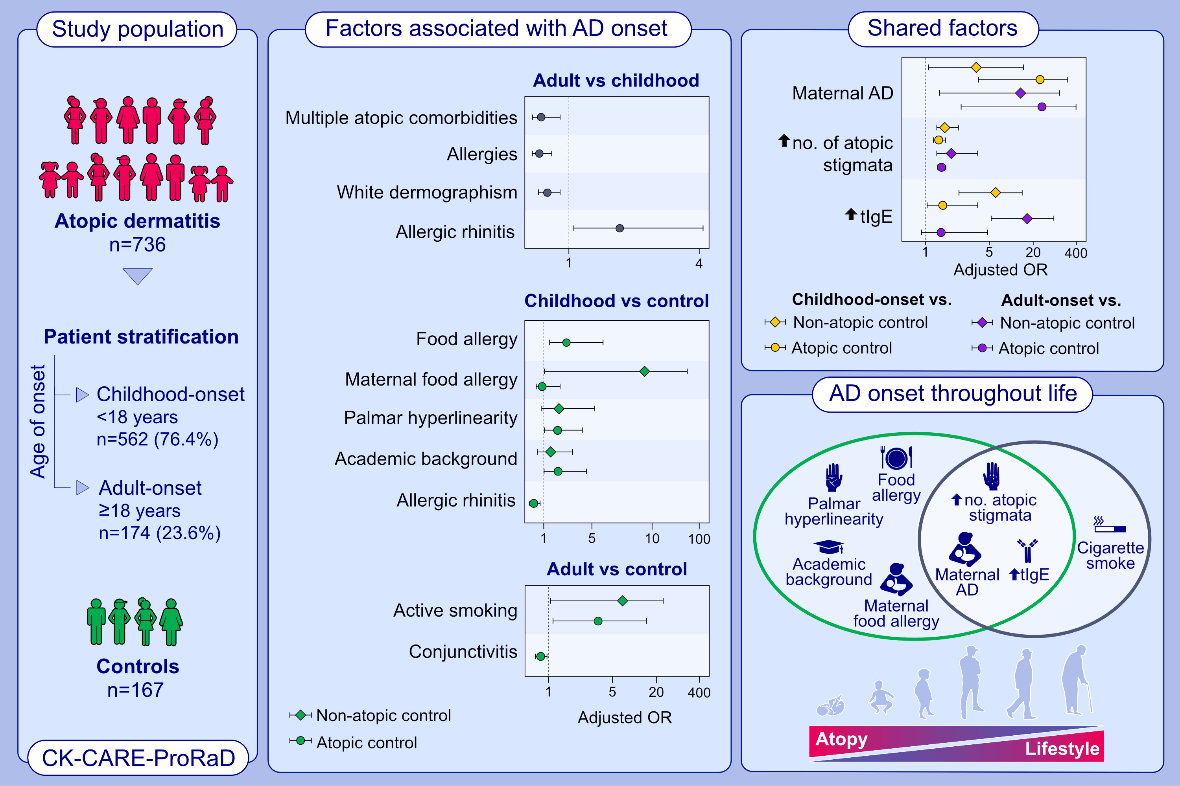
Atopic dermatitis: correlation of distinct risk factors with age of onset in adulthood compared to childhood
Laura Maintz, Marie-Therese Schmitz, Nadine Herrmann, Svenja Müller, Regina Havenith, et al.
Allergy. 2023; pages: 2181-2201
https://doi.org/10.1111/all.15721
© 2019 EAACI and John Wiley and Sons A/S. Published by John Wiley and Sons Ltd.
Notes:
HIGHLIGHTS
Adult- compared to childhood-onset AD was associated with allergic rhinitis, but reduced odds of multiple atopic comorbidities, allergies and white dermographism.
Compared to controls, adult-onset was associated with active smoking, childhood-onset with food allergy, maternal food allergy, palmar hyperlinearity and both with maternal AD, increased tIgE, higher number of atopic stigmata.
Our data point towards partly varying endo- and exogeneous mechanisms underlying adult- and childhood-onset with the highest impact of atopy on onset in early life while lifestyle factors gain importance within adult-onset.
Abbreviations: AD, atopic dermatitis; Ig, immunoglobulin; no., number; OR, odds ratio; tIgE, total serum IgE.
Academic background was defined as education at least A-level up to university degree of patients´ and their parents. Allergies were self-reported.

