Slide 1
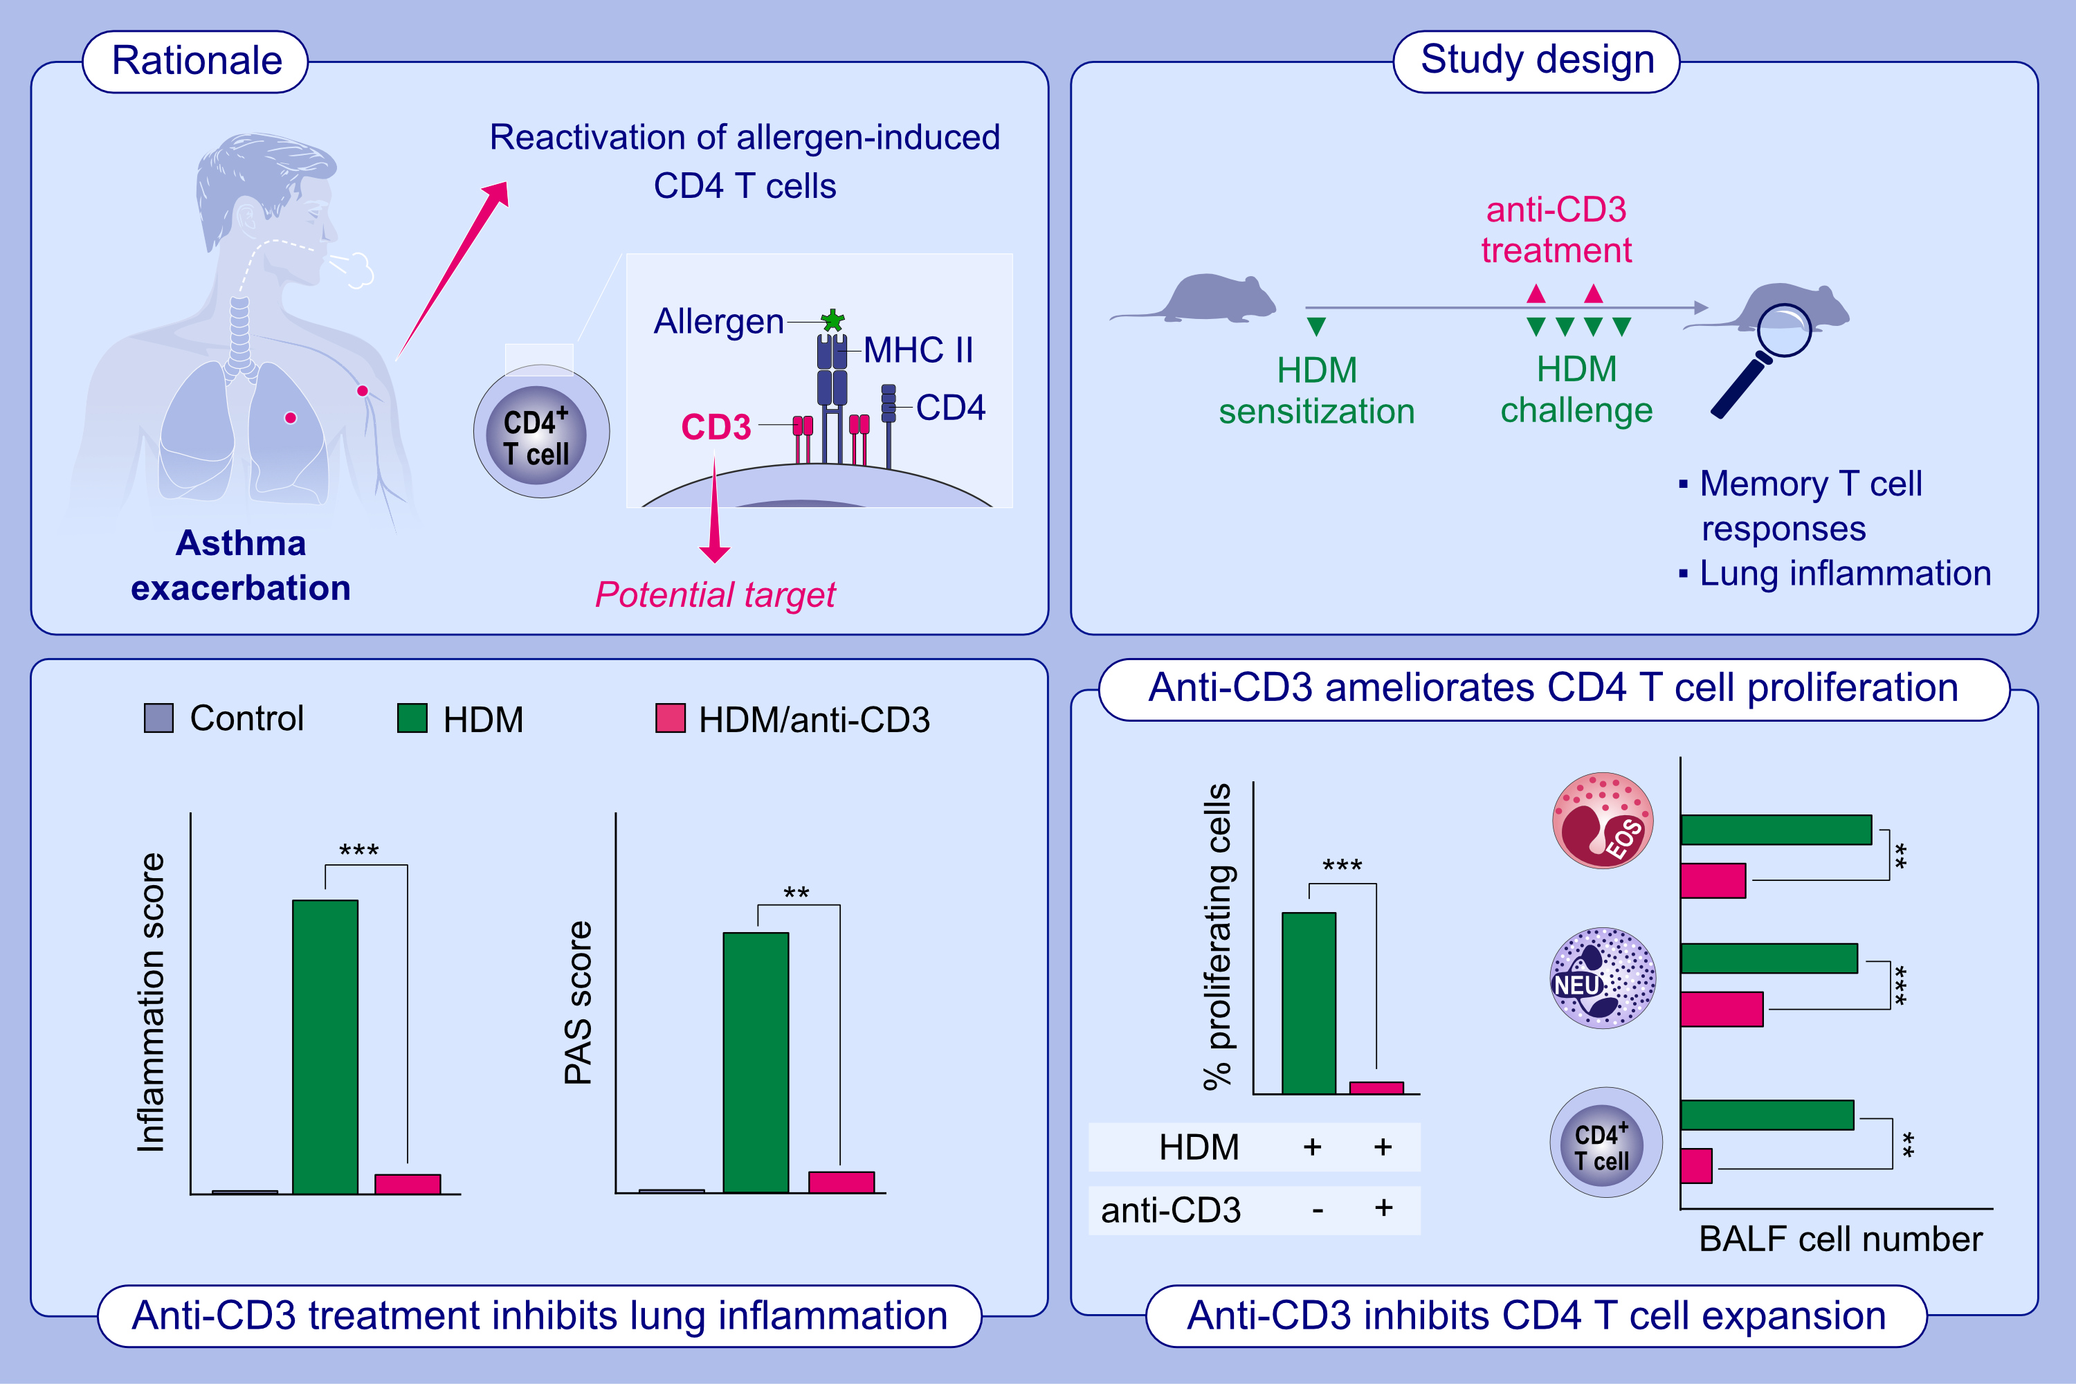
Anti-CD3 Inhibits Circulatory and Tissue-resident Memory CD4 T Cells that Drive Asthma Exacerbations in Mice
Gurupreet S. Sethi, Donald T. Gracias, Rinkesh K. Gupta, Daniel Carr, Haruka Miki,, et al.
Allergy. 2023; pages: 2168-2180
https://doi.org/10.1111/all.15722
© 2019 EAACI and John Wiley and Sons A/S. Published by John Wiley and Sons Ltd.
Notes:
HIGHLIGHTS
Therapeutic treatment with anti-CD3 F(ab’)2 fragments inhibits exacerbations of allergen-driven asthmatic lung inflammation in mice.
Anti-CD3 limits the expansion of tissue-resident and circulatory memory CD4 T cells.
Anti-CD3 ameliorates proliferation of human HDM-reactive memory CD4 T cells.
Abbreviations: BALF, bronchoalveolar lavage fluid; EOS, eosinophil; HDM, house dust mite; NEU, neutrophil; PAS, periodic acid-Schiff; TCR, T cell receptor.

