Slide 1
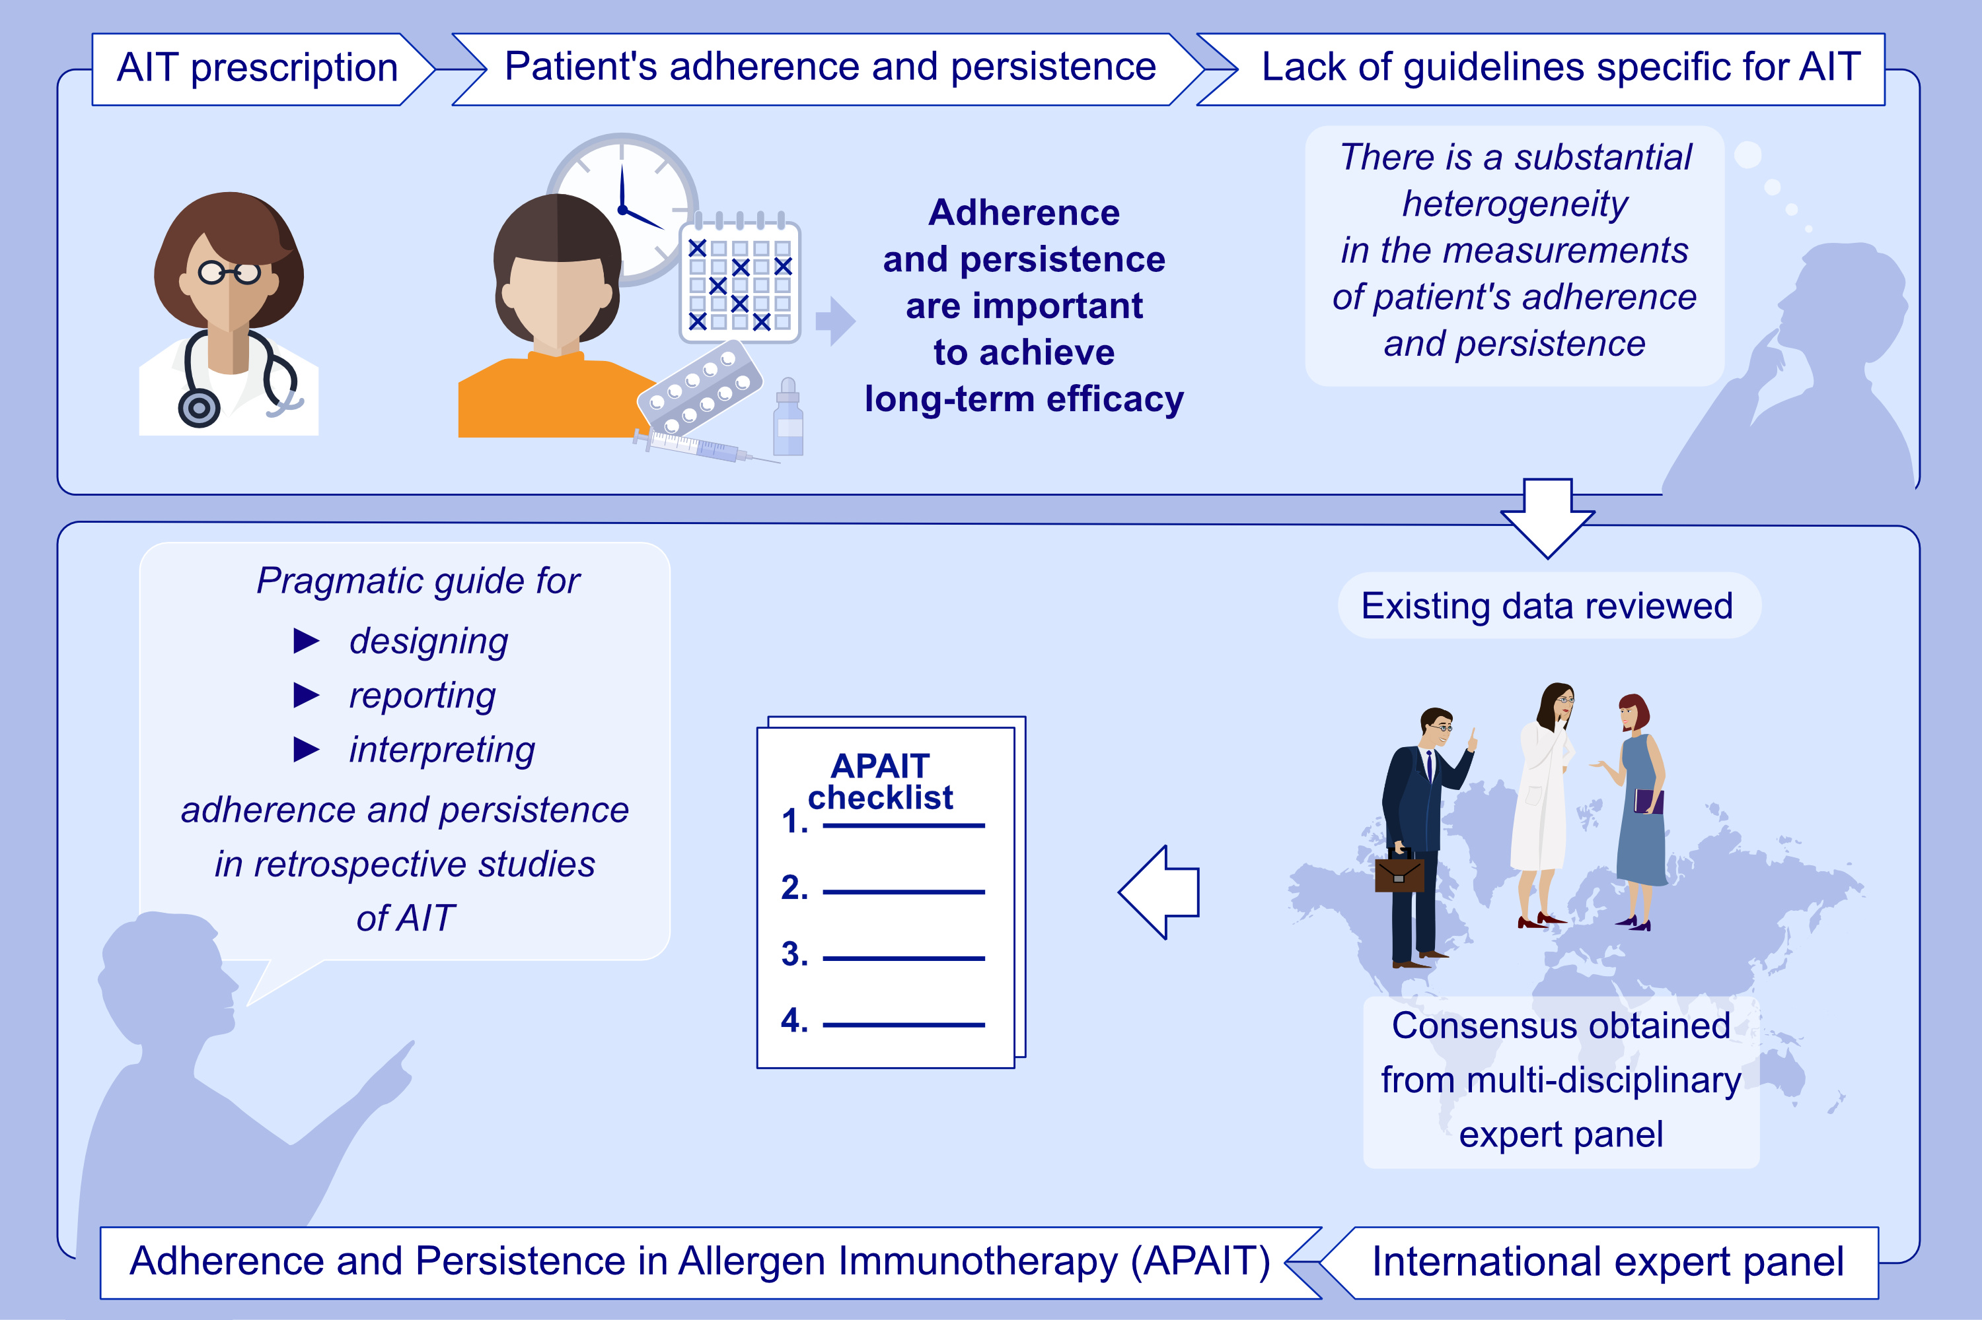
Adherence and persistence in allergen immunotherapy (APAIT): a reporting checklist for retrospective studies
Oliver Pfaar, Philippe Devillier, Jochen Schmitt, Pascal Demoly, Ole Hilberg, et al.
Allergy. 2023; pages: 2277-2289
https://doi.org/10.1111/all.15723
© 2019 EAACI and John Wiley and Sons A/S. Published by John Wiley and Sons Ltd.
Notes:
HIGHLIGHTS
The understanding of adherence or persistence to AIT is hampered by a lack of specific guidance on appropriate clinical trial design.
We conducted a comprehensive review of current evidence and developed a checklist to enhance the design and reporting of trials evaluating adherence or persistence to AIT.
The APAIT checklist is novel and highlights an important issue in the allergy field.
Abbreviations: AIT, allergen immunotherapy; APAIT, adherence and persistence in AIT.

